Slide 1
Solid Edge ST4 Instructor-Led Training Assembly

Slide 2
Lessons
Modeling assemblies
Assembly features
Assembly patterning
Assembly systems libraries
Working with large assemblies
Inspecting assemblies
Replacing parts in an assembly
Designing in the context of an assembly
Revising assemblies
Assembly reports
Virtual components in assemblies
Alternate assemblies
Adjustable parts and assemblies
Exploding assemblies
Rendering assemblies
Animating assemblies
XpresRoute (tubing)

Slide 3
Modeling assemblies

Slide 4
Placing parts in assemblies
Placing the first part in an assembly
Placing additional parts in an assembly
Positioning parts
Placing parts that are not fully positioned
Placing the same part more than once
Positioning a set of parts
Finding parts
Part placement properties
Placing simplified parts
Placing subassemblies

Slide 5
PathFinder in assemblies
Using the top pane
Determining the status of a component
Determining how the assembly was constructed
Making changes to assembly components
Changing the display status of assembly components
Reordering parts within an assembly
Grouping parts and subassemblies within an assembly
Renaming PathFinder entries
Finding parts
Replacing the file name with the document name formula value
Using the bottom pane
Viewing assembly relationships
Modifying assembly relationships

Slide 6
PathFinder in assemblies (continued)
Deleting assembly relationships
Replacing relationships
Conflicting relationships
Suppressing assembly relationships
Displaying document status in PathFinder
Dashed line in the bottom pane
Managing relationships in nested assemblies

Slide 7
Assembly relationships
Part positioning workflows
Maintaining assembly relationships
Capturing design intent
Assembly relationships and part movement
FlashFit
FlashFit options
Moving and rotating parts with FlashFit
Traditional part positioning workflow
Reduced steps
Capture fit
Defining offset values
Locking and unlocking rotation on axial align relationships
Assembly relationship dimensions

Slide 8
Assembly relationships (continued)
Assembly Relationship Assistant command
Applying a connect relationship
Recognizable elements for the connect relationship
Differences between assembly relationships and sketch relationships
Positioning parts using coordinate systems

Slide 9
Capture fit
Capture fit command
Capture the assembly relationships for a part
Activity: Positioning parts with mate, axial align, planar align and insert
Activity: Placing parts in an assembly using FlashFit

Slide 10
More relationships
Relationship List
Relationship Types
Connect Relationship
Activity: Positioning assembly parts using the connect relationship
Activity: Positioning assembly parts using the angle relationship

Slide 11
Assemble command
Activity: The Assemble command

Slide 12
Designing in the context of an assembly
Activity: Designing in the context of a synchronous assembly

Slide 13
Assembly patterning

Slide 14
Assembly Patterning
The Pattern Part command is used to copy parts or subassemblies in a rectangular or circular pattern.
The pattern can be driven by either an assembly sketch pattern, or a pattern that exists within one of the parts.
If the pattern exists in a part, the pattern will have a reference feature, an example being a hole for a fastener to be placed. The first part should be placed into the reference feature, and the pattern can then be created using the parts pattern.

Slide 15
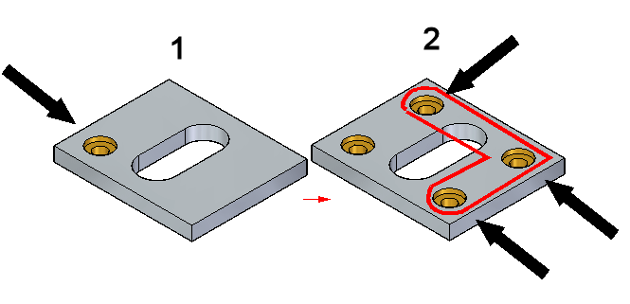
Reference feature in a part pattern
To create an assembly pattern of parts using an existing pattern in an assembly, the first part should be placed in the pattern reference feature.
1: Reference feature contained in the part
2: Patterned features

Slide 16
Reference feature in a part pattern
The part or subassembly to be patterned does not have to be positioned on the reference feature, or on the part containing the pattern. Pattern Part creates the pattern using the distances defined by the pattern in the part. If the part to be patterned is offset from the reference feature, the pattern will be offset by that same distance.
In most cases, such as patterning fasteners in an assembly, the first parts will be positioned in the reference feature.

Slide 17
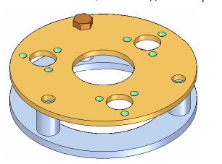
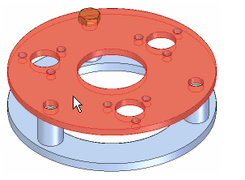
Steps for patterning parts using an existing part pattern
1. Position the first part in the reference feature as shown.
2. Identify the part containing the pattern feature.

Slide 18
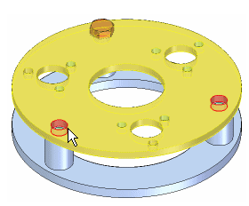
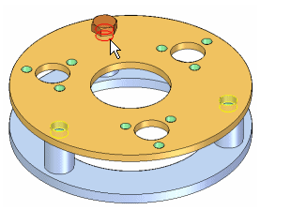
Steps for patterning parts using an existing part pattern
3. Select the pattern feature on the part or assembly sketch.
4. Identify the reference feature

Slide 19
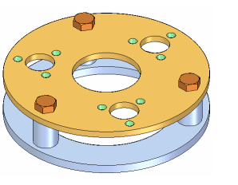
Steps for patterning parts using an existing part pattern
5. Finish. The pattern of parts is created.

Slide 20
Pattern parts from an assembly sketch
A pattern of parts can also be created from an assembly sketch.
Once in the sketching environment in assembly, the patterning commands will exist on the home tab in the features group.

Slide 21
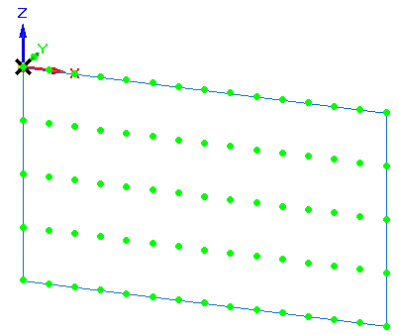
Pattern parts from an assembly sketch
The steps for patterning parts using an assembly sketch are the same as using an embedded pattern in a part. Identify the sketch as the location of the pattern when prompted.

Slide 22
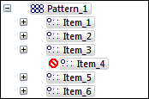
Suppressing patterned parts in an assembly
Assembly pathfinder shows the parts contained in the pattern. Expand the pattern and suppress individual occurrence(s) of the part or subassembly that were patterned.
To suppress, right click the item in pathfinder and then click suppress.

Slide 23
Suppressing patterned parts in an assembly
Assembly pathfinder shows the parts contained in the pattern. Expand the pattern and suppress individual occurrence(s) of the part or subassembly that were patterned.
To suppress, right click the item in pathfinder and then click suppress.

Slide 24
Suppressing patterned parts in an assembly
Assembly pathfinder shows the parts contained in the pattern. Expand the pattern and suppress individual occurrence(s) of the part or subassembly that were patterned.
To suppress, right click the item in pathfinder and then click suppress.

Slide 25
Suppressing patterned parts in an assembly
Assembly pathfinder shows the parts contained in the pattern. Expand the pattern and suppress individual occurrence(s) of the part or subassembly that were patterned.
To suppress, right click the item in pathfinder and then click suppress.

Slide 26
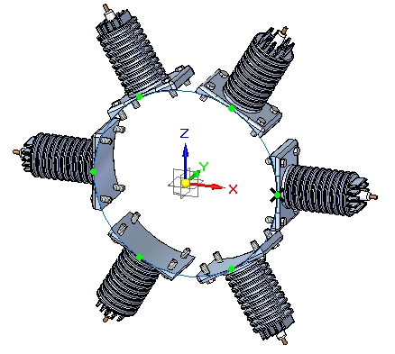
Activity
Activity: Generating a pattern in an assembly

Slide 27
Assembly systems libraries

Slide 28
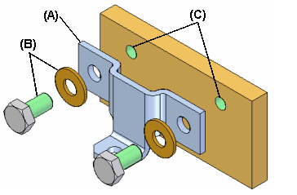
Working with Systems Libraries in assemblies
When building assemblies, you often need to use the same group of parts more than once. This group of parts may also need the same feature modification made to a mating part in the assembly to facilitate placement of the group of parts.
For example, you may need to place a bracket (A) and its mounting bolts and washers (B) in many different assemblies, or many times in one assembly. The bolts may also need mounting holes in the part (C) to which they are fastened.

Slide 29
Working with Systems Libraries in assemblies
You can use the systems library functionality in Solid Edge to define the group of parts, features, and assembly relationships so you can reuse them easily later.
The parts, features, and relationships for a systems library member are stored in an assembly document you define.
A systems library document can consist of the following:
Complete subassembly documents
Part documents
Features that are associative children of one of the part documents

Slide 30
Creating Systems Library members
When creating a new systems library member, you must adhere to the following rules:
You can only select parts and entire subassemblies that are in the top level assembly.
You cannot create a systems library member when working in an alternate assembly. You can use the Save Member As command to save a copy of the alternate assembly as a normal assembly to use this functionality.
You cannot create a systems library member when you are in-place activated in a subassembly.

Slide 31
Selecting components
Any parts and subassemblies that are in the active assembly can be added to a systems library document. When adding a subassembly, the entire subassembly must be added. You cannot select individual parts in the subassembly. You can select the parts you want to capture in the assembly window or in PathFinder. If you select an assembly pattern, the parts that were used to define the pattern are automatically captured.
The parts and subassemblies you select are listed in the Selected Components dialog box. When you have selected all the parts and subassemblies you want in the new systems library member, click the Accept button on the command bar to proceed to Captures Features Step. The relationships used to position the parts and subassemblies are automatically captured.

Slide 32
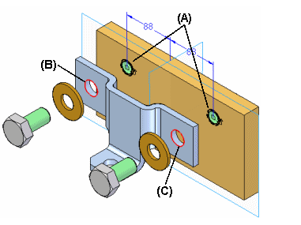
Capturing features
You can only capture features that were created using inter-part associativity techniques. If one of the parts you selected in the Select Components Step was used as a parent to create an associative feature on another part, the associative child feature on that other part is available for use in the systems library member. For example, if the hole feature (A) in the mounting plate was constructed using the Include command to associatively include edges (B) (C) from the bracket part, the hole feature (A) can be part of the systems library document.

Slide 33
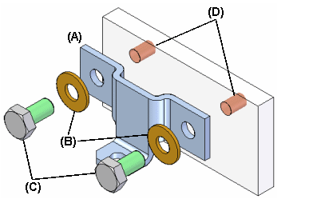
Capturing features
NOTE:
System Libraries use Inter-part associativity to maintain the relations between library features and the parts that they will be placed on. For more information on inter-part associativity, see the Inter-Part Associativity Help topic.
In the previous example, the system library member will then consist of the bracket part (A), the bolts and washers (B) (C), and the hole feature (D). When you place the systems library document later, the plate part itself is not placed.

Slide 34
Capturing features
When you select parts that have been used as parents in an associative inter-part feature, the child features that are available for including in the new systems library document are listed in the Captured Features dialog box and are highlighted in the assembly window so you can select only the features you want to capture.
You can also capture any treatment features that modified the associative inter-part feature. For example, if you added chamfers to the holes described earlier, you can add them to the captured features list by selecting the chamfer feature in the assembly window.
After you have selected the features you want to capture, click the Accept button on the command bar. If you do not want to capture features for the new systems library document, you can click the Next button on the command bar to bypass this step.

Slide 35
Capturing relationships
When you finish defining the parts and features you want to capture, the Capture Relationships dialog box is displayed so you can review the parts, features, and positioning relationships you captured. You can click the relationships listed on the Capture Relationships dialog box to highlight the faces used to define the relationship you selected, or you can click the OK button on the dialog box to dismiss it.

Slide 36
Defining the Systems Library container document
When you click the Create Group button on the command bar, the Create Systems Library dialog box is displayed so you can define the systems library document name and location, the assembly template you want to use, and rename any features you captured.
If you are going to share systems library documents with other users at your company, you should define file naming and location conventions to make it easier to use systems library documents.

Slide 37
Placing a Systems Library member document
You place a systems library member document by dragging the assembly document for the systems library member from the Parts Library page in PathFinder, and dropping it into the assembly window. When you drop the systems document in the assembly window, a command bar and the Input dialog box are displayed to guide you through the steps required to place the systems document:
Positioning the parts
Positioning the features
The parts that comprise the systems library document are also temporarily positioned in the assembly window.
The Input dialog box lists the assembly relationships required to position the systems library components. When placing the component parts and captured features, options are provided on the command bar to skip captured relationships or features. As you complete the steps required to define a relationship, the Input dialog box is updated to indicate the steps you have completed.

Slide 38
Positioning parts
You position the parts similarly to the way you would normally position a part in an assembly, by selecting a part already in the assembly, and a face or element on that part to define the relationship. If the Use Reduced Steps When Positioning Parts option is set, then you will only need to select a face or element on an assembly part to define the relationship.

Slide 39
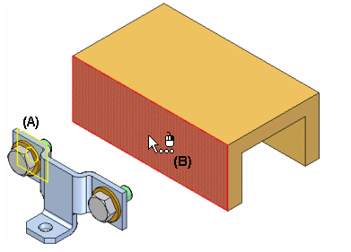
Positioning parts
When you drop the systems library member into the assembly, the face on the placement part for the first positioning relationship is highlighted (A). You can then select the target face in the assembly to satisfy the first relationship (B). The Input dialog box displays the relationship type and default value for each relationship. You can also use the command bar to define a new offset value for the first relationship, or skip defining the relationship entirely.

Slide 40
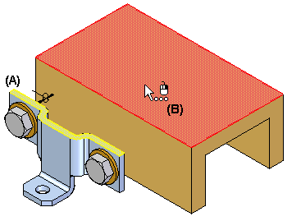
Positioning parts
After you select the target face for the first relationship, the set of parts is repositioned, and the face on the placement part for the second positioning relationship is highlighted (A). You can then select the target face in the assembly to satisfy the second relationship (B).
You continue in this fashion until all the positioning relationships have been defined or skipped.

Slide 41
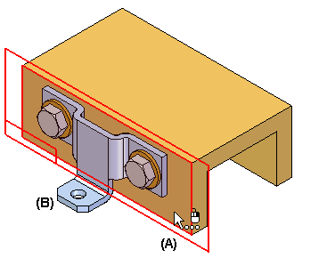
Positioning features
After you define the assembly relationships, you specify the part that you want to modify with the captured features. For example, if the feature you are placing is a hole feature, you would select a planar face on the assembly part (A) on which you want to apply the hole feature. The hole feature is associatively linked as a child of the parent part used to define the feature. In this example, the parent part is the bracket part (B).

Slide 42
Positioning features
After placement, the parts behave exactly the same as any part in an assembly. The systems library document itself is not placed into the assembly. It is used as a container that defines the systems components.

Slide 43
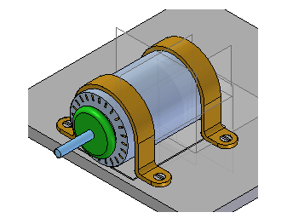
Activity
Activity: Activity Systems library

Slide 44
Working with large assemblies

Slide 45
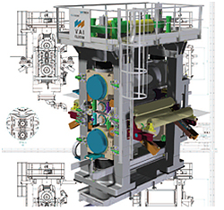
Working with large assemblies efficiently
There are many ways you can improve interactive performance when working with large assemblies in Solid Edge.

Slide 46
Working with large assemblies efficiently
Things you can do to increase performance external to Solid Edge:
(Read the readme.txt file that comes with the product for more information about system guidelines and recommendations)
Increase physical memory
Add virtual memory
Add a high end graphics card that supports Open GL acceleration
Use computers with multiple processors
Use a 64 bit platform
Use task manager to remove any unnecessary processes and evaluate both physical and virtual memory usage

Slide 47
Working with large assemblies efficiently
Things you can do to increase performance within Solid Edge:
(Refer to Solid Edge Help for more information)
Set view options to not show hidden edges, textures, shadows etc.
Use display configurations to hide, unload, and inactive assembly components
Use simplified parts and simplified assemblies
Use Zones
Inactivate parts in areas that are not currently in use
Unload hidden parts from memory
Use display configurations to snapshot and save displays that you will return to at a later time
Use the selection tools to select parts, based on criteria such as size. For example you select and turn off parts (such as fasteners) under a certain size that you control. You can also use select identical parts, all the parts constrained to a given part, or only parts currently being viewed.
Do not expand subassemblies in pathfinder until needed
Use Fast locate in the assembly options to highlight parts

Slide 48
Improving performance when opening assemblies
Open the assembly as read-only, then edit only the subassembly where you have responsibility.
Set the Hide All Components option to open the assembly with all parts hidden. You can then display only the parts you want to work with. The fastest way to open an assembly is with all parts hidden.
Select a display configuration from the Configuration list when opening an assembly.
You can select a zone from the Zones list when opening an assembly.
You can set the activation status of assembly components with the Apply Activation Override option on the Open File dialog box. You can then use the Activate command to activate only the parts you want to work with.
You can also open the assembly with all parts active, or, by clearing the Apply Activation Override option, open it with the active/inactive statuses that were in use when the assembly was last saved.

Slide 49
Activities
Activity: Creating a simplified assembly
Activity: Working with zones
Activity: Using configurations in assembly

Slide 50
Inspecting assemblies

Slide 51
Inspecting Assemblies
Solid Edge supports a variety of tools to inspect and analyze assemblies. Covered here are:
Motion
Collision detection
Sensors
Mass properties
Measuring distances

Slide 52
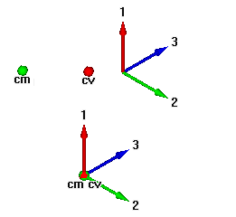
Physical properties of parts and assemblies
You can calculate the following physical properties of parts and assemblies:
Volume
Mass
Center of volume
Center of mass
Surface area
Orientation of the principal axis
Mass moments of inertia
Radii of gyration
Center of mass, center of volume, mass moment of inertia, and principal axis coordinates are output with respect to the global coordinate system. Principal moments of inertia and radii of gyration are output with respect to the principal axes.

Slide 53
Calculating and storing physical properties
When you calculate physical properties for a part, the Physical Properties command calculates and stores the properties for the individual part. In the Assembly environment, the Physical Properties command calculates and stores the properties for the entire assembly.
If you want to calculate the properties for a portion of an assembly, you can select the individual parts in the assembly before selecting the command. The software places property symbols indicating the center of mass, center of volume, and principal directions for the selection set.
Physical properties for a selection set are not stored with the assembly. When you close the Physical Properties dialog box, the property data for the entire assembly is restored. To store physical properties of a selection set, click the Save As button before dismissing the Physical Properties dialog box.

Slide 54
Physical properties manager
In the Assembly environment, you can use the Physical Properties Manager command to view, edit, and manage the physical properties for all the parts in the active assembly. This can be useful because you can view and edit the physical properties for all the parts at once, rather opening each part document to view and edit its physical properties.

Slide 55
Analyzing movement and detecting collisions in assemblies
You can use the Drag Component command in the Assembly environment to analyze physical motion and detect collisions between parts in an assembly.
The Options button on the Drag Component command bar displays the Analyze Options dialog box so you can define the analysis options you want to use. To reduce the performance impact when working with large assemblies, you should limit the analysis to as few parts as possible.
You can:
Analyze motion
Detect collisions

Slide 56
Measure
On Inspect tab in the measure group, you can measure:
Minimum Distance
Normal Distance
Angle
Distance
Inquire Element

Slide 57
Sensors
When constructing parts and assemblies, you often need to keep track of critical design parameters. For example, when designing a shield or shroud that encloses a rotating part, you must maintain enough clearance for maintenance and operational purposes. You can use the Sensors tab on PathFinder to define and keep track of design parameters for your parts and assemblies.
You can define the following types of sensors:
Minimum distance sensors
General variable sensors
Sheet metal sensors
Surface area sensors
Custom sensors

Slide 58
Defining a sensor
Although there are several types of sensors, you follow the same basic steps when creating any sensor:
From the Sensors tab on PathFinder, select the sensor type you want.
Define what you want to track in the design.
Define the operating limits for the sensor.
Every sensor you define in the document is displayed and managed on the Sensors tab on PathFinder.

Slide 59
Sensor Types
Minimum distance sensors
General variable sensors
Sheet metal sensors
Surface area
Custom sensors

Slide 60
Checking interference on parts
Solid Edge allows you to check for interference between parts in assemblies using the Check Interference command on the Inspect tab.
To run an interference analysis, you must create one or two sets of parts. A set of parts typically contains many parts; however, each set can contain any number of parts. If a set of parts will include all the parts in a subassembly, you can select the subassembly using the PathFinder.

Slide 61
Checking sets of parts for interference
You can check parts in the following ways during the interference analysis:
All parts of set one against all parts of set two.
All parts of set one against all other parts in the active assembly.
All parts of set one against all currently displayed parts.
All parts of set one against themselves.
Unless you indicate otherwise, the software uses the first option, checking all the parts of set one against all the parts of set two.

Slide 62
Analyzing interference results
Before running the interference analysis, you can set options for analyzing results. The following methods are available:
Output a report to a text file.
Display the interfering volumes.
Save the interfering volumes as parts.
Highlight the interfering parts.
Dim the display of parts that do not interfere.
Hide parts not selected for an interference check.
If no interferences were detected during the interference analysis, the software displays a message box telling you that no interferences were detected.

Slide 63
Activities
Activity – Computing mass properties of an assembly
Activity – Analyzing motion
Activity – Creating a sensor
Activity – Interference checking

Slide 64
Revising assemblies

Slide 65
Revising Assemblies
The procedures and examples covered in this activity are only those that are delivered with the Solid Edge product and does not include other data management products, such as Teamcenter. Please refer to the documentation within data management programs if you have them.
Solid Edge supports assembly management, including the process of revising assemblies. View and Markup : revision manager lets you copy an assembly, replace parts in it, and create new revisions of the assembly and its parts. Document management tools in Solid Edge enable efficient management of Solid Edge documents and related information. Use these tools to save descriptive information about a document, control access to files, and track a file’s progress through the work cycle. Searching for and retrieving documents is easy with user-defined search criteria. Documents can be routed to a group of users for review, approval, or rejection. Windows explorer can access many document management tasks. A shortcut menu displays Solid Edge-related commands when you click the right mouse button over a Solid Edge file in Windows explorer.

Slide 66
Templates
Templates are the starting point for creating new Solid Edge files.
Templates are Solid Edge files that can be customized with properties, like units, drafting standards, text sizes and much more.
Templates can be set up on networks so many users have the same parameters when starting a design.

Slide 67
Standard and Custom properties
Using document properties, you can store document information with the document itself, instead of in a separate database.
Some of the properties you can set:
Units of measure
Dimension style properties
Preview properties
General statistics, such as title, author and keywords for searching
Custom properties
Document Status (ie. Available, In Work, Released, Baselined, etc.)
Propseed.txt is an ASCII text file that is used to populate values on the Properties dialog box. You can use a text editor, such as Notepad, to add values to the file. The path to this file can be set up to be on a network share, like a template so users have access to a common file.

Slide 68
Concurrent design and document status
You can track or change the status of a document (ie. Available, In Work, Released, Baselined, etc.) in the Status page of the File Properties dialog box.
You can determine the status of a document within its life cycle or browse parts of the document tree. A document tree consists of a top-level document and subdocuments. The status of a document can be updated using the Update Status Info command, available from the shortcut menu in PathFinder while no item is highlighted.

Slide 69
Concurrent design and document status
Changing Document status
The software tracks the status of a document with a status property.
Available:
When you create a document, the default status property is set to available.
In Work:
If you want to work with a document for an extended time, you can use the Properties command on the File menu to change the status to in work.
In Review:
The software then stores your user name with the document. If you want to review information in a document, you can change the status to in review.

Slide 70
Concurrent design and document status
Baselined:
You can use the Properties command to baseline a document, freezing it and preventing further modification. Documents linked to a baselined document are not frozen. You must either baseline or release any linked documents that you want to freeze from modifications.
Released:
Base documents contain all the links for individual documents. Individual documents can contain parts, floorplans, drawings, and so forth. You can use the Properties command to release a base document and its individual documents at the same time, or you can release individual documents.

Slide 71
Property Manager
The Property Manager dialog box is displayed to allow you to edit the properties of the active document. You can use the No Levels and BOM View options on the Property Manager dialog box to display the document in a list view with no levels or a BOM view with levels. By default, the view is a list view.

Slide 72
Revision Manager
Revision manager is a tool within the View and Markup product.
It allows you to copy and revise assemblies and maintains associative links while doing so.
With Revision Manager, you can:
Copy and rename documents selected for revision to locations you specify.
Update the revision and document numbers you specify.
Update or maintain references in the document hierarchy.
Show the size of documents.
Copy a row or rows of data to the clipboard for printing.
Save previous query paths.
Preview a document.

Slide 73
Revision Manager wizard
Revision manager contains a tool called the Revision manager wizard that helps you enter the correct parameters for what you are trying to do.

Slide 74
Activities
Activity – Revision manager (release and revise)
Activity – Revision manager (revise and release an assembly draft)
Activity – Editing a part in context of the assembly

Slide 75
Assembly Reports

Slide 76
Types of assembly reports
Solid Edge creates reports that provide information about the components that make up an assembly. You can create:
Assembly reports—For assembly and structural frame models, assembly reports list the parts and subassemblies in the model.
You can generate these types of reports:
Bill of Materials—This report supports item number levels that match the assembly structure.
Exploded Bill of Materials
Summary of Atomic Reports
Parts List—This report is a flat list that shows the quantity of each element.
Pipe reports—For pipe and tubing models, lists the pipes and fittings in an assembly.
Harness reports: You can create the following types of wire reports:
Top Level
Expanded

Slide 77
Showing assembly item numbers in reports
You can show assembly item numbers in assembly and structural frame reports, and in pipe reports. Assembly item numbers are saved with the assembly and are available for downstream use, for example, in balloons placed on a model and in ballooned parts lists placed on an assembly drawing. This ensures consistent part numbering is propagated across all applications of the model.
To create item numbers in the assembly, select the Maintain item numbers check box in the Item Numbers page (Solid Edge Options dialog box).
To use these item numbers in assembly reports, select the Use assembly generated item numbers check box, which is available in the Report dialog box.
Alternatively, you can leave this option unchecked and have the assembly Report command generate item numbers on the fly.

Slide 78
Assembly item numbers
Item numbers for parts and subassemblies can be created and maintained automatically in an assembly model. Item numbers are based on the assembly structure, that is, the order in which parts, subassemblies, and assemblies are displayed in Assembly PathFinder.
Item numbering allows you to:
Create item numbers in assemblies
Edit item numbers
Use assembly item numbers in reports
Use assembly item numbers in PMI balloons
Use assembly item numbers on a drawing

Slide 79
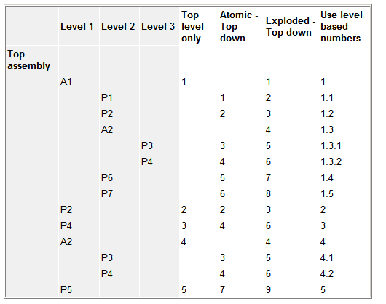
Item numbering schema
Use the Item Numbers page (Solid Edge Options dialog box) to select an item numbering schema for the parts and subassemblies in the assembly model. Refer to the following table for a comparison of item numbering options.

Slide 80
Formatting a report
You can format the report using the Format option on the Reports dialog box. Using the Format Report dialog box, you can set the following:
Font
Column headings (based on available properties)
Sorting method
Each property you include in the report will be a new report column. Standard properties you can choose from include Quantity, Document Number, Revision, and Author. You can also include custom file properties that you have recorded in the part and subassembly documents.
After you have formatted the report, you can preview the report output by selecting the OK button on the Format Report dialog box.

Slide 81
Outputting the report
After previewing the report, you have the following options:
Save the current report.
Print the current report.
Copy the current report to the Clipboard.
Create another report.

Slide 82
Activities
Activity – Revision manager (release and revise)
Activity – Revision manager (revise and release an assembly draft)
Activity – Editing a part in context of the assembly

Slide 83
Replacing parts in an assembly

Slide 84
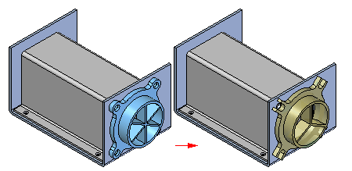
Replacing parts in an assembly
At times you may need to replace a part or subassembly in an assembly with a new part or subassembly. For example, a part may be placed in multiple assemblies, and at a later time, the part needs to be redesigned for one assembly only. After creating a new version of the part, you can replace the existing part using the Replace command.

Slide 85
Replacing similar parts
When you replace a part with a new version of the same part, Solid Edge attempts to use the existing assembly relationships to position the new version. However, if any faces used to position the old part were consumed when the part was modified; assembly relationships can fail. If this occurs, you can delete the affected assembly relationships using PathFinder, and then apply new relationships to completely position the new part.
You can also use a member of a family of parts as a replacement part. If the current part is not a family of parts member, and you want to replace it with a family of parts member, use the Replacement Part dialog box to select a family of parts member as the replacement part.
If the current part is a member of a family of parts, the Family of Parts Member dialog box is automatically displayed when you select the part you want to replace. You can then specify another family member you want to use as the replacement part. If you want to replace the family of parts member with any other part, click the Browse button on the Family of Parts Member dialog box to display the Replacement Part dialog box. This allows you to select any part as the replacement part.

Slide 86
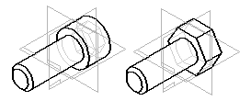
Replacing dissimilar parts
When you replace a part with a different part, one that was created independently of the part being replaced, Solid Edge compares the geometry of the two parts. If the geometry matches sufficiently, the replacement part is positioned properly.
When replacing dissimilar parts, the original part and the replacement part are required to be in the same relative orientation in their respective part files.

Slide 87
Replacing parts in subassemblies
When you replace a subassembly, you can replace it with another subassembly or you can replace it with a part. If the current or replacement subassembly is also a family of assemblies, you can use the Assembly Member dialog box to specify which family member you want to use as the replacement.

Slide 88
Replacing renamed occurrences
When you replace an assembly occurrence whose default name in PathFinder has been overridden using the Rename or Occurrence Properties commands on the PathFinder shortcut menu, you can control whether the replacement occurrence uses the new document name or the overridden name in PathFinder.
When you set the Use Default Placement Name During Replace Part option on the Assembly tab on the Options dialog box, the document name of the replacement occurrence is used. When you clear this option, the overridden name is maintained.
When you override the name of an assembly occurrence, the actual document name is not changed.

Slide 89
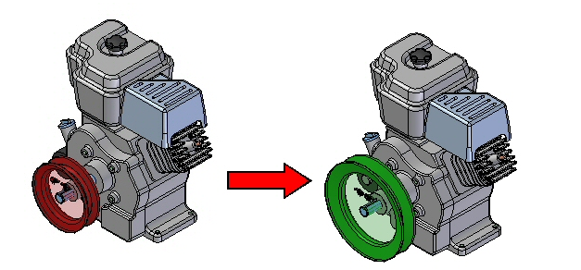
Activities
Activity: Replacing parts in an assembly

Slide 90
Designing in the context of an assembly

Slide 91
Top-Down assembly modeling
Top-down assembly modeling is an assembly-centric modeling method where the assembly design is started at the highest level possible, and individual parts and subassemblies are defined within the context of the overall assembly. With this approach, an assembly layout is typically created first, and this assembly layout is used to define individual part geometry and position.
This approach is often used at companies where the product being designed is large enough that it requires many people to complete the design. A senior-level designer might create the initial assembly layout, then divide the assembly layout into logical subassemblies and parts for the remainder of the organization to complete.

Slide 92
Bottom-Up assembly modeling
Bottom-up assembly modeling is a part-centric modeling method where the assembly design is started with a principal structural or functional element, and individual parts are designed in relative isolation from the overall assembly. Component parts and subassemblies are defined as the process moves up towards the top-level assembly. With this approach, as the design of a key component is completed, its geometry may or may not be used to aid the design of related mating components.
This approach is often used at companies where the product being designed is small enough that one or only a few people are needed to complete the design.

Slide 93
Combining both approaches
Solid Edge provides tools that allow you to take advantage of the benefits of both approaches as needed. Many organizations use a combination of both methods, using the method which best suits the immediate requirements. For example, you can use the top-down approach to create the initial assembly layout and to define the document structure needed. You can then copy the assembly layout geometry to subassembly and part documents to divide the work among the organization.
You can shift to the bottom-up approach in areas of the design that use purchased parts, existing parts from an earlier project, or where you are modeling standard parts in 3D that were created on an earlier 2D CAD system.
The suite of commands and tools in Solid Edge also allow you to use either approach associatively or non-associatively, as you see fit.

Slide 94
Top-Down tools
Creating and Publishing Virtual Components
Create In-Place
Inter-Part Associativity
Include command
define the extent of the feature associatively by selecting a keypoint on another part in the assembly.

Slide 95
Bottom-Up tools
Part Copy command.

Slide 96
Transferring parts to a new subassembly
Solid Edge allows you to create a new subassembly for parts you want to transfer. The New Subassembly button on the Transfer to Assembly Level dialog box accesses the Create New Subassembly dialog box. You can use this dialog box to specify a template, file name and location for the new database. You can also use the dialog box to define the position of the transferred parts in the new subassembly.
You have two options when defining the part position.
Position First Selected Part at Origin and Others Relative to It
Maintain Current Offsets From Assembly Origin

Slide 97
Dispersing subassemblies
You can use the Disperse command to disperse a subassembly by reassigning the parts to the next highest subassembly and removing the reference to the existing subassembly. The command will disperse only the top-level occurrence of a subassembly. For example, if a subassembly exists as an occurrence within the assembly being dispersed, the subassembly remains unchanged, but is moved up to the next higher assembly level.
The command does not modify the dispersed subassembly on the disk. The part occurrences are copied to the next higher level and the reference to the subassembly is deleted. When you save the top-level assembly, since it is no longer in the assembly structure, the dispersed subassembly occurrence is not saved.
If the subassembly being dispersed contains a pattern, the parts of the pattern are placed at the proper location in the next higher level and a ground constraint is placed on each of the parts. The parts will not be grouped in the PathFinder under a pattern node, but will be ordered the same in the next higher assembly.

Slide 98
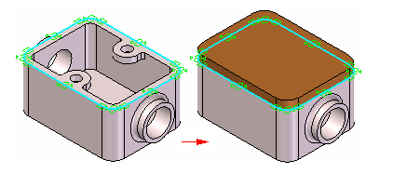
Inter-part associativity
When constructing the parts and assemblies for a design project, you can use the geometry on other parts in the assembly to help you construct a new part or subassembly. For example, you can use the Include command to create 2D geometry for the base feature of a new part by copying edges on an existing part.

Slide 99
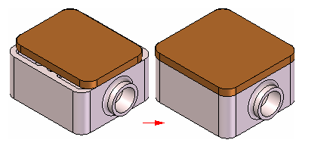
Inter-part associativity
Depending on the approach you use, the included geometry can be associative or non-associative to the original edges.
When you create new geometry associatively, then modify the original, or parent geometry; the child geometry also updates. If you change the size of the parent part, the included child geometry for the base feature also updates.

Slide 100
Associative Geometry
The following commands and functions in Solid Edge allow you to use existing geometry associatively:
Include command
Inter-Part Copy command
Assembly-Driven Part Features
Reference Plane Definition
Feature Extent Definition
Variable Table

Slide 101
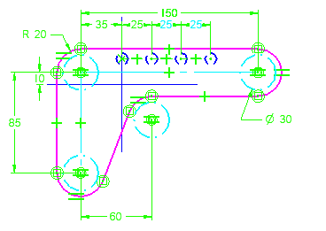
Assembly layouts
As you develop the design concepts for a new assembly, it is useful to create a layout of the preliminary design. The Sketch command in the Assembly environment allows you to draw 2D sketch geometry on part or assembly reference planes.
You can draw assembly sketches on the three default assembly reference planes or you can create new assembly reference planes to draw sketches on.
You can use assembly sketches to do the following:
Create 3D ordered geometry within parts.
Create assembly features.
Position 3D parts relative to the sketch geometry.
Position an assembly sketch relative to a 3D part.

Slide 102
Activities
Activity: Transferring and dispersing assemblies
Activity – Inter-part assembly modeling
Activity – layout sketches in assembly

Slide 103
Assembly Features

Slide 104
Assembly-based features
You may want to construct a feature within the context of the assembly, rather than in the Part or Sheet Metal document.
You can use the feature commands in the Assembly environment to construct features such as cutouts, revolved cutouts, holes, chamfers, and threads. You can also mirror and pattern these features.
In Solid Edge, you can construct two types of assembly-based features:
Assembly Features
Assembly-Driven Part Features
You use the Feature Options dialog box to specify whether the assembly-based feature you are constructing affects only the selected parts (Assembly Feature), or affects all parts with the same document names as the selected parts (Assembly-Driven Part Feature).

Slide 105
Assembly features
When you set the Create Assembly Features option, the feature affects only the parts you select.
For profile-based features, the reference plane, profile, extent definition, and surface geometry resides in and can only be viewed from the assembly document where the feature was constructed.
This option is useful when you want to modify one or more commonly-used parts, but do not want to affect other instances of the same parts in the active assembly or other assemblies that reference those parts.
You do not need write access to the affected part files to construct an assembly feature.

Slide 106
Assembly-Driven Part Features
When you set the Create Assembly-Driven Part Features option, the feature affects all parts with the same document name as the selected parts.
The reference plane, profile, and extent definition, resides in and can only be viewed from the assembly document where the feature was constructed. The surface geometry resides in the part documents. The surface geometry can be viewed in the part documents, and any other assemblies that reference the part documents.
This option is useful when you want to globally modify one or more parts while working in the assembly.
You need write access to the affected part files to construct an assembly-driven part feature.
A part document that contains an assembly-driven part feature is associatively linked to the assembly document where the feature definition (reference plane, profile, and extent definition) resides.

Slide 107
Assembly-Driven Part Features
You can break the links that control an assembly-driven part feature by in-place activating the part document, selecting the feature in PathFinder, and clicking the Break Links command on the shortcut menu. After the link is broken, it is likely that some aspects of the feature will become undefined. For example, the reference plane may no longer be associated to its parent face. You can repair the broken links by selecting the feature, and using the Edit Definition option on the command bar to redefine the reference plane, feature extents, and so forth.

Slide 108
Creation steps
The steps for creating assembly based features is as follows.
Draw the Profile
Dimension the Profile
Define the Extent
Select the Parts
If the Create Assembly option is selected, the feature will only exist in the assembly and the original part remains untouched.
If the Create Assembly Driven feature option is selected, the feature is associatively linked to the part and the actual part is modified.

Slide 109
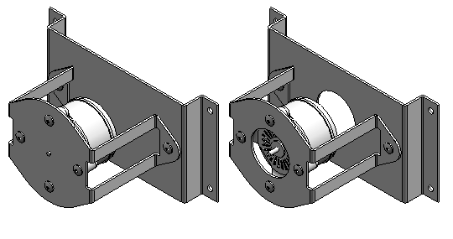
Activities
Activity: Assembly features

Slide 110
Alternate Assemblies

Slide 111
Alternate Components
Some products require you to define multiple variations of a single assembly. These variations can be categorized into two types:
Assembly variations where ALL parts are identical, but some part positions change during the physical operation of the assembly. These types of assemblies contain mechanisms, linkages, actuators, and so forth. In Solid Edge, these types of assemblies are considered Alternate Position Assemblies.
Assembly variations where MOST parts are identical, but some parts and subassemblies are different between the individual assemblies. These types of assemblies may have different components, fastener types, trim, accessories, and so forth. In Solid Edge, these types of assemblies constitute a Family of Assemblies.

Slide 112
Creating a New Alternate Assembly
Use the Alternate Assemblies tab to create alternate positions for an assembly or a family of assemblies. The first time you click the New Member button on the Alternate Assemblies tab, the Alternate Assemblies Table dialog box is displayed. You must specify whether the assembly will be converted to:
a family of assemblies or
an assembly containing alternate positions.
Once the assembly has been converted, it cannot be changed from (A) to (B) or from (B) to (A).

Slide 113
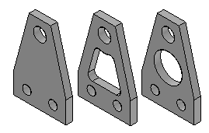
Define Alternate Component Command
Defines a list of documents which are related to the selected part or subassembly. Alternate components are typically similar in nature, and can be based on documents that were created independently. Defining a list of alternate components makes it easier to find and select valid components when replacing parts in an assembly.
A simple example of an application for an alternate component group is where there are several versions of a part that have different finishing details. The parts can be independently created or members of a family of parts.

Slide 114
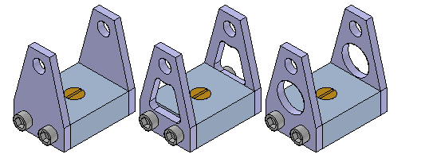
Define Alternate Component Command
In an assembly where one of the parts is used, you can use the Define Alternate Components command to specify that all three parts are members of the same alternate component group.
You can then use the Replace command to replace the part with one of the alternate component members. When you select a part to replace that is a member of a alternate component group, the Alternate Member dialog box is displayed so you can select another alternate component member as the replacement part.

Slide 115
Defining an Alternate Component Group
You can select any part or subassembly in the active assembly to define an alternate component group. When working with a nested assembly, you cannot select individual components that are in a subassembly.
Although an alternate component group would typically contain similar parts, you can define an alternate component group that contains different document types than the original component. For example, you can define an alternate component group that consists of a Part document, a Sheet Metal document, and an Assembly document.
If the component you select to define the alternate components group is a member of a family of parts or a family of assemblies, all related members from the same master document are added to the Alternate Candidates list automatically.
The assembly document in which you define the alternate components group stores the group member data.

Slide 116
Alternate Components and Alternate Assemblies
You can use an alternate component to replace a component in an alternate assembly that is a family of assemblies, but not an alternate position assembly. For example, you can use the Replace command to replace a part in a family of assembly member with an alternate component, rather than use the Exclude Occurrence functionality on the Alternate Assembly tab. Although this approach can be quicker than using the Exclude Occurrence functionality, when you use Revision Manager to copy or move the assembly data set to a new location, any members of the alternate components group that are not used in a family of assembly member will not be included in the data set.
For more information on working with alternate assemblies, see the Alternate Assemblies Help topic.

Slide 117
Sensors
When constructing parts and assemblies, you often need to keep track of critical design parameters. For example, when designing a shield or shroud that encloses a rotating part, you must maintain enough clearance for maintenance and operational purposes. You can use the Sensors tab on PathFinder to define and keep track of design parameters for your parts and assemblies.
You can define the following types of sensors:
Minimum distance sensors
General variable sensors
Sheet metal sensors
Surface area sensors
Custom sensors

Slide 118
Defining a sensor
Although there are several types of sensors, you follow the same basic steps when creating any sensor:
From the Sensors tab on PathFinder, select the sensor type you want.
Define what you want to track in the design.
Define the operating limits for the sensor.
Every sensor you define in the document is displayed and managed on the Sensors tab on PathFinder.

Slide 119
Sensor Types
Minimum distance sensors
General variable sensors
Sheet metal sensors
Surface area
Custom sensors

Slide 120
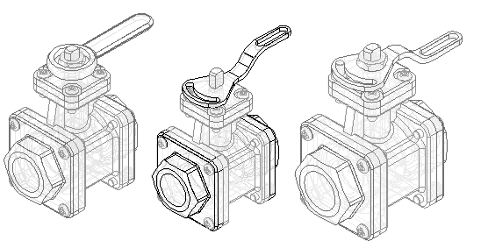
Activity
Activity: Creating an alternate assembly

Slide 121
Adjustable parts and assemblies

Slide 122
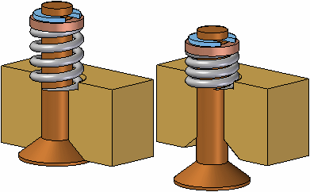
Adjustable Parts
In some designs, there are parts that must react to changing conditions in the assembly. For example, a spring that is compressed or uncompressed based on the position of other parts in the assembly.
The Adjustable Parts functionality in Solid Edge allows you to define parameters in a part model that will adjust with respect to corresponding parameters within the assembly. This allows you to control the size and shape of the part based on parameters you define in the assembly.

Slide 123
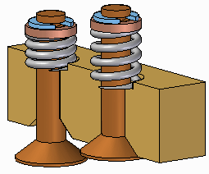
Adjustable Parts
When you specify that a part is adjustable, the design body in the part model does not change when the assembly parameters change. An associative copy of the design body in the assembly changes. The associative copy of the design body is placed in the assembly automatically and is managed by Solid Edge when you specify that a part is adjustable within the context of the assembly.
This allows you to place several occurrences of an adjustable part into an assembly, and each occurrence of the adjustable part will conform to the current parameter values for that occurrence of the part. For example, one occurrence of a spring can be shown compressed while another occurrence of the spring can be shown uncompressed.

Slide 124
Making a part adjustable
To make a part adjustable within the context of an assembly, you first must define the parameters you want to adjust in the part document. You can then define corresponding parameters in the Assembly environment.
You can use driving dimensions and variables that control a feature, reference plane, or construction element as the parameters to define an adjustable part.
When you specify that a part is adjustable, you cannot in-place activate the part using the Edit command. You can use the Open command to open the part.

Slide 125
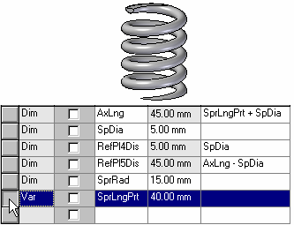
Defining the part parameters
The Adjustable Part command on the Tools tab in the Part or Sheet Metal environments displays the Adjustable Part dialog box so you can define or edit the adjustable parameters.
When the Adjustable Part dialog box is displayed, you can select features to display their dimensions, or you can click the Variable Table button on the Adjustable Part dialog box to display the variable table.
For example, to make the length of the spring shown adjustable, you can add the variable which controls spring length: SprLngPrt, to the adjustable parameters list by selecting the variable in the Variable Table.

Slide 126
Defining the part parameters
When you add a variable or dimension to the Adjustable Part dialog box, the parameter name is added to the Variable Name column (A). You can also add text to the Notes column (B) to make it easier to remember later what aspect of the part the adjustable parameter controls.

Slide 127
Placing adjustable parts in an assembly
When adding an adjustable part to an assembly, you should place and position the parts which interact with the adjustable part first. This allows you to use the surrounding parts to define the assembly parameters required to complete the process. You can specify whether an adjustable part is adjustable or rigid in the assembly when placing the part or after you position the part in the assembly.
When you drag and drop an adjustable part into an assembly, a dialog box is displayed that allows you to specify whether the part is rigid or adjustable.
When you set the Place Rigid option, the part placement process proceeds as it would for a typical part. You can then define assembly relationships to position the part in the assembly. An adjustable part placed as rigid in an assembly behaves the same as any other part in an assembly.
When you set the Place Adjustable option, the part placement process is temporarily suspended so you can define the adjustable parameters in the assembly using the Adjustable Part dialog box.

Slide 128
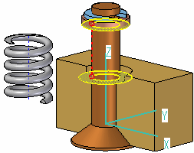
Defining the assembly parameters
Defining the assembly parameters
In addition to the options for selecting driving dimensions and variables, the Adjustable Part dialog box in the Assembly environment contains options that allow you to define a measurement variable. This allows you to use geometry on other parts in the assembly to define variables which will control the size and shape of the adjustable part in the assembly.
The measurement variable options activate one of the Measurement commands that are also available on Inspect→Measure. For example, you can use the Measure Minimum Distance option to specify that the minimum distance between the two faces shown controls the height parameter of the part.

Slide 129
Defining the assembly parameters
After you select the elements in the assembly that define the distance you want to measure, an assembly variable is created automatically and added to the Assembly Variable cell in the Adjustable Part dialog box for the adjustable part you are placing or editing.

Slide 130
Defining the assembly parameters
There are three columns in the Adjustable Part dialog box in the Assembly environment: Part Variable (A) Notes (B), and Assembly Variable (C). In this example, the part variable SprLngPrt is controlled by the measurement variable SprLngAsm in the assembly.
In addition to defining measurement variables, you can also use assembly relationship variables for an adjustable part. For example, you can use the offset value for a mate or planar align relationship as an assembly variable by selecting the variable value for the relationship in the Variable Table.

Slide 131
Defining the assembly parameters
The place like a spring option will use the variable created by measuring a distance to adjust the length of the corresponding variable in the part or sheet metal document. The position of the parts attached to the adjustable part determines the length of the variable defining the distance.
The adjust to fit and allow assembly relationships option will use the variable created by the measurement to change the length of the adjustable part, and reposition parts within the assembly that are not constrained. The length of the variable defining the adjustable part length is used to position the unconstrained parts connected to the adjustable part.

Slide 132
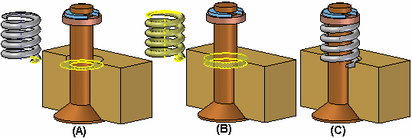
Defining the assembly parameters
After you have defined all the parameters in the assembly to control the adjustable part, click the OK button on the Adjustable Part dialog box to resume the part placement process. In this example, a mate relationship (A) and an axial align relationship (B) fully position the part in the assembly (C).
You can also specify that a part is adjustable after it has been positioned in the assembly. First, you must define the adjustable parameters for the part in the Part or Sheet Metal environment. Then, in the assembly, you can use the Adjustable Part command on the shortcut menu when a part is selected to specify that the part is adjustable and then define the adjustable parameters.

Slide 133
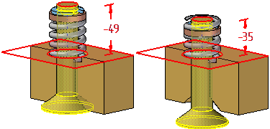
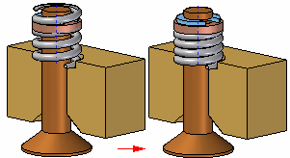
Updating adjustable parts
When you edit the assembly such that the adjustable part must change, the size and shape of the adjustable part updates automatically when the Automatic Update option is set. For example, in this assembly, if you edit the offset value for the planar align relationship between the valve and body parts, the valve opens.
This causes the size and shape of the adjustable part to update automatically.

Slide 134
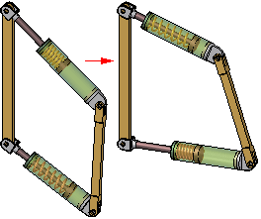
Adjustable parts in adjustable subassemblies
You can place a subassembly that contains an adjustable part into an assembly, then make the subassembly adjustable. For example, you may need to place two instances of a cylinder subassembly, with each subassembly in different positions.
Each cylinder assembly contains a spring that is an adjustable part, which allows the spring to change length as the cylinder subassemblies change positions.
When you make a subassembly adjustable that contains adjustable parts, the adjustable part variables are promoted to the current assembly.
For more information on creating and using adjustable assemblies, see the Adjustable assemblies Help topic.

Slide 135
Activity
Activity: Creating an adjustable part

Slide 136
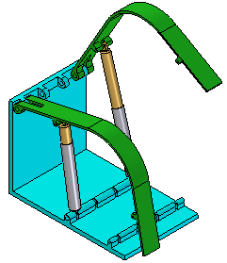
Adjustable and rigid assemblies
When working with assemblies, it is sometimes necessary to allow movement within a subassembly while working in a higher-level assembly. In other instances, it can be necessary to show identical subassemblies in different positions. For example, you can have two identical hydraulic cylinder subassemblies in an assembly, but need to show the hydraulic cylinders in different positions.

Slide 137
Comparing rigid and adjustable subassemblies
Specifying that a subassembly is adjustable allows you to place positioning relationships between parts in the subassembly while in the higher-level assembly. This is not possible with a rigid subassembly.
When you specify that a subassembly is adjustable, you are prevented from in-place activating the subassembly. For example, when you try to in-place activate the subassembly using the Edit command, a dialog box is displayed that informs you that the subassembly is adjustable and to use the Open command to open the subassembly.

Slide 138
Displaying identical subassemblies in different positions
There are several approaches to solving this problem:
You can create uniquely-named subassemblies for each of the otherwise identical subassemblies. This allows you to assign unique offset values to the affected relationships, but creates extra files and complicates data management.
You can create a single-level assembly where the subassembly components are placed as discrete parts, instead of as a subassembly. This also allows you to assign unique offset values to the affected relationships, but makes it more difficult to reuse the hydraulic cylinder components later in another assembly. Another disadvantage of this method is that the parts are listed individually, rather than as a subassembly.

Slide 139
Displaying identical subassemblies in different positions
Alternately, you can use the Adjustable Assembly functionality within Solid Edge. This approach eliminates the need to create multiple copies of the hydraulic cylinder subassembly data set or to create single-level assemblies.

Slide 140
Preparing the subassembly
To use the Adjustable Assembly functionality, the subassembly should be left under-constrained in the range of motion in which you want to adjust. This allows you to apply the relationship(s) that you want to adjust in the higher level assembly, not in the subassembly.

Slide 141
Placing the subassembly into the higher-level assembly
You place the subassembly into the higher-level assembly in the same manner as you would any subassembly. There are several methods available to specify that you want the subassembly to be considered an adjustable assembly.
To specify that the subassembly is considered adjustable while you are placing the subassembly, set the Place As Adjustable option on the Options dialog box on the Assemble command bar.
To specify that the subassembly is considered adjustable after you have completed positioning the subassembly, select the subassembly in PathFinder, then click the Adjustable Assembly command on the shortcut menu.
Note:
Only subassemblies that contain parts that are not fully positioned can be marked as adjustable.

Slide 142
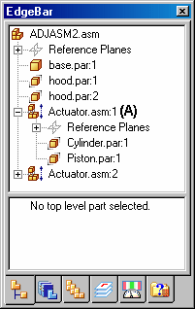
Placing the subassembly into the higher-level assembly
You can also specify that a subassembly is adjustable by setting the Place as Adjustable when this Assembly is Placed into Another Assembly option on the Assembly tab on the Options dialog box.
Regardless of the method used, a special symbol is used in PathFinder (A) to indicate the subassembly is adjustable.

Slide 143
Working with adjustable assemblies
When a subassembly is set to adjustable, all assembly relationships existing within the subassembly are solved at the level of the active assembly. In other words, the relationships in the subassembly are promoted to the higher-level assembly for solve purposes.
The relationships used to position the parts within the subassembly can be viewed in the bottom pane of PathFinder when you select a part in the subassembly. These relationships are read-only and the text label is gray to indicate that the relationship cannot be edited. Displaying the read-only relationships makes it easier to evaluate the existing relationships and apply the remaining relationships.

Slide 144
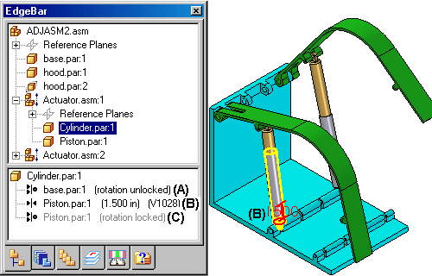
Working with adjustable assemblies
For example, when you select cylinder.par:1 in the adjustable assembly named Actuator.asm:1, three relationships are displayed. The axial align relationship to base.par (A) was placed in the current assembly. It was used to position the subassembly in the current assembly, and is editable.
The Mate relationship to piston.par:1 (B) was placed in the current assembly after the subassembly was made adjustable. Its purpose is to adjust the length of the hydraulic cylinder subassembly and the relationship is editable.
Notice that no visual distinction is made between relationships (A) and (B), although one of the relationships was used to position the subassembly in the current assembly (A), and the other was used to position the two parts in the subassembly.

Slide 145
Working with adjustable assemblies
The remaining axial align relationship to piston.par:1 (C) was placed in the subassembly, is read-only and not editable within the current assembly. Notice that the text label is gray, indicating that the relationship is read-only.
If you specify that a subassembly is flexible, add positioning relationships, and then specify that the subassembly is rigid, conflicting relationships can occur. You can delete or suppress relationships to correct this situation.

Slide 146
Adjustable assemblies and adjustable parts
You can create assemblies that contain adjustable parts within an adjustable subassembly. For example, you may need to place two instances of a cylinder subassembly, with each subassembly in different positions.
Each cylinder assembly contains a spring that is an adjustable part, which allows the spring to change length as the cylinder subassemblies change positions.

Slide 147
Activity
Activity: Creating an adjustable assembly

Slide 148
Virtual components in assemblies

Slide 149
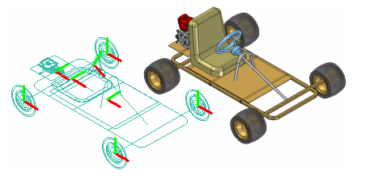
Creating and publishing Virtual Components
You can use the Virtual Component functionality in Solid Edge or in Teamcenter to define the assembly structure for a new design project.
When you have finished defining the assembly structure, you can publish the assembly. Publishing the assembly creates the new Solid Edge documents required, copies assembly sketch geometry to the new documents, and adds the 3D geometry for existing Solid Edge documents to the assembly.

Slide 150
Virtual components in Solid Edge
The basic workflow for creating and publishing a virtual assembly in the unmanaged Solid Edge environment is:
Define the virtual components you need.
Add existing documents to the virtual assembly structure.
Assign 2D geometry to individual virtual components.
Position virtual components.
Publish virtual components.

Slide 151
Defining the assembly structure
The Virtual Component Structure Editor command defines the assembly structure for a new design project in an unmanaged environment. When you click the Virtual Component Structure Editor command, the Virtual Component Structure Editor dialog box is displayed.
The Virtual Component Structure Editor defines the name and document type for new virtual components, and allows you to drag any existing Solid Edge documents into the virtual assembly structure.

Slide 152
Defining new virtual components
You use the right pane on the Virtual Component Structure Editor to define virtual components and organize the assembly structure. The Component Type options on the right pane of the Virtual Component Structure Editor define the document type for new virtual components:
Assembly components
Part components
Sheet metal components
The Name option assigns a name to the virtual component you are creating. You can select a default name from the list, or type the name you want in the Name box.

Slide 153
Adding existing documents to the virtual structure
You can also place existing Solid Edge documents into the assembly structure using the Virtual Component Structure Editor dialog box.
The left pane on the Virtual Component Structure Editor dialog box browses to and selects existing documents on your computer or another computer on your network. If you are working in Teamcenter mode, you can select existing documents from your Teamcenter database.
You can place an existing document into the virtual assembly structure in one of two ways: as a pre-defined component or as a real component.

Slide 154
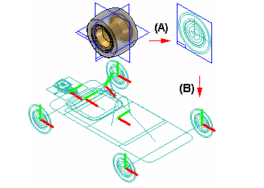
Pre-defined components
Pre-defined components are virtual components that are based on an existing document. You cannot place 3D geometry using a pre-defined component, but you can create 2D geometry in the parent document (A), then position the 2D geometry in the assembly sketch (B). You can reuse existing documents in new design projects without the overhead of 3D geometry.

Slide 155
Pre-defined components
When you clear the Add As Real Component option on the Virtual Component Structure Editor, then drag an existing component into the right pane of the structure editor, the component is placed as a pre-defined component. If you want to add the document to a virtual subassembly, position the cursor over the virtual subassembly when dropping the pre-defined component.
Pre-defined components are typically purchased or released parts that are not subject to significant changes.

Slide 156
Adding real components
When you set the Add As Real Component option on the Virtual Component Structure Editor before you drag an existing document into the virtual assembly structure, the 3D geometry associated with the component is added to the assembly. When this option is set you can only place the component in the top-level assembly.
The component is placed in the assembly hidden, with no relationships applied, and is oriented in the assembly by aligning the base reference planes of the component with the base reference planes in the assembly.
You can position the real component within the assembly sketch using assembly relationships such as mate and align, or 2D relationships and dimensions such as Connect and Distance Between.

Slide 157
Saving the tree structure
When you click the OK button on the Virtual Component Structure Editor dialog box, the virtual assembly structure you defined is added to the PathFinder tab. You can make changes to the virtual assembly structure later using the Virtual Component Structure Editor dialog box.
You can dismiss the Virtual Component Structure Editor dialog box without saving changes by clicking the Cancel button.

Slide 158
Assigning sketch geometry to Virtual Components
You can assign 2D sketch geometry from the assembly layout to a virtual component. You can create the 2D geometry before or after you define the assembly structure.
Assigning geometry to a virtual component defines its size and position in the assembly sketch. You can only assign geometry to one occurrence of a particular virtual component.
When you assign 2D geometry to a virtual component, it becomes the master, or source component. You can edit the sketch geometry associated with the source component directly. If there are additional occurrences of a particular virtual component, they become slave or instance components.

Slide 159
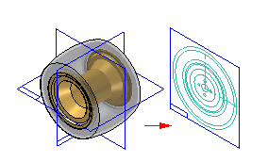
Creating sketch geometry for pre-defined Virtual Components
You create the sketch geometry for a pre-defined virtual component by opening the parent document, then using the Component Sketch command to create a component sketch.
There are two types of graphics you can create in a component sketch: component image graphics, and wireframe graphics. Component image graphics are created using the Component Image command. This command creates a 2D representation of the visible edges on a part.
Component image graphics are not individually selectable in the assembly sketch, but provide a reference envelope.

Slide 160
Positioning Virtual Components
You use the Position Virtual Component command on the PathFinder shortcut menu to position virtual components. This command is only available when you are editing an assembly sketch. You can position an empty virtual component (a virtual component that has no geometry assigned), an instance virtual component, or a pre-defined component.
You can position a virtual component by dragging it from the PathFinder tab and dropping it into the sketch window.
As discussed earlier, source virtual components are positioned as part of the process of assigning geometry.

Slide 161
Publishing Virtual Components
When you are ready to create the document set for the new design project, you can click the Publish Virtual Components command. You can then use the Publish Virtual Components dialog box to specify the target folder and template you want to use to create the document set.
In an unmanaged Solid Edge environment, when you click Publish, all virtual components are published at one time. The unmanaged Solid Edge documents are created using the names, folder path, and templates you specified.
If you have associated 2D assembly sketch graphics with source virtual components, the sketch graphics, including dimensions and relationships, are copied to the proper document as sketches. The sketch graphics are positioned in the new document using the Publish On option you specified on the Edit Definition command bar when you assigned the sketch geometry to the source component.

Slide 162
Publishing Virtual Components
There is no associative link between the sketch graphics in the original assembly and the sketch graphics copied to the new documents.
The sketch graphics associated with instance virtual components are deleted from the source assembly.

Slide 163
Activity
Activity: Virtual component editor

Slide 164
Exploding assemblies

Slide 165
Exploding assemblies
Course overview
The Explode-Render-Animate application within the Solid Edge assembly environment is a tool for creating different types of presentations of Solid Edge assemblies. Exploding an assembly allows you to control the movement, sequence and grouping of parts and subassemblies. Rendering a view allows you to define textures, lighting, shadows, backgrounds and other properties to create presentation style images. Motors apply movement to under constrained parts in an assembly which can be animated. Using Animation, you can combine previously created exploding sequences and custom camera movement to create animation. Each frame of the animation can be rendered to create presentation quality animations.

Slide 166
Explode-Render-Animate
Course overview (continued)
Once you complete the activities in this course, you will be able to control the sequence and direction of explode events.

Slide 167
Explode-Render-Animate
Entering the Explode-Render-Animate environment (ERA)
To enter the ERA environment, within an assembly, click the Tools Tab. In the Environs group, click ERA.

Slide 168
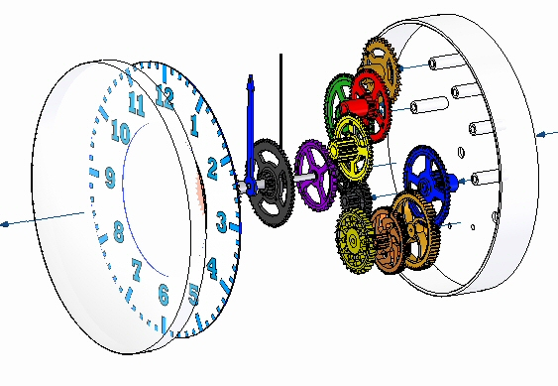
Exploding Assemblies
Solid Edge enables you to easily create exploded views of your assemblies. You can use the exploded views you define in the Assembly environment to create exploded assembly drawings in the Draft environment. You can also create presentation-quality renderings and animations of exploded assemblies.

Slide 169
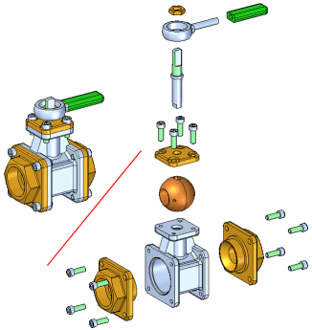
Exploding Assemblies
Explodes the active assembly by applying a spread distance between parts.
The Automatic Explode command explodes assemblies based on the relationships applied between parts. In assemblies where the components are positioned using mate or axial align relationships, the Automatic Explode command quickly gives you excellent results.

Slide 170
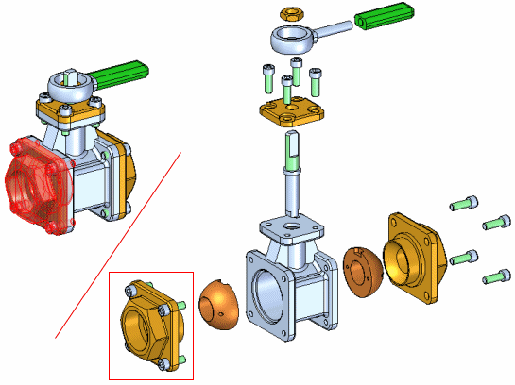
Binding Subassemblies
Groups the parts in a subassembly so they will explode as a single unit when using the Automatic Explode or Explode commands. To bind a subassembly, you must first select it using PathFinder.
A symbol is added adjacent to the subassembly entry in PathFinder to indicate that the subassembly is bound. You can use the Unbind Subassembly command to unbind a subassembly.

Slide 171
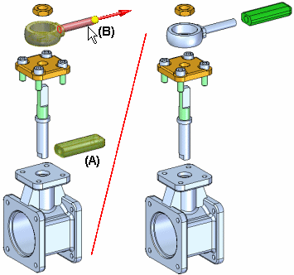
Explode Command
Explodes one or more parts in a specified direction. The parts (A) selected for explosion are offset along an explode vector you define by selecting a face or reference plane on a base or reference part (B).
You can manually explode a single part, multiple parts, and bound subassemblies. You define the offset distance using the Distance box on the command bar.

Slide 172
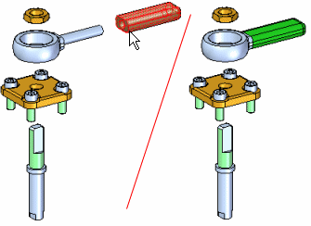
Collapse command
Returns an exploded part to its original assembly position relative to its parent part.
You can collapse several parts in one operation by holding the Shift key and selecting the parts you want to collapse. If you select a part that is a component in a bound subassembly, the entire subassembly is collapsed.
When you collapse a part, the flow line for the part is deleted.

Slide 173
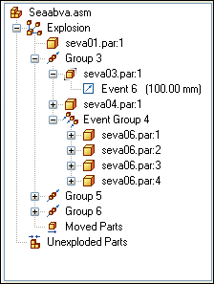
Explode PathFinder tab
Provides alternate ways of viewing and editing an exploded assembly. The Explode PathFinder tab displays the structure for the current exploded view configuration in a hierarchical list. The Explode PathFinder tab helps you work with the components that make up an exploded view.

Slide 174
Explode PathFinder tab
This allows you to view the structure and perform edit operations on the current exploded view configuration. Some of the operations you can perform include:
You can select an explode event, then edit the offset or rotational value using the command bar.
You can use the commands on the shortcut menu to show and hide parts, collapse parts, show and hide flow lines, and so forth.
You can add and remove parts from explode Groups and Event Groups. This is useful when working with animations.

Slide 175
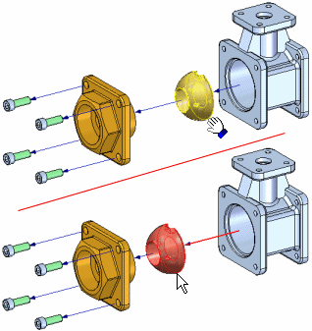
Move Part command
Moves or rotates parts in an exploded view in an assembly. You can use this command to do the following:
Move one or more parts along the original explode vector or a new vector you define.
Rotate one or more parts along the original explode vector or a new vector you define.
Move one or more parts within a plane you define.
You can move or rotate a single part, a set of parts, or a part and all its dependent parts. The same basic steps apply whether you are moving, rotating, or moving within a plane.

Slide 176
Reposition command
Repositions a part with respect to another reference part in an exploded view. This can be useful when you want to change the position of a part after using the Automatic Explode command.
To reposition a part, select the part you want to reposition (A), then position the cursor over the reference part (B). The reference part highlights, and an arrow is displayed on the reference part to indicate which side of the reference part the selected part will be repositioned to.

Slide 177
Display Configurations
To save an exploded view to be used in another application, a display configuration needs to be saved while the part is exploded. The display configuration is used to place an exploded view on a drawing sheet.

Slide 178
Activity
Activity – Explode

Slide 179
Rendering assemblies

Slide 180
Rendering assemblies
Course overview
The Explode-Render-Animate application within the Solid Edge assembly environment is a tool for creating different types of presentations of Solid Edge assemblies. Exploding an assembly allows you to control the movement, sequence and grouping of parts and subassemblies. Rendering a view allows you to define textures, lighting, shadows, backgrounds and other properties to create presentation style images. Motors apply movement to under constrained parts in an assembly which can be animated. Using Animation, you can combine previously created exploding sequences and custom camera movement to create animation. Each frame of the animation can be rendered to create presentation quality animations.

Slide 181
Explode-Render-Animate
Course overview (continued)
Once you complete the activities in this course, you will be able to:
Assign material properties and textures to parts and subassemblies.
Set viewing properties to change lighting, backgrounds, shadows, reflections, refractions and perspectives.
Edit material properties to create different results in the final rendering.

Slide 182
Explode-Render-Animate
Entering the Explode-Render-Animate environment (ERA)
To enter the ERA environment, within an assembly, click the Tools Tab. In the Environs group, click ERA.

Slide 183
Rendering
Supported advanced rendering entities:
Advanced rendering provides rendering support for these entities:
Backgrounds
Foregrounds
Materials
Environments
Lighting Studios
Render Mode
Scenery

Slide 184
Rendering
Activating advanced rendering
Advanced rendering is activated automatically when you click the Render Scene and Render Area. When you click these commands, two new tabs are added to PathFinder automatically.
The sessions entity tab
The predefined archives tab

Slide 185
Rendering
Session entities tab
The Session Entities tab displays the name of the active assembly, along with a tree structure that shows you the entities that are applied to the assembly. You can right-click an entity to display a shortcut menu to:
Edit the properties of an entity as the basis for creating a new entity.
Detach (remove) a material that you have applied to the model.
Cut, copy, and paste an entity.
Rename an entity you created.

Slide 186
Rendering
Predefined archives tab
The Predefined Archives tab displays a list of folders that contain predefined entities, such as backgrounds, foregrounds, and materials. You can right-click an entity to display a shortcut menu to:
Create a new archive folder or advanced rendering entity.
Apply an entity to the model.
Cut, copy, and paste an entity.
Rename an entity you created.
A toolbar on the Predefined Archives page contains commands used to create, save, open, close, and import customized entities in user-defined archive folders.

Slide 187
Rendering
Adding a user defined entity to the predefined archives
Any material, color, background, light, or scene that you want to customize needs to be applied to the assembly first, and then modified within the Session Entities tab to look the way you want it to. When you have adjusted the parameters of an entity so that it looks good on the model, you then copy the entity from the Session Entities page to a user-defined entity archive on the Predefined Archives page on PathFinder.

Slide 188
Activity
Activity – Rendering

Slide 189
Animating assemblies

Slide 190
Animating assemblies
Course overview
The Explode-Render-Animate application within the Solid Edge assembly environment is a tool for creating different types of presentations of Solid Edge assemblies. Exploding an assembly allows you to control the movement, sequence and grouping of parts and subassemblies. Rendering a view allows you to define textures, lighting, shadows, backgrounds and other properties to create presentation style images. Motors apply movement to under constrained parts in an assembly which can be animated. Using Animation, you can combine previously created exploding sequences and custom camera movement to create animation. Each frame of the animation can be rendered to create presentation quality animations.

Slide 191
Explode-Render-Animate
Course overview (continued)
Once you complete the activities in this course, you will be able to:
Add a motor to a unconstrained part of an assembly to create movement for an animation.
Manipulate animation events and explode events to create an animation of an assembly.

Slide 192
Explode-Render-Animate
Entering the Explode-Render-Animate environment (ERA)
To enter the ERA environment, within an assembly, click the Tools Tab. In the Environs group, click ERA.

Slide 193
Defining Motors
There are two types of motors that can be defined in Solid Edge: rotational and linear.
You use motor features to help you observe how a set of under-constrained parts will move relative to the part you define as a motor. This allows you to design and simulate complex mechanisms where the movement of a set of interrelated parts needs to be simulated.

Slide 194
Defining Motors
Motor command
You use motor features to help you observe how a set of under-constrained parts will move relative to the part you define as a motor. This allows you to design and simulate complex mechanisms where the movement of a set of interrelated parts needs to be simulated.
For example, you can specify that a crankshaft part (A) in a mechanism rotates around an axis you specify (B).

Slide 195
Simulate motor
Simulate motor command
Display a kinematic simulation of motion in an assembly. You use motor features to define how a set of interrelated parts will move. This is useful when working with assemblies that contain crankshafts, gears, pulleys, and hydraulic or pneumatic actuators.

Slide 196
Activity
Activity – Motor

Slide 197
Animate
Solid Edge enables you to easily create animated presentations of your assemblies. Assembly animations can be useful for motion studies of mechanisms, visualizing how parts are assembled into a completed assembly, and vender or customer presentations

Slide 198
Animate
Animation Editor command
You can define the following types of animation events:
Camera
Motor
Explosion
Appearance
Motion Path

Slide 199
Animate
You can use the controls on the Animation Editor tool to play, stop, pause, and rewind the animation in the graphic window.
You can also save an assembly animation in AVI format with the Save As Movie button on the Animation Editor tool.

Slide 200
Animate
Event duration bar
A user-interface element on the timeline (right) pane of the Animation Editor tool.
Event duration bars allow you to visualize and control the timing of events in an assembly animation.
Event duration bars represent the start time, elapsed time, and end time for an animation event. There are two basic types of event duration bars:
Duration bars for explode, appearance, and motor events.
Duration bars for camera and motion path events. Duration bars for these event types also support key frames (A).
You can move and modify duration bars using the cursor and shortcut menu commands.

Slide 201
Animate
Camera Path Wizard command
Runs the Camera Path Wizard, which guides you through the process of creating a camera path for an assembly animation. The Camera Path Wizard allows you define the camera path name, camera direction, and so forth. You can use camera paths as part of an assembly animation.

Slide 202
Activity
Activity – Animate

Slide 203
XpresRoute (tubing)

Slide 204
Introduction
You can use XpresRoute to create path segments and tubes in an assembly. To access the commands for tubing, while in Assembly, choose Tools→Environs→XpresRoute .
Tube parts are designed in the context of an assembly, so you to directly model them within an assembly, using existing part and assembly geometry to ensure accurate fit and function. Tube parts are fully associative and update with the parts to which they are connected. Tube wire parts are directed parts. They conform to the path segment and the options you use to construct the part. When you make changes to the assembly that cause the path to change, the part will also change.

Slide 205
Tube design workflow
Tube design workflow:
Create a path
Use the PathXpres command to automatically create a 3D path for the tube.
To learn how, see Create a tube path with PathXpres.
Use the Line Segment or Arc Segment command to manually draw the path for the tube.
Create the tube
Use the Tube command to assign pipe attributes and fittings to a path segment that defines the route the pipe should follow.

Slide 206
Creating the path with PathXpres
Tubes and Pipes are created along a path segment. You can use the PathXpres command in XpresRoute to create the path without manually drawing the individual lines of the path or you can use the Line Segment command or Arc Segment command to manually draw the path.
Use the PathXpres command to create a 3D path for a tube or pipe without having to manually draw the individual lines of the path. PathXpres generates a path between two points that is orthogonal to the default reference planes. These points must be circular or elliptical element, the endpoint of a segment, or the endpoint of a sketch element.

Slide 207
Creating the path with PathXpres
In cases where more than one way for the path exists, you can use the Next and Previous button on the PathXpres command bar to display alternative paths. The order of the paths goes from the simplest path, with the least number of segments, to the most complex path. The maximum number of segments in a path that PathXpres generates is five.

Slide 208
OrientXpres tool
You use the OrientXpres tool to assist you in drawing lines and arcs in 3D space when drawing a path manually. As you draw the line or arc segments, use OrientXpres to lock the orientation of the element parallel to an axis or plane as you draw it. For example, after you define the start point for a line segment, you can use OrientXpres to lock the orientation to the y axis.

Slide 209
OrientXpres tool
When you click to define the second point for the line, you can then use OrientXpres to lock the orientation to the z axis.

Slide 210
OrientXpres tool
You can continue to lock the axis or plane to assist you in defining the path (A), (B), (C).

Slide 211
OrientXpres tool
The OrientXpres tool is an interactive design aid for drawing lines, arcs, and curves in 3D space, and for editing the position of bluedots in 3D space. OrientXpres is displayed automatically when creating or editing elements which require its capabilities. For example, OrientXpres is displayed when drawing line segments in the XpresRoute and Frame applications, and when editing bluedots in the Part and Sheet Metal environments.
When working in 3D space, you often need to restrict the placement or movement of elements to be parallel to a particular axis or plane. The OrientXpres tool provides that capability. You can do the following using OrientXpres:
To restrict movement parallel to an axis, select one of the three axes (X, Y, or Z). You can also cycle through the axes by typing Z key on the keyboard.

Slide 212
OrientXpres tool
To restrict movement parallel to a plane, select one of the three planes (XY, YZ, or XZ). You can also cycle through the planes by typing X key on the keyboard.
To move the OrientXpres tool to a more convenient location, select the origin, and drag it to a new location.

Slide 213
OrientXpres tool
You can type C key on the keyboard to clear any locks to planes or axes.

Slide 214
Modifying path segments
There are four types of geometric relationships for tube parts:
Connect relationships
Coaxial relationships
Parallel relationships
Tangent relationship
The PathFinder tab displays the tube path segment relationships.
You can delete any relationship by deleting its handle in the graphic window or deleting the relationship in PathFinder.
Path segments can be dimensioned to control size and the move command will allow them to be modified if a position adjustment needs to be made.

Slide 215
Creating the tube
Once you have drawn a tube path, use the Tube command to create a tube along the path segment. With the Tube command you can select a single segment or a chain of segments as the tube path. You can also define tube extents to both ends of the tube path.
When creating a tube part, you can use the Tube Options dialog box to define parameters such as material, outside diameter, bend radius, and wall thickness for the part. To access the Tube Options dialog box, click the Tube Options button on the Tube command bar.

Slide 216
Generating tube information
You can use tube properties to extract information to create such reports as bend tables, tube reports, and parts lists.
Outputting bend information
You can use the Bend Table command to create an ASCII text file that contains information about how to manufacture the tube. You can output the tubes as a select set or output them all at once. The information consists of columns of data such as feed length, rotation angle, bend radius, and bend angle.
Creating tube reports and parts list
You can include tube properties defined on the Tube Options dialog box in reports or parts lists. When you create a tube file, these tube properties are automatically stored in the tube file and are exposed so that they can be included in reports and parts lists.

Slide 217
Activity
Activity: Placing tubes in assembly with XpresRoute

