Slide 1
Solid Edge ST4 Training Sheet metal design

Slide 2
Sheet Metal
Course overview
The Solid Edge Sheet Metal application is specialized for modeling straight brake sheet metal parts.
Once you complete the activities in this course, you will be able to:
Set parameters for sheet metal, such as bend radius and material thickness.
Place and manipulate flanges and bends.
Specify sheet metal treatments and corner parameters.
Place holes, cutouts, dimples, louvers, beads, gussets.
Modify geometry using live rules for synchronous design.
Prepare the sheet metal geometry for downstream manufacturing processes such as creating a flat pattern.

Slide 3
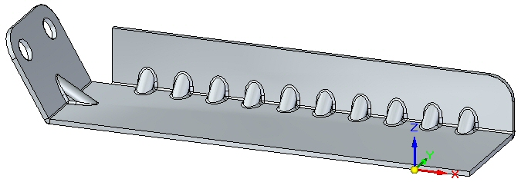
Sheet Metal Overview
Sheet metal overview
Sheet metal design is governed by the premise that the raw material used to form a sheet metal part is of common stock and of uniform thickness. The sheet metal part is designed in the formed state, but in the manufacturing process, many of the features of the part will be applied to the part before bending. The final locations of these features on the formed part is dependant on how the material behaves during the bending process

Slide 4
Sheet Metal Overview
Sheet metal overview (continued)
Material may stretch as the elastic limit is exceeded during bending and, while this stretching may be negligible in the final positioning of the feature, it may also make the target position after bending be incorrectly located.
The stretching of material during bending varies based on the material used and the thickness of the material. To correctly accommodate the stretching of material, calculations are made using a standard bend formula, which is provided. This bend formula can be customized for each stock material and by doing so, better accuracy is achieved in the resulting parts.

Slide 5
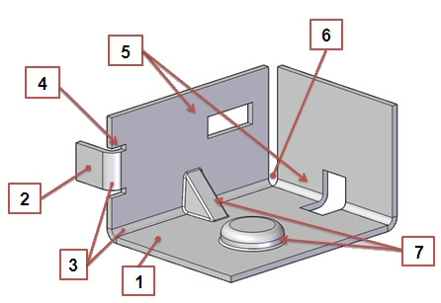
Terminology
Sheet metal features
Plate: Consists of a layer face and a thickness face.
2. Tab-Flange: Two plates connected by a bend.
3. Bend: Connects two tab-flanges.
4. Bend Relief: Option to prevent tearing during bending.
5. Cutouts: Openings in the part.
6. Corner: Where 2 or 3 bends meet.
7. Procedural Feature: Deformation features such as dimples, drawn cutouts, louvers, beads, gussets, and so forth.

Slide 6
Material Table and gage
Material Table
Defines the material and mechanical properties for a part. When you select a material from the list, material and mechanical properties for the material such as face style, fill style, density, coefficient of thermal expansion, and so forth are assigned.
When working with a sheet metal part, you also use the material table to define the properties for the sheet metal stock you are using, such as material thickness, bend radius, and so forth
Sheet Metal Gage
Displays the name of the current gage. When you select a name from the list, a set of associated material and mechanical properties is displayed. You can use the tabs on the dialog box to review or modify the properties. You can also define the material thickness using the Material Thickness option on the Gage tab.

Slide 7
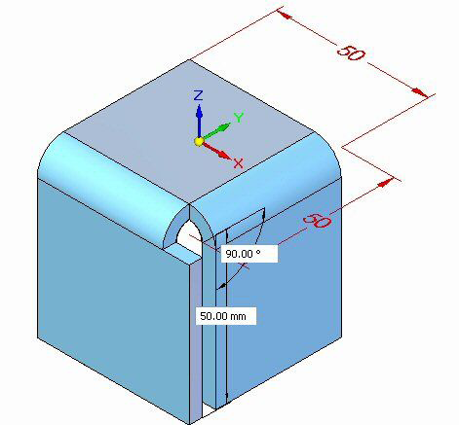
Activity: Starting sheet metal design
Activity objectives
This activity demonstrates how to begin working in sheet metal. The activity explores some of the settings used to create the part with the desired material and material properties. In this activity you will accomplish the following:
• Create a new sheet metal part.
• Create the material to be used for the part.
• Modify the thickness of the material.
• Examine the bend formula and change the neutral factor.
• Create a base geometry consisting of a tab and then create flanges around the tab.

Slide 8
Locking the sketch plane
Automatic plane locking
Manual plane locking
Using the lock icon to lock or unlock a sketch plane
Using the F3 function key to lock a plane

Slide 9
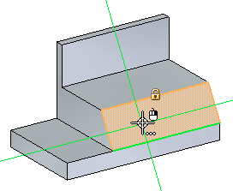
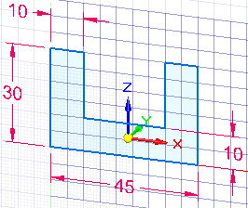
Drawing synchronous sketches
Lock to a face or plane to draw sketch
Alignment lines
Using a grid

Slide 10
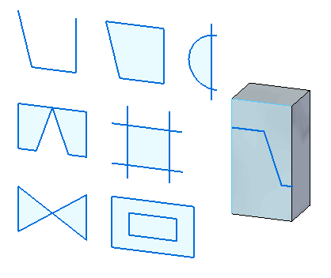
Drawing synchronous sketches
regions
Activity: Create regions

Slide 11
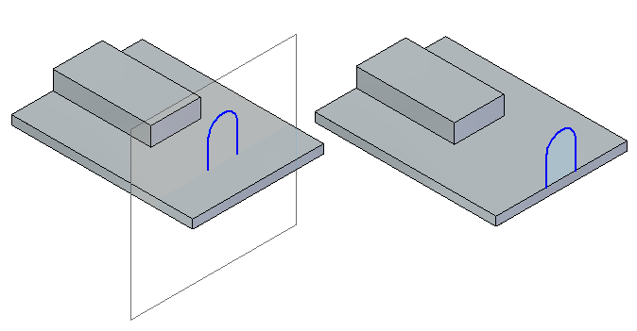
Drawing synchronous sketches
open sketches

Slide 12
Synchronous sketch behavior in the ordered environment
Synchronous sketch dimensions are not migrated to ordered features.
Synchronous sketches are not consumed when creating an ordered feature.
Synchronous sketches can drive ordered features.
Synchronous sketches appear while in the ordered environment.
Regions are disabled.
Synchronous sketches appear in the synchronous sketch style and colors.
When using the Select Tool in the ordered environment, synchronous sketch elements locate as individual elements.
Synchronous sketches can be moved using the steering wheel handle. The entire sketch moves (not single elements).
In the ordered environment, synchronous sketch geometry or relationships commands are not available.
Synchronous and ordered sketches cannot be copied while in ordered environment.
Manual plane locking
Using the lock icon to lock or unlock a sketch plane
Using the F3 function key to lock a plane

Slide 13
Drawing ordered sketches
Workflow
Choose the sketch command.
Select a reference plane or part face as the sketch plane.
Automatically enter the sketch environment.
Draw sketch elements.
Add sketch geometric relationships and functional variables.
Add sketch dimensions.
Close the sketch environment.

Slide 14
Drawing 2D elements
Overview
Intent zones
Construction geometry
Modifying sketch elements
Applying colors and patterns to closed sketch boundaries

Slide 15
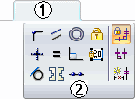
Geometric relationships
The sketch relationship commands are located on the Sketching tab (1) in the Relate group (2).
Note: When creating a synchronous feature, the sketch relationships do not migrate to the feature created from them.
Relationships

Slide 16
Drawing tools
Working with grids
IntelliSketch
Projection lines
Distance and area measurements in sketches

Slide 17
Dimensioning sketches
Dimensioning commands are located in three locations. They are located in the Dimension group on the Home, Sketching and PMI tabs.
Locked dimensions
Dimension orientation
Dimension style

Slide 18
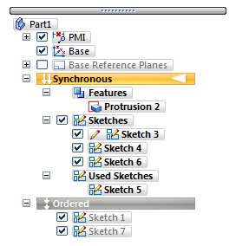
Sketches in PathFinder
Sketches context menu in PathFinder
Used Sketches context menu in PathFinder

Slide 19
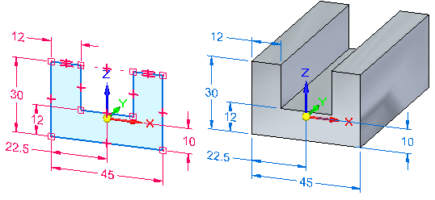
Sketch consumption and dimension migration
Working with combinable sketches

Slide 20
Manipulating sketches
Moving and copying sketches
Projecting elements to a sketch

Slide 21
Sketching Activities
Activity: Sketching (Part 1)
Activity: Sketching (Part 2)
Activity: Sketching (Part 3)
Additional:
Sketching Projects A-E

Slide 22
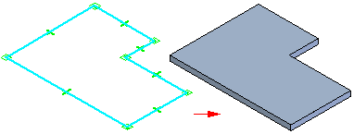
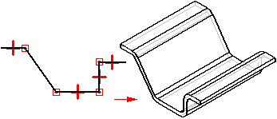
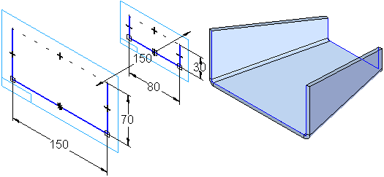
Base Features
Construct the base feature
You can construct a base feature with the Tab, Contour Flange, and Lofted Flange commands. The Tab command constructs a flat feature of any shape using a closed profile.
Tab:
Contour Flange:
Lofted Flange:

Slide 23
Tab Command: Synchronous environment
Constructs a tab feature on a sheet metal part. You can use this command to construct a base feature or add a feature to an existing sheet metal part.
In the synchronous environment, you can construct a tab with a single sketch region,
or with multiple sketch regions.

Slide 24
Tab Command: Ordered environment
In the ordered environment, you can only have one profile per tab feature.
When selecting multiple regions, the regions must be contiguous and in the same plane. When constructing a base feature in the ordered environment, the profile must be closed, and you must also define the material direction and material thickness you want.
For subsequent features in the ordered environment, the profile can be open or closed. When using an open profile, you must define the side of the profile to which you want to add material.

Slide 25
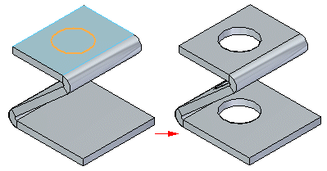
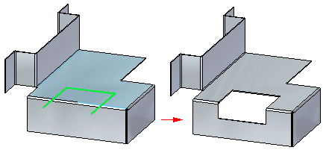
Cut Command
Cuts through a defined portion of the part.
You can create a sheet metal cutout with an open profile

Slide 26
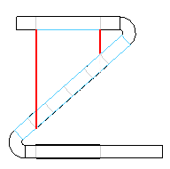
Cut Command
Face Normal cut types
Thickness cut:
This option creates a cutout that compensates for the material thickness of the part.
The Thickness cut option is useful when creating parts in which a shaft must pass through aligned circular cutouts.

Slide 27
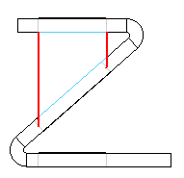
Cut Command
Face Normal cut types
Mid–plane cut:
This option creates a cutout based on the mid-plane of the part.
This option creates a cutout based on the mid-plane of the part.

Slide 28
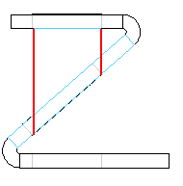
Cut Command
Face Normal cut types
Nearest Face cut:
This option creates a cutout based on the nearest face of the part.

Slide 29
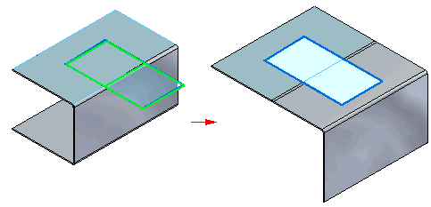
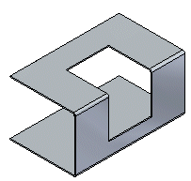
Cut Command
Cuts across bends
The Wrapped Cut option unfolds the bend to create a cut,
and then rebends when the cut is complete.

Slide 30
Activity: Using regions to create tabs and cuts
Activity: Using regions to create tabs and cuts

Slide 31
Contour Flange
Simple contour flanges
A simple contour flange is created when a sketch is used to create the first feature in the sheet metal file.
When a simple contour flange is created in the synchronous environment, it contains a set of tabs and bends that have no relationship to one another. The simple contour flange is represented in PathFinder as a collection of tabs and flanges.

Slide 32
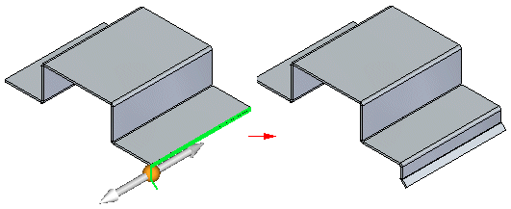
Contour Flange
Chained contour flanges:
A chained contour flange is created when a sketch is used to add a contour flange to an existing tab or flange. The sketch must be perpendicular to the thickness face to which it is attached.
Note:
Swept, non-linear edges and bends without flanges are not supported when creating a contour flange.
Chained contour flanges create matched rows of flanges.

Slide 33
Activity: Constructing a base feature using contour flange
Activity: Constructing a base feature using contour flange

Slide 34
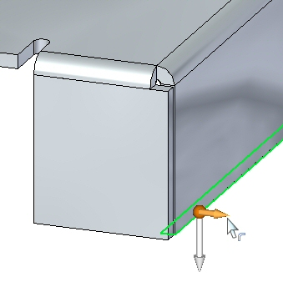
Flanges, corners and bend relief
You create flanges using flange handles (synchronous environment). As you create them, you can control end conditions such as bend relief and corner conditions. You can insert bends across layer faces.

Slide 35
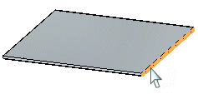
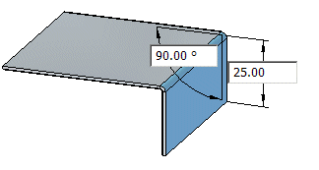
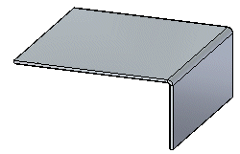
Flanges – Synchronous environment
Flanges in the synchronous environment
In the synchronous environment, you can construct a flange by selecting a linear thickness edge to display the flange start handle,
clicking the flange start handle,
specifying a flange distance,
and clicking to place the flange.
When you click, a 90° flange is drawn automatically. However, when specifying the distance for the flange, you can also specify an angle.

Slide 36
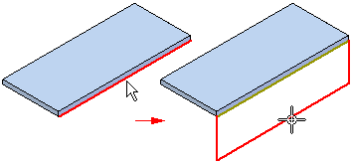
Flanges – Ordered environment
Flanges in the ordered environment
In the ordered environment, you construct a flange by selecting a linear thickness edge, and then reposition the cursor to define the flange direction and length.

Slide 37
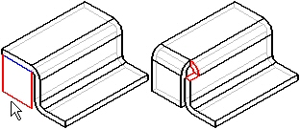
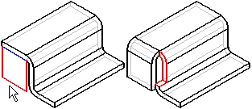
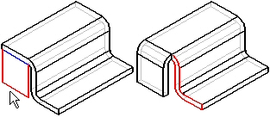
Corner Relief
Specifies that you want to apply corner relief to flanges that are adjacent to the flange you are constructing. When you set this option, you can also specify how you want the corner relief applied.
Bend Only
Specifies that corner relief is only applied to the bend portion of the adjacent flanges.
Bend and Face
Specifies that corner relief is applied to both the bend and face portions of the adjacent flanges.
Bend and Face Chain
Specifies corner relief is applied to the entire chain of bends and faces of adjacent flanges.

Slide 38
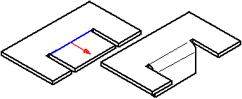
Bend Command
Inserts a bend across a planar face. You can use the command to add a bend in the middle of a part. The bend profile must be a single linear element. You cannot insert a bend across an existing flange

Slide 39
Bend Command (ordered environment)
Insert a bend in the ordered environment
Choose Home tab→Sheet Metal group→Bends list→Bend.
Define the profile plane.
Draw a profile. The profile, which must be a single linear element, represents the approximate location of the bend.
Choose Home tab→Close group→Close.
Define the bend location with respect to the profile.
Define which side of the part will move.
Define the bend direction.
Finish the feature.

Slide 40
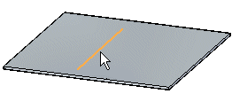
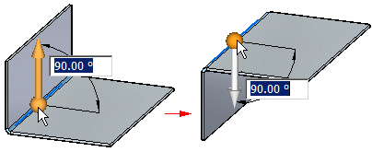
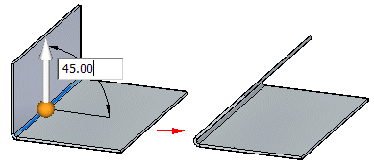
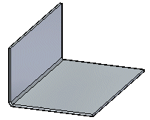
Bend Command (Synchronous environment)
Choose Home tab→Sheet Metal group→Bends list→Bend.
Select the sketch element to create the bend.
Click the side of the sketch to move.
(Optional) Click to the direction arrow to change the direction of the bend.
(Optional) Type a value to change the bend angle.
Click to create the bend.

Slide 41
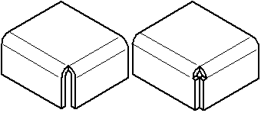
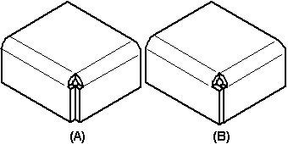
Close 2-Bend Corner command
Closes the corner where two flanges meet and creates the smallest gap permissible without joining the corner. Flange edges can equally meet, overlap, totally intersect, or intersect with circular corner relief.
You can specify whether you want to close (A) or overlap (B) the corners.

Slide 42
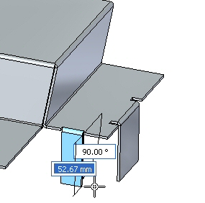
Activity: Flange and corner conditions
Activity: Flange and corner conditions

Slide 43
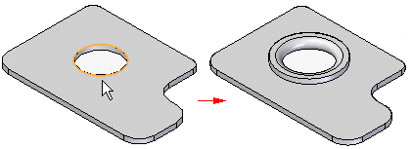
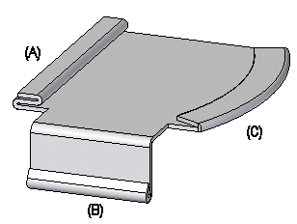
Hem Command
Constructs a hem, where the material folds back
You can use the Hem Options dialog box to specify the type of hem to be created. The Hem Type list contains several types of hems from which to choose. For example, you can define s-flange (A), loop (B), and closed (C) hems.
.

Slide 44
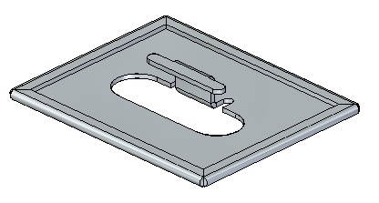
Activity: Using the hem command in sheet metal design
Activity: Using the hem command in sheet metal design

Slide 45
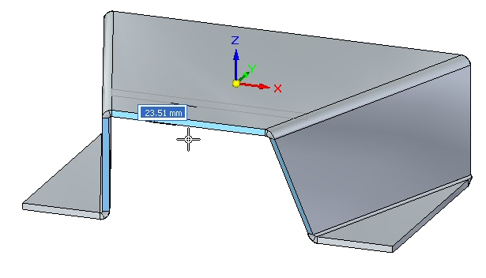
Live rules in sheet metal
Live rules in sheet metal
When you use the steering wheel to modify a portion of a model, Live Rules and relationships control how the rest of the model responds.

Slide 46
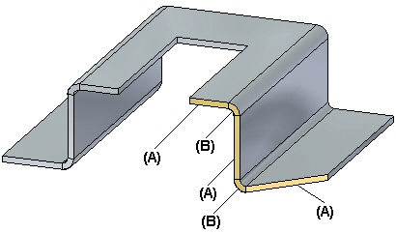
Live Rules: Thickness Chain
Thickness chain on a sheet metal part
A contiguous series of thickness faces (A) and bend end caps (B) in a sheet metal part.

Slide 47
Live Rules: Thickness Chain
Live Rules works the same in synchronous sheet metal modeling as it does in synchronous part modeling. An additional Live Rules option is available in the synchronous sheet metal modeling environment. The option is called Maintain Thickness Chain.
The Maintain Thickness Chain option maintains the position of a thickness chain, made up of thickness faces connected by bends, during a move operation.
When the Thickness Chain option is set, if you move one thickness face, the other connected faces move also.

Slide 48
Live Rules: Thickness Chain
Selecting the Suspend Live Rules option does not affect the setting of the Thickness Chain option. In other words, if the Thickness Chain option is set and you select the Suspend Live Rules option, the Thickness Chain options remains set.
The Thickness Chain option ignores the Coplanar rule within the thickness chain so the thickness chain does not have to be coplanar to work.

Slide 49
Live Rules: Thickness Chain
Relationships are not detected between members of the same thickness chain, but are detected between members of separate chains. So even though the Coplanar rule is not detected within one thickness chain, it is detected from one thickness chain to another. In the following example, Symmetry and Thickness Chain are disabled. When the selected face is moved, the faces in red move also because they are coplanar and are part of a separate thickness chain. Since Thickness Chain is disabled and the Coplanar rule is not detected within the thickness chain containing the face selected to move, the blue face does not move.

Slide 50
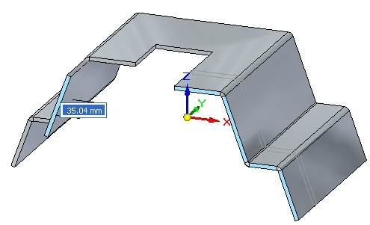
Activity: Using live rules in sheet metal
Activity: Using live rules in sheet metal

Slide 51
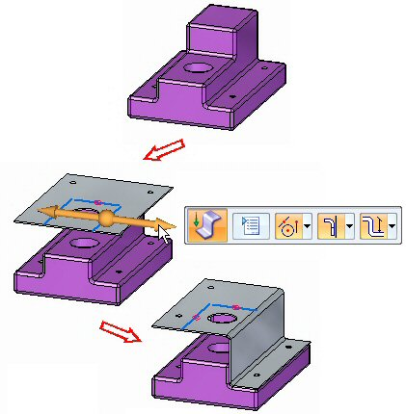
Sheet Metal: Jog
Constructing a Jog in a sheet metal part
A jog constructs an offset face with a connecting flange and maintains the positions of any features contained on the face, such as holes and deformation features.

Slide 52
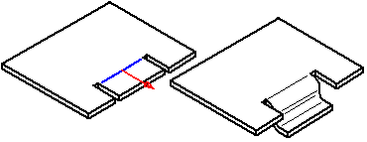
Sheet Metal: Jog
Constructs two bends to add a jog to a planar face of a sheet metal part. In the ordered environment, the profile for a jog feature must be a single linear element. In the synchronous environment, the sketch element used to construct the jog must be a single line that is coplanar with the face being bent. The jog can be minimal: for example, a slight offset or step to provide clearance or rigidity to a part.

Slide 53
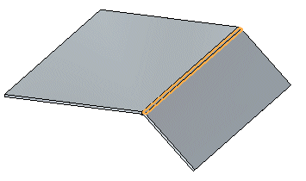
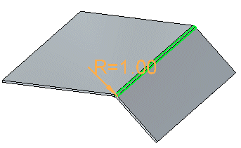
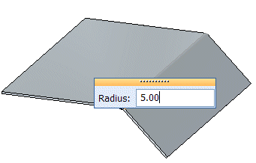
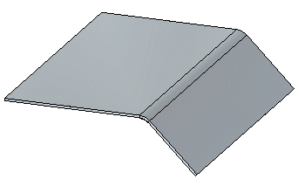
Sheet Metal: Editing the bend radius
When you create a bend, the bend radius is defined from the default global parameters. Once a bend is created, it can be edited by selecting the bend,
then selecting the bend radius handle,
then typing a new value in the dynamic edit control,
and then clicking to finalize editing the radius.

Slide 54
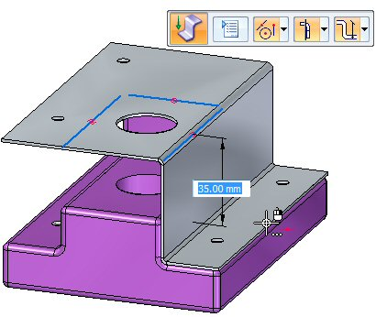
Activity: Using the jog and break corner command
Activity: Using the jog and break corner command in sheet metal design

Slide 55
Deformation Features
Deformation features in a sheet metal part
Deformation features model features on the thickness faces of sheet metal parts, such as louvers, beads, dimples, drawn cutouts, and gussets, that can be manufactured by striking the stock with a tool. The values you use to define deformation features as you create them are stored with the features, and you can edit them later. Also the feature origin, or strike point, of the feature is positioned on the face such that if the face is later rotated or a jog is added, the feature will remained positioned. The feature can be relocated by modifying the position of the feature origin.
Deformation features consist of louvers, beads, dimples, drawn cutouts, and gussets.

Slide 56
Deformation Features: Louvers
Constructing louvers
Like a jog feature, a louver feature is constructed using a single, linear element.
When constructing a louver, the louver height (H) must be equal to or less than the louver depth (D) minus the material thickness (T).
You can also specify whether you want the louver ends
formed (A) or lanced (B) using the Louver Options
dialog box.
Louver features cannot be flattened.

Slide 57
Deformation Features: Dimples
Constructs a sheet metal dimple from a selected region. If you use an open profile, the open ends of the profile must theoretically intersect part edges. Dimples are special die-formed features in which material deformation occurs. Dimples cannot be flattened.

Slide 58
Deformation Features: Drawn Cutouts
In the ordered environment, if you use an open profile, the open ends of the profile must theoretically intersect part edges. A closed profile cannot touch any part edges. Drawn cutouts cannot be flattened.
In the synchronous environment, the geometry used to create the cutout can be a closed internal profile that creates a region or an open profile extended to a part edge to create a closed region.

Slide 59
Deformation Features: Beads
Constructs a bead feature on a sheet metal part. A bead feature is often used to stiffen a sheet metal part.
In the ordered environment, you can construct a bead with an open
or closed profile.

Slide 60
Deformation Features: Gussets
Constructs a stiffening gusset across a bend to provide reinforcement in a sheet metal part.
You can create a gusset automatically or from a user-drawn profile. You can use the Gusset Options dialog box to specify the method to use when constructing the gusset. The steps required to construct the gusset are different depending on the method you use.

Slide 61
Deformation Features: Working with Feature Origins
You can use the feature origin handle to move or rotate manufactured features that contain a feature origin. The feature origin provides a reference point that can be used to move a feature without changing its shape.
The feature origin is used primarily in sheet metal models (.psm) for features such as dimples, drawn cutouts, and louvers.
Note:
A feature origin is also used for hole features in part and sheet metal documents. The feature origin for a hole feature does not have XY fins.
You can dimension to a feature origin, and then edit the dimensional value to move the entire feature.
Note:
When using Smart Dimension to dimension to a feature origin you cannot select the feature origin first.
Show and Hide commands are available to display and hide the feature origin when you select a feature that contains a feature origin. You can also display and hide all the features origins in a document.
Shortcut menu commands are available to reposition the feature origin for a feature.

Slide 62
Activity: Working with deformation features
Activity: Working with deformation features in sheet metal.

Slide 63
Feature modeling environments
Opening a Solid Edge modeling document
Moving between modeling environments
Feature display
Editing features
Moving ordered features to synchronous
Activity: Creating ordered features
Activity: Creating both ordered and synchronous features in a model

Slide 64
Modeling ordered features
Sketching activities:
Sketching activities
Using IntelliSketch
Applying sketch relationships (collinear, parallel, equal)
Applying sketch relationships (symmetric)
Using construction elements in a profile
Creating ordered base feature activities:
Constructing ordered features from sketches
Creating a loft and swept protrusion
Creating profile-based ordered features activity

Slide 65
Modeling ordered features
Miscellaneous activities:
Constructing a mouse base
Embossing text on a part
Modeling a machined part
Constructing a bracket

Slide 66
Manipulating sheet metal geometry
Manipulating sheet metal geometry
After constructing a sheet metal part, you may need to create a flat pattern of the part for manufacturing.

Slide 67
Creating a flat pattern
Select Tools tab→Model → Pattern.
Select Tools tab→Flat group→Flatten .
Click a face to be oriented upward in the flat.
Click an edge to define the X axis and origin.
Click to complete the flat pattern.

Slide 68
Activity: Creating a flat pattern
Activity: Creating a flat pattern from a sheet metal part

