Slide 1
Solid Edge ST4 Training Sketching

Slide 2
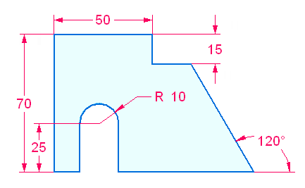
3D Sketching Overview
Sketch workflow
Activity: Draw a simple sketch

Slide 3
Locking the sketch plane
Automatic plane locking
Manual plane locking
Using the lock icon to lock or unlock a sketch plane
Using the F3 function key to lock a plane

Slide 4
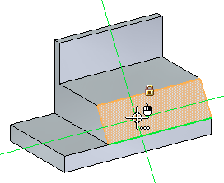
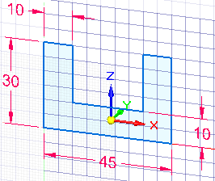
Drawing synchronous sketches
Lock to a face or plane to draw sketch
Alignment lines
Using a grid

Slide 5
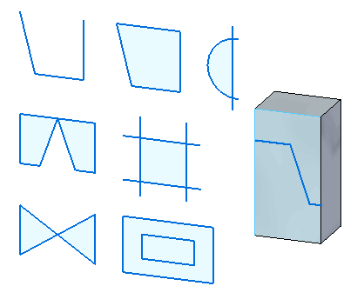
Drawing synchronous sketches
regions
Activity: Create regions

Slide 6
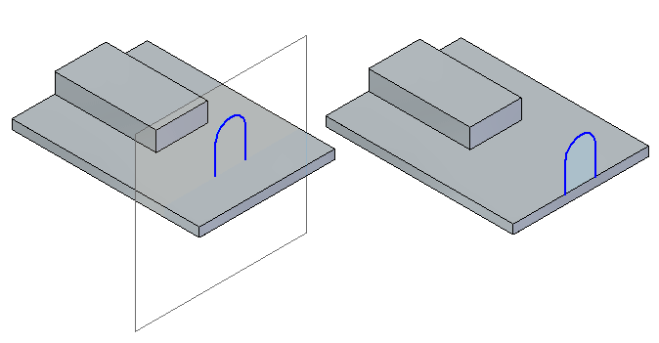
Drawing synchronous sketches
open sketches

Slide 7
Synchronous sketch behavior in the ordered environment
Synchronous sketch dimensions are not migrated to ordered features.
Synchronous sketches are not consumed when creating an ordered feature.
Synchronous sketches can drive ordered features.
Synchronous sketches appear while in the ordered environment.
Regions are disabled.
Synchronous sketches appear in the synchronous sketch style and colors.
When using the Select Tool in the ordered environment, synchronous sketch elements locate as individual elements.
Synchronous sketches can be moved using the steering wheel handle. The entire sketch moves (not single elements).
In the ordered environment, synchronous sketch geometry or relationships commands are not available.
Synchronous and ordered sketches cannot be copied while in ordered environment.
Manual plane locking
Using the lock icon to lock or unlock a sketch plane
Using the F3 function key to lock a plane

Slide 8
Drawing ordered sketches
Workflow
Choose the sketch command.
Select a reference plane or part face as the sketch plane.
Automatically enter the sketch environment.
Draw sketch elements.
Add sketch geometric relationships and functional variables.
Add sketch dimensions.
Close the sketch environment.

Slide 9
Drawing 2D elements
Overview
Intent zones
Construction geometry
Modifying sketch elements
Applying colors and patterns to closed sketch boundaries

Slide 10
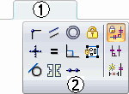
Geometric relationships
The sketch relationship commands are located on the Sketching tab (1) in the Relate group (2).
Note: When creating a synchronous feature, the sketch relationships do not migrate to the feature created from them.
Relationships

Slide 11
Drawing tools
Working with grids
IntelliSketch
Projection lines
Distance and area measurements in sketches

Slide 12
Dimensioning sketches
Dimensioning commands are located in three locations. They are located in the Dimension group on the Home, Sketching and PMI tabs.
Locked dimensions
Dimension orientation
Dimension style

Slide 13
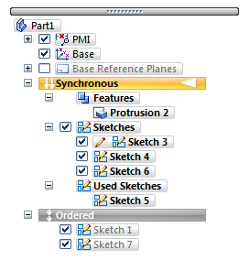
Sketches in PathFinder
Sketches context menu in PathFinder
Used Sketches context menu in PathFinder

Slide 14
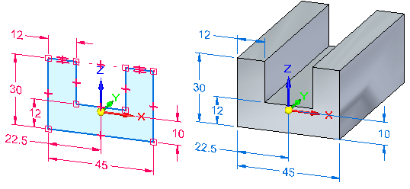
Sketch consumption and dimension migration
Working with combinable sketches

Slide 15
Manipulating sketches
Moving and copying sketches
Projecting elements to a sketch

Slide 16
Sketching activities
(3) Instructional activities
(5) Creating a sketch from a dimensioned drawing

