Slide 1
Solid Edge ST4 Training Moving and rotating faces

Slide 2
Overview
A synchronous solid model is defined as a set of connected facial topology that encompasses a volume. A synchronous solid model is modified by manipulating the facial topology.
In this course, you will learn to modify a synchronous model by moving and rotating facial topology.

Slide 3
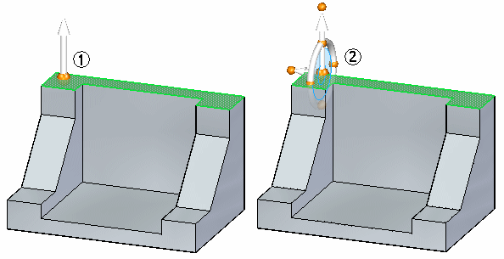
Moving synchronous faces
When a synchronous face or reference plane is selected, a default graphic handle (1) appears at the select point. If the handle origin is selected, a different graphic handle (2) appears with more move options. Click the primary axis, secondary axis, or torus to start the Move command.

Slide 4
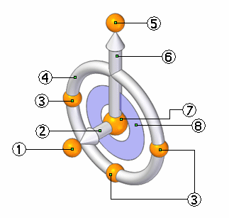
Graphic handle (3D steering wheel)
(1) secondary knob
(2) secondary axis
(3) cardinal points
(4) torus
(5) primary knob
(6) primary axis
(7) origin
(8) tool plane

Slide 5
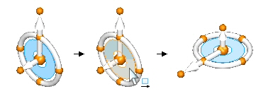
Reorient the steering wheel
Swap the primary and secondary axes
Change the direction of the primary axis at 90° increments
Change the direction of the primary axis at a user-defined angle
Change the direction of the primary axis using a geometric keypoint
Change the direction of the secondary axis
Change the secondary axis direction at a user-defined angle
Maintain a steering wheel orientation at a different location
Activity: Reorient the steering wheel

Slide 6
Moving a face
You can move a face in the following ways:
Move a face in a direction along the primary axis or secondary axis by selecting either axis.
Move a face freely along a plane where the graphic handle is connected by clicking the plane on the handle.
Set the direction of the primary axis by dragging the handle origin to an edge or vertex. The primary knob also locks onto the edge to define the direction.
Reposition the primary knob to change the direction of the primary axis.
Reposition the secondary axis direction in 90° increments by selecting one of three cardinal points.
The origin is the move from point. The origin can be moved prior to a move.

Slide 7
Rotating a face
Rotate a face by positioning the steering wheel secondary axis on an edge. The secondary axis becomes the axis of revolution.
Select the torus to begin dynamic rotation or type a rotation angle in the dynamic input box.

Slide 8
Move face workflow
Single face move
Using the Select tool, select a face. The 3D steering wheel appears on the selected face. Initially you get the primary axis only. Click the 3D steering wheel origin to display entire steering wheel.
QuickBar appears with the available operations that can be performed on the selected face. Move is the default operation and thus does not need to be selected.
Click the primary axis on the handle to move the face in or out in a direction normal to the face.
Define the move to location by one of the following methods:
Dynamically drag the face to a new location and then click.
Click a keypoint location. Choose the keypoint type on the Move QuickBar drop list.
Type in a ± distance in the dynamic input box.
Press Esc key to end move.

Slide 9
Move face workflow
Single face rotate
Using the Select tool, select a face. The 3D steering wheel is displayed on the selected face. Initially you get the primary axis only. Click the 3D steering wheel origin to display entire steering wheel.
Click and drag the origin of the steering wheel to an edge to rotate about.
Make sure the secondary axis of the steering wheel lies on the edge to rotate about. Click and drag the secondary knob to position if necessary.
Click the torus on the handle to rotate the face. Dynamically rotate the face by moving the cursor or by typing in a ± angle in the dynamic edit input box.
Press Esc key to end rotate.

Slide 10
Move face activities
Activity: Move and rotate faces
Activity: Copying a face and using keypoints to define movement

Slide 11
Selecting faces
Select faces using the Select tool.
A collection of selected faces to perform an action on is referred to as a select set.
Face selection methods
Select and deselect faces manually (one face at a time).
Select and deselect faces with the assistance of a selection manager.
The selection manager uses the topological and attribute data of the face selected to add faces to a select set.

Slide 12
Selection mode
A selection mode symbol is located next to the cursor.
Press the spacebar to change the select mode.
The select mode selection is also available on the Home tab in the Selection group.

Slide 13
Selection mode
normal mode
Normal mode is the default selection mode.
Normal mode is a single selection.
Select a face and the steering wheel displays on that face.
Select another face and the steering wheel moves to that face.
The face previously selected is deselected.
Only one face selected per click.

Slide 14
Selection mode
add/remove mode
The add/remove selection mode is used to build a select set.
In the normal mode, select a face and then press the spacebar to switch to the add/remove mode.
Each face selected in this mode is added to the select set.
If a face is selected that has already been selected, it is deselected.
The graphic handle remains on the first face selected.
Both selected and unselected faces highlight as the cursor moves over them.

Slide 15
Selection mode
add mode
The add mode only adds faces to the select set.
Only unselected faces highlight as the cursor moves over faces.
To set the mode to add, cycle through the select modes by pressing spacebar.

Slide 16
Selection mode
remove mode
The remove mode only removes (deselects) faces from the select set.
Only selected faces highlight as the cursor moves over faces.
To set the mode to remove, cycle through the select modes by pressing spacebar.

Slide 17
Selection mode
Selection Manager mode
The selection manager icon attaches to the cursor.
Move cursor over a face and click to display the Selection Manager menu.

Slide 18
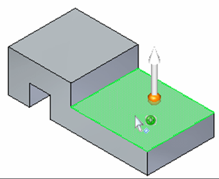
Selection manager
Use Selection Manager to add or remove items from a select set using the topological and attribute data of a selected object.

Slide 19
Selection manager
Clicking on a face displays the Selection Manager menu.
The topological relations relate only to the face selected.
The topological relations listed in the Select Manager menu are determined by the type of face selected (planar, non-planar, cylindrical, partial cylindrical).
You can also switch to a Selection Manager mode. On the Home tab, in the Select group, in the Select drop list, choose the Select Manager Mode command .

Slide 20
Selection manager
You can also start the Select Manager mode by pressing Shift + Spacebar.
When in this mode Select Manager is active.
Click on a face in the select set to display the select manager.
To end the Select Manager mode, press the Spacebar.

Slide 21
Selection manager
Selection manager options
Select tool menu
Activity: Using the Selection Manager
Activity: Modifying a part by moving select sets

Slide 22
QuickBar options for moving faces
You can control the results of the Move command with options that control the interaction of the select set and the rest of the model.
By setting these options, the resultant transformation can be altered within the command.
The options are Connected faces, Copy, Detach, and Precedence.

Slide 23
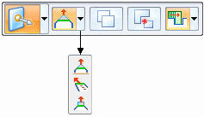
Connected face options
Extend/Trim
Default option. Selected face moves by extending and trimming the adjacent faces.
Tip
Selected face is rigid. Adjacent faces change to meet the movement of the rigid selected face.
Lift
Selected face is rigid. Adjacent connected faces are not affected. The selected face moves in a direction normal to the face to either add or remove material.

Slide 24
Copy
The copy option creates a copy of the faces in the select set.
The faces are collected into a face set feature.
The face set feature can be moved or rotated.
This option is similar to a copy and paste operation.
The original selected faces are unchanged.
Activity: Copying and attaching a feature (method 1)
Activity: Copying and attaching a feature (method 2)
Activity: Copying, rotating, and attaching a feature to a new location

Slide 25
Detach
The detach option removes the select set from the part body.
The removed select set can be moved or rotated.
This option is similar to a cut and paste operation.
Activity: Detaching and attaching a feature

Slide 26
Precedence
The precedence option is used to set which face(s) have priority during a synchronous move operation.
Select Set Priority Selected and other moving faces have priority over non-moving faces.
Model Priority Non-moving faces have priority over moving faces.

Slide 27
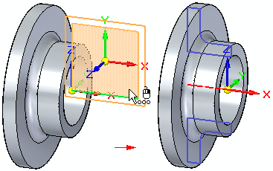
Working with Live Sections
You use the Live Section command to create a 2D cross-section on a plane through a 3D part. For example, you can select one of the principal planes on the base coordinate system as the plane for a live section.

Slide 28
Working with Live Sections
Creating live sections
Editing live sections
Editing 2D elements in a live section to modify the 3D model
Editing the entire live section
Displaying live sections
Model editing and live section update
Live sections in an assembly
Activity: Live Section

