Slide 1
Solid Edge ST4 Training Constructing procedural features

Slide 2
Procedural features
Procedural features are manufactured features which perform a particular function. Unlike rounds and drafted faces, procedural features generally come later in the design process and thus do not affect the form of the model. There are several types of procedural features available within Solid Edge, some of which are used extensively in the plastics industry. In this lesson, you will learn how to define the following features.
Hole
Rib
Vent
Lip
Also in this lesson, you will define feature patterns for repetitive use, as well as learn the organizational aspects of feature libraries. You will learn how to manage features using standard Windows operations Cut, Copy and Paste. You will also learn about the Attach and Detach functionality.

Slide 3
Hole command
Plane locking
Precise placement
Hole types
Threaded holes
Hole extents
V bottom angles
Hole edits
Holes.txt and Pipethreads.txt files
Saving commonly used hole parameters
Activity: Place holes
Activity: Edit holes

Slide 4
Pattern features
Rectangular Pattern command
Activity: Rectangular Patterns
Circular Pattern command
Activity: Circular Patterns
Pattern Along Curve command
Activity: Pattern Along Curve
Fill pattern
Activity: Fill pattern

Slide 5
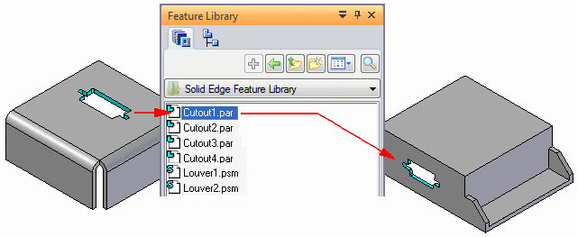
Feature libraries
You can use many of the features used for modeling in Solid Edge in a similar fashion in other designs. The Feature Library page and Teamcenter Feature Library page provides a place for you to store commonly used part and sheet metal features in an easy to access location so you create new designs with less effort and more consistency.
For example, you can construct a cutout feature in one part, store the feature in a feature library location, then reuse the feature in a new part later.

Slide 6
Feature libraries
Storing features in a library
Placing feature library members
Redefining parent edges
Feature library guidelines
Create an unmanaged feature library member
Place a feature library member into another document
Activity: Feature Libraries

Slide 7
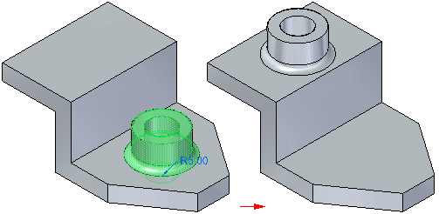
Detaching and attaching faces and features
You can modify synchronous models by detaching and attaching one or more faces or features. Detaching faces or features makes it possible to remove faces from the solid model without deleting them. This can be useful when you need to create a new variation of an existing model that does not contain some of the features on the existing model, but you want to maintain the features in the document for possible future needs.
Detaching faces or features also makes it possible for you to move or rotate the face set to a new position on the model and then reattach them in the new location.

Slide 8
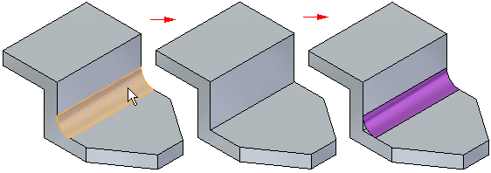
Detaching faces
You can detach faces using the Detach command on the shortcut menu when one or more faces or features are selected, or you can use the Detach option available on the Move QuickBar. You can select the faces in the graphics window or in PathFinder.
When you use the Detach shortcut menu command, the detached faces are hidden automatically in the graphics window, and the color is changed to the construction color. You can use PathFinder to redisplay the faces.

Slide 9
Attaching faces
You can attach faces using the Attach command on the shortcut menu when detached faces are selected in PathFinder or the graphics window. To successfully attach, a valid solid body must be formed. If the faces you are trying to attach do not form a valid solid body, a message is displayed.

Slide 10
Detaching and attaching faces and features
Detach faces
Attach features
Activity: Detach and attach face sets
Activity: Attach

Slide 11
Cutting, copying, and pasting model elements
Copying and cutting elements
Pasting elements
Activity: Copy and move face sets
Activity: Copy and paste face sets

Slide 12
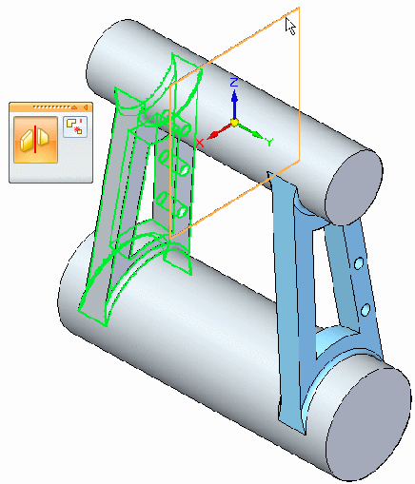
Mirror
Constructs a mirror copy of selected elements about a plane you define.
You can mirror any of the following
Faces of the model body
Face Sets
Surfaces
Procedural Features, such as Hole Occurrences and Patterns
Entire model body
The mirror plane can be a reference plane or a planar face.
Activity: Mirror faces and features

Slide 13
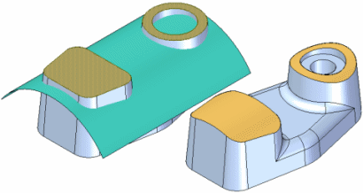
Replace face command
Replaces selected faces on a part. The replacement face can be a construction surface, a reference plane, or another face on the part. When replacing more than one face, the faces being replaced cannot touch each other.
When you replace a face using a construction surface, the construction surface is hidden automatically when you finish the feature.
If edges on the face you are replacing have rounds applied, the rounds are reapplied after you complete the replace face operation.

Slide 14
Plastics design features
Rib command
Web network command
Vent command
Lip command
Activity: Functional features in consumer products

