Slide 1
Solid Edge ST4 Training Structural Frame Design

Slide 2
Frames workflow
Start the Frame Design application.
Create the 2D framework.
After the framework design is complete, build the 3D frame.
Modify a structural frame.
Return to the Assembly environment.
Produce a structural frame drawing.
Create a cut lengths parts list and automatically add balloons.
(Optional) Add weld features to the frame design.

Slide 3
Starting the frames application
The Frames application is only available from within the Assembly environment.
Procedure for entering and exiting the Frames application
Step 1. Open a new assembly file.
Step 2. To start the Frames application, on the Tools tab, in the Environs group, choose Frame Design .
Step 3. The tools needed to create paths that define the framework are located in the Home tab, Segments group (1). In the Frame group (2), the Frame command creates frames once the framework design is complete.
Step 4. To exit the Frames application, click the Close Frame command in the Close group.

Slide 4
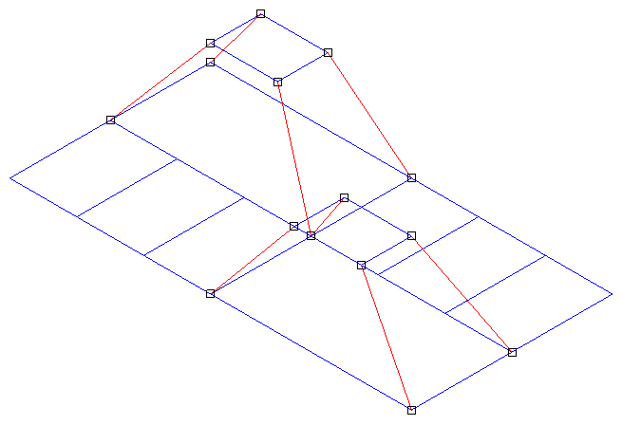
Creating the framework
Create the entire framework for the frame unit before creating frames.
The framework can be a combination of sketches and 3D line segments.
Use sketches when the frame is planar.
Use edges and other geometry from 3D parts in the assembly.
The framework model below contains sketch elements (blue) and 3D line segments (red).

Slide 5
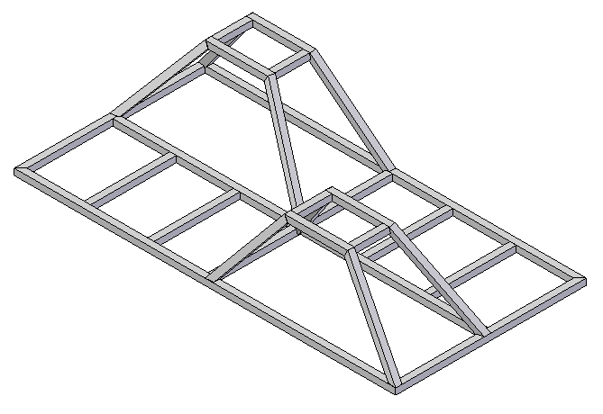
Creating the framework
Square cross sectional frames applied to the framework

Slide 6
Creating 3D segments
Use the Line Segment command in the Segments group to create 3D paths.
Create line segments in 3D space without having to define a plane to draw on.
Use OrientXpres to control the endpoints of the line segments.

Slide 7
OrientXpres tool
The OrientXpres tool is an interactive design aid for drawing lines, arcs, and curves in 3D space, and for editing the position of bluedots in 3D space. OrientXpres is displayed automatically when creating or editing elements which require its capabilities. For example, OrientXpres is displayed when drawing line segments in the XpresRoute and Frame applications, and when editing bluedots in the Part and Sheet Metal environments.

Slide 8
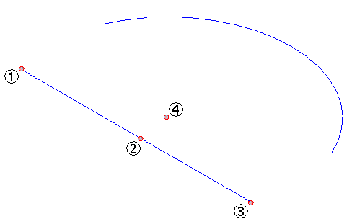
3D connect points
3D line segments connect to sketch elements at the locations shown. Sketch lines have connect points at endpoints (1,3) and midpoint (2). Arcs have only a center point connection (4).

Slide 9
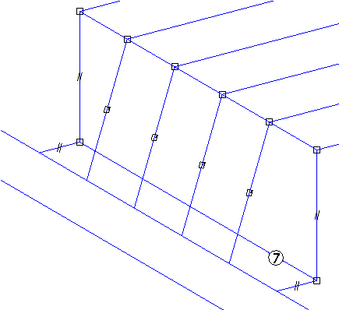
Activity
Using OrientXpres

Slide 10
Placing frames
After the framework design is complete, create frames that follow the sketch and 3D line segment paths.
To create frames, choose the Frames command in the Frame group.

Slide 11
Frame options
To display the Frame options, click the Options button on the Frame command bar.

Slide 12
Corner treatment options
Apply corner treatment
Apply radius
Extend frame component
No corner treatment

Slide 13
Apply corner treatment
(1) Miter A miter cut is applied to corner(s).
(2) Butt1 Material is removed from the longest member.
(3) Butt2 Material is removed from the shortest member.

Slide 14
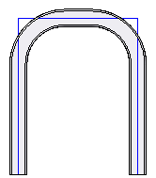
Apply radius
A fillet is applied at the corner(s).
The result is a single frame spanning the selected planar segments.

Slide 15
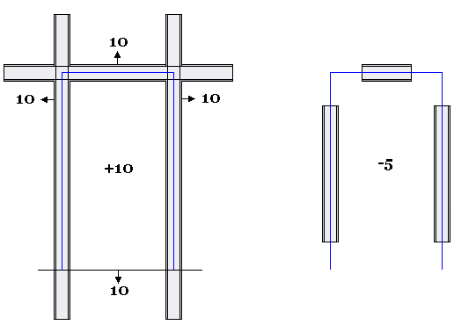
Extend frame component
Each frame added is extended by a specified (+/-) length.

Slide 16
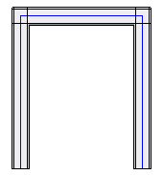
No corner treatment
No frames are trimmed. Each frame is the length of the path element.

Slide 17
Frame component location
Frames components are stored in unmanaged and managed locations.
browse for an unmanaged frame component
select a managed frame component from the Standard Parts Library
Click the folder icon on the Frame command bar to browse for a frame component.
The default folder is controlled from the Applications button→Solid Edge Options→File Locations tab.
To change the default frame folder location, select Frame Local Library Folder and then click Modify.

Slide 18
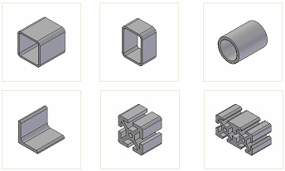
Browse for component
Store frame components in a common location accessible to all company frame designers.
Solid Edge delivers a sample set of frame components.
The sample frame components are found in the Program Files\Solid Edge ST3\Frames folder. Frame component samples

Slide 19
Frame files dialog
When using a sample frame component, the Frame Files dialog informs that the frame component will be removed when Solid Edge is uninstalled.
If a frame component is moved, renamed or deleted, a File Load Failure dialog displays when opening an assembly file which uses that frame component.

Slide 20
Frames ribbon bar
Choose the Frame command and the Frame command bar appears.
The Frame Options dialog displays where you can accept or change the active settings.
The automatic display of the dialog can be turned off.
The dialog can be shown at any time by clicking the Options button on the command bar.

Slide 21
Select path step
The Frame Options button is available at all times within the Frame command.
The first step in the Frame command is the Select Path Step.
While in the Path Selection Step, browse for a frame component or select a component from the Recently Used Component list.
You have the option to select single path elements or to select a chain of path elements.
When the path elements are selected, click the Frame Accept button. Deselect the selected path elements by clicking the Frame Deselect button.
The frames are placed after accepting the paths.
Click Finish to end the Frame component placement step.

Slide 22
Modify cross sections step
The Frame command bar changes when editing a frame definition. The Modify Cross Sections step becomes active. The Modify Cross Sections step allows you to:
specify the angular orientation of the cross section
define handle points at which the cross section lies on the path
select a new component to define the cross section for the frame

Slide 23
Modify end conditions
The Frame command bar changes when editing a frame definition. The Modify End Conditions step becomes active.
Change the end condition to a:
miter (1)
butt1 (2)
butt2 (3)
none (4)
When the end condition is changed to None (4), the command bar changes to provide additional end conditions.
fillet (5)
extend (6)
remove end condition (7)

Slide 24
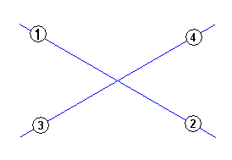
Placing frames on colinear paths
Selecting colinear path segments results in a single frame spanning the length of the colinear paths. This is important to know when paths cross.
The image below shows an example with four lines.
Line segments 1,2 are colinear and line segments 3,4 are colinear.

Slide 25
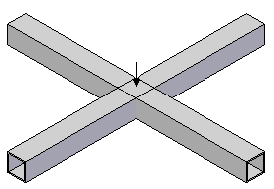
Placing frames on colinear paths
When selecting all four lines in the path step, the result is shown below. A frame set with two frames is created and notice that the two frames occupy the same space at the intersection.

Slide 26
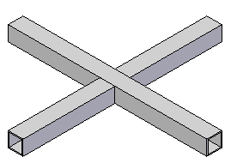
Placing frames on colinear paths
You get the same result by selecting lines 1,2 to create a frame and then selecting 3,4 to create another frame.
The correct process would be to determine which colinear paths make up the frame that will span the entire length. Create a frame that spans the entire colinear length. Create a single frame for each segment that butts up to the frame that spans the entire length.
In the example below, a single frame was created with lines 1,2. A single frame was created with line 3 and then a single frame was created with line 4.

Slide 27
Activities
Corner treatment options
Dune buggy frame

Slide 28
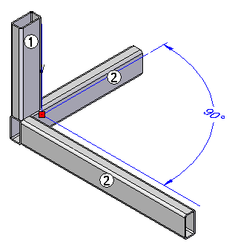
Automatic frame component positioning
The automatic frame component positioning option is used when adding a vertical frame component (1) whose path vertex is connected to the path vertices of an existing 90° frame corner (2). Frame (1) repositions to where the outside faces are coplanar to the (2) components. When auto-positioning is on for (1), any repositioning of the 90° frame corner components will cause the vertical component (1) to automatically reposition. If (1) has auto-positioning turned off, it
will not move from its default placement position when the 90° frame corner
components are repositioned.

Slide 29
Automatic frame component positioning
Activity

Slide 30
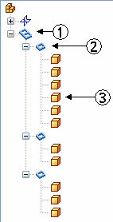
Editing frames
Edit a frame definition during creation or after the frame command is finished.
Edit frame paths, position, end conditions and component type.
PathFinder
In PathFinder, notice Frame Components collector (1). Whenever you create frames you will get a Frame Components collector. Control the display of all frame components by right-clicking (1) and then by clicking Show/Hide.
All frames created in a single operation are grouped as a Frame set (2). Turn on/off the display of the frame group.
Each frame in the group is a part file (3) with the filename of the frame component used. Turn on/off the display of any part in the group.

Slide 31
Edit definition process
To edit a frame:
Step 1. Click the Select tool .
Step 2. In PathFinder, click the Frame group to edit.
Step 3. Two methods of selecting the Edit Definition command are available.
(Method 1) Right-click on the Frame set or a member of the frame set in PathFinder and then click Edit Definition.
(Method 2) Right-click on the frame in the assembly window and then click Edit Definition.

Slide 32
Editing frame paths
Add or remove paths from the frame definition.
To edit a path definition:
Step 1. Within the Edit Definition command, click the Select Path Step.
Step 2. To add a path segment, select the path(s). The selected path(s) highlights along with the other paths in the frame path definition.
Step 3. Click the Accept button or right-click to complete the path step.
Step 4. To remove a path segment, press the Ctrl key and select the path(s). The selected path(s) no longer highlights.
Step 5. Click the Accept button or right-click to complete the path step.

Slide 33
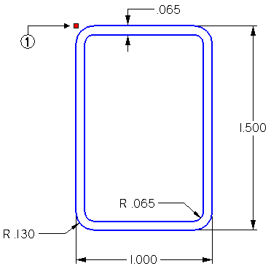
Editing frame position
A frame is positioned on a path by a snap point. The default snap point is defined during the creation of the frame component cross section.
Rectangular frame component example
(1) Default “snap” point

Slide 34
Editing frame position
To edit a frame(s) position
Step 1. Select a frame group or a single frame within a frame group.
Step 2. Right-click and click the Edit Definition command.
Step 3. Click the Modify Cross Sections step.
Step 4. If a frame group is selected, all frame cross sections in the group highlight. To position all highlighted cross sections simultaneously, click the Accept button. If only a single cross section from a selected frame group needs positioning, click the Deselect button and then select the cross section to position. Click the Accept button.
Step 5. Choose positioning method (hot key, snap point or angular rotation).

Slide 35
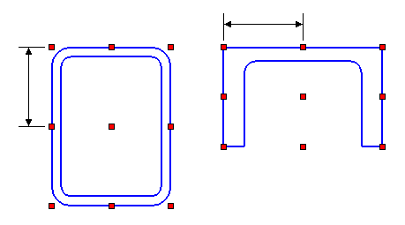
Positioning frames with hot keys
Hot keys are available to shift/rotate selected frame sections. All positioning is restricted to the cross section plane.
Pressing the n key rotates the cross section in 90° increments.
Pressing the f key flips the cross section (rotate 180°). You can also choose the Flip command on the command bar.
↑ shifts upward
↓ shifts downward
← shifts to left
→ shifts to right Note: All shifting via arrow keys is relative to the screen. Note: Shift delta is ½ the size of the section in the direction being shifted.

Slide 36
Frame snap points
You can position frames using snap points. Snap points are cross section sketch keypoints, cross section range box points, and the cross section centroid.
To display the frame snap point commands, you must first select the Define Snap Point button on the Frame command bar.

Slide 37
Frame snap points
Show Default Snap Point Shows the default snap point (blue dot).
Show Current Snap Point Shows the current snap point (green dot).
Show Cross Section Centroid Shows the centroid of the cross section (yellow dot).

Slide 38
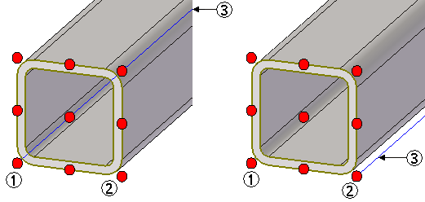
Frame snap points
Show Range Box Points Shows the cross section range box points (red dots). When you select one of the nine default snap points, the cross section shifts such that the selected snap point connects to the path (3). The default snap point (1) lies on the path (3) in the left image. If you select handle point (2), then that point moves to the path (3) as shown in the right image.

Slide 39
Frame snap points
Show Cross Section Sketch Activates the keypoints button , if a single cross section is selected. You can use this button to select any keypoint on the cross section sketch to snap to. The selected keypoint connects automatically to the frame path.

Slide 40
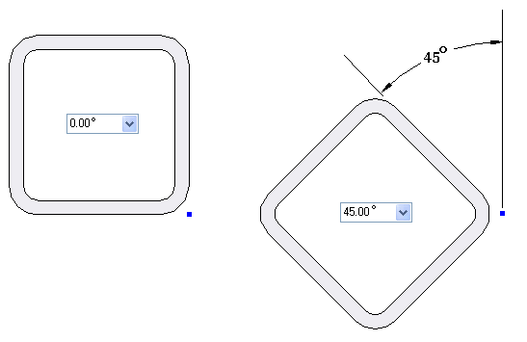
Angular orientation of frames
On command bar, specify the angular orientation (1) of a frame cross section relative to the path.

Slide 41
Editing Frame Components
Select a new frame cross section for an entire frame set or selected frames. Change cross sections in the Modify Cross Sections step.
Once the frames are selected, click the Accept button.
Click the Select New Cross Section Component button .
The file Open dialog or the standard parts interface (depending which option is set) displays.
Select either new size of cross section or even a totally different type/size.
The default location to begin browsing for frame components is Program Files→Solid Edge ST4→Frames.
In the Open dialog, select the component file and then click the Open button. The frames update with the new component.

Slide 42
Editing frame end conditions
Edit the end conditions of adjacent frame components. On the frames command bar, click the Modify End Conditions step.
Select the vertex of adjacent frame components to modify end condition between components. You can select more than one vertex. To edit the end conditions of the selected vertices, click the Accept button.
Click the new end condition and the modification is applied. Edit additional end conditions by clicking the Modify End Conditions step again. When all end condition modifications are complete, click Finish.

Slide 43
Editing frames activities
In these activities, you will edit an existing frame model. You will edit frame paths, position, end conditions and components.
Editing a corner treatment
Editing a path definition
Editing a single vertex
Editing frame position using hot keys
Editing frame position using snap points
Editing frame components
Editing frame cross section orientation

Slide 44
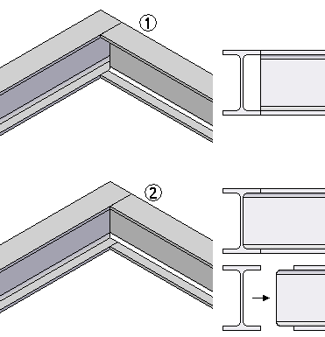
Coping joints
In the Frames Options dialog, the coping option is off by default. You apply coping to non-mitered joints.
(1) shows the result of coping turned off and (2) coping turned on.

Slide 45
Activity
Coping joints and colinear paths
In this activity, you will use the coping non-mitered joints option. You will also learn how to handle colinear path segments.

Slide 46
Creating custom frame components
Create frames using delivered frame components or frame components from the Standard parts Library. A user-defined frame component can be used. This lesson covers the process of creating custom frame components.

Slide 47
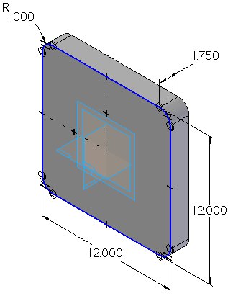
Creating the frame cross section
A complete cross section of component must reside in either the first feature or first sketch of a part file.
If this component were used as is, it would produce a “solid” square tube (not hollowed out).

Slide 48
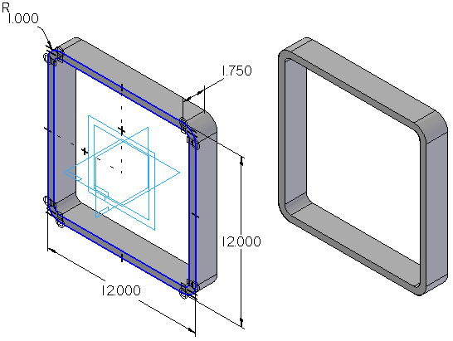
Creating the frame cross section
This component produces the intended “hollowed out” square tubing.

Slide 49
Snap point
The snap point is a point element in the cross section sketch. Use this point to specify the default snap/attach point for each cross section. The “snap” point indicates the point of the cross section that will be connected to the specified frame path.
Note: If a snap point does not exist in the frame component file, the Frames command will default to the centroid of the 2-D cross section.

Slide 50
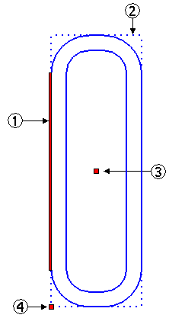
Frame component definition file
(1) relative orientation line
(2) range box of cross section
(3) computed centroid of range box
(4) default snap point
Add company specific file property information (for BOM parts list purposes).
Note: The frame component file does not have to contain a solid body of the feature. A sketch is enough to successfully create frames. However, it is a good idea to create the solid so the preview
will be available when selecting the frame component.

Slide 51
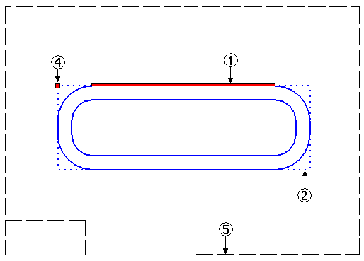
Cross section orientation on reference plane
(5) reference plane created to place cross section onto

Slide 52
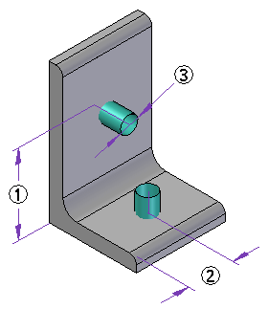
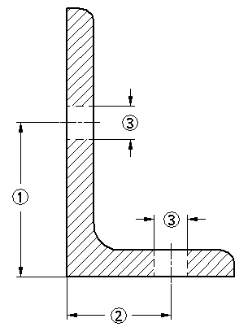
Defining hole locations in a frame
A frame component may contain information on where holes can be drilled.
Hole locations (1, 2) are defined in the frame cross section.
Hole diameter (3) represents the maximum allowed hole size.
Hole position along a frame is specified during the assembly hole feature creation. A cylindrical construction surface added to the frame component defines the hole location.

Slide 53
Applying frame attributes
Once the custom frame cross section is defined, the next step is to apply frame attributes. You must be in the profile or sketch environment of the user-defined cross section.
To apply frame attributes, click Applications→Run Macro.
In the Run Macro dialog, click on the file FrameComponentsUtility.exe located in the Program Files/Solid Edge ST3/Frames folder. Click Open.
Frame utility location
Program Files\Solid Edge ST3\Frames\Frame Component Utility

Slide 54
Frame components utility process
Step 1. Click on the profile point to be defined as the handle point.
Step 2. Click on the profile line to be defined as the relative orientation.
Note: Steps 1 and 2 are order independent as long as you complete steps 1 and 2. This must be done for both handle point and orientation line for non-circular cross sections. Each section must have no more than one handle point and one orientation line defined.
Step 3. Click Step 3 in the Frame Component Utility. The profile point and line should highlight to verify appropriate attributes have been selected.
Step 4. Click Quit to complete the addition of attributes to the cross section.
The “Delete ALL Frame attributes on profile elements” button scans the current profile and deletes all of the existing frame attributes that may have been previously created.
User-defined frame component is now ready for use.

Slide 55
Activity
Creating a custom frame
In this activity, you will create a custom frame.

Slide 56
Drafting activity
The process of creating drawings of 3D frames is the same as creating 3D assembly drawings.
We will cover the Parts List features that pertain to frames in an activity.
To learn more about parts lists, see the following Help topics:
Parts lists
Exploded parts lists
Using the columns tab
Using the options page
In this activity you will create a parts list that includes cut lengths for each component and choose how you want to organize the list for downstream viewers in manufacturing or purchasing. You will also create a parts list using rough-cut sizing, where you specify an amount that the system automatically adds to the exact length of frame. The last parts list will include the total length of each frame component.

Slide 57
Saving frame components
A frame entity can be saved non-associatively to either a part or assembly file.
Saving a single frame entity
Step 1. In the frame section of Assembly PathFinder, right-click a single entity.
Step 2. On the shortcut menu, click Save As and on the Save As dialog box, specify a folder and name for the entity.
The frame entity is not associative. Opening the saved entity file shows that the frame is a body feature not linked to the original model.

Slide 58
Saving frame components
Saving a frame set
Step 1. In the frame section of Assembly PathFinder, right-click a frame set.
Step 2. On the shortcut menu, click Save As and on the Save As dialog box, specify a folder and name for the frame set. The frame set name is the default filename for the save as assembly file.
The frame set is not associative. Notice when the Save As assembly (i.e. Frame_5.asm) is opened that the components from the original file are copied and renamed.

Slide 59
Saving frame components
Save a single frame component associatively with the Save Selected Model command.
Step 1. Choose Application button→Save As→Save Selected Model.
Step 2. Select a frame entity to be saved to the file.
Step 3. Enter a filename and folder for the saved model. When the saved model is opened, notice that the geometry of the frame comes in as a linked part copy . Any change made to the original frame entity will be reflected in the saved model.

