Slide 1
Solid Edge ST4 Training Designing in the context of an assembly

Slide 2
Top-Down assembly modeling
Top-down assembly modeling is an assembly-centric modeling method where the assembly design is started at the highest level possible, and individual parts and subassemblies are defined within the context of the overall assembly. With this approach, an assembly layout is typically created first, and this assembly layout is used to define individual part geometry and position.
This approach is often used at companies where the product being designed is large enough that it requires many people to complete the design. A senior-level designer might create the initial assembly layout, then divide the assembly layout into logical subassemblies and parts for the remainder of the organization to complete.

Slide 3
Bottom-Up assembly modeling
Bottom-up assembly modeling is a part-centric modeling method where the assembly design is started with a principal structural or functional element, and individual parts are designed in relative isolation from the overall assembly. Component parts and subassemblies are defined as the process moves up towards the top-level assembly. With this approach, as the design of a key component is completed, its geometry may or may not be used to aid the design of related mating components.
This approach is often used at companies where the product being designed is small enough that one or only a few people are needed to complete the design.

Slide 4
Combining both approaches
Solid Edge provides tools that allow you to take advantage of the benefits of both approaches as needed. Many organizations use a combination of both methods, using the method which best suits the immediate requirements. For example, you can use the top-down approach to create the initial assembly layout and to define the document structure needed. You can then copy the assembly layout geometry to subassembly and part documents to divide the work among the organization.
You can shift to the bottom-up approach in areas of the design that use purchased parts, existing parts from an earlier project, or where you are modeling standard parts in 3D that were created on an earlier 2D CAD system.
The suite of commands and tools in Solid Edge also allow you to use either approach associatively or non-associatively, as you see fit.

Slide 5
Top-Down tools
Creating and Publishing Virtual Components
Create In-Place
Inter-Part Associativity
Include command
define the extent of the feature associatively by selecting a keypoint on another part in the assembly.

Slide 6
Bottom-Up tools
Part Copy command.

Slide 7
Transferring parts to a new subassembly
Solid Edge allows you to create a new subassembly for parts you want to transfer. The New Subassembly button on the Transfer to Assembly Level dialog box accesses the Create New Subassembly dialog box. You can use this dialog box to specify a template, file name and location for the new database. You can also use the dialog box to define the position of the transferred parts in the new subassembly.
You have two options when defining the part position.
Position First Selected Part at Origin and Others Relative to It
Maintain Current Offsets From Assembly Origin

Slide 8
Dispersing subassemblies
You can use the Disperse command to disperse a subassembly by reassigning the parts to the next highest subassembly and removing the reference to the existing subassembly. The command will disperse only the top-level occurrence of a subassembly. For example, if a subassembly exists as an occurrence within the assembly being dispersed, the subassembly remains unchanged, but is moved up to the next higher assembly level.
The command does not modify the dispersed subassembly on the disk. The part occurrences are copied to the next higher level and the reference to the subassembly is deleted. When you save the top-level assembly, since it is no longer in the assembly structure, the dispersed subassembly occurrence is not saved.
If the subassembly being dispersed contains a pattern, the parts of the pattern are placed at the proper location in the next higher level and a ground constraint is placed on each of the parts. The parts will not be grouped in the PathFinder under a pattern node, but will be ordered the same in the next higher assembly.

Slide 9
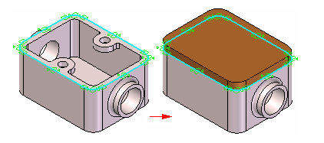
Inter-part associativity
When constructing the parts and assemblies for a design project, you can use the geometry on other parts in the assembly to help you construct a new part or subassembly. For example, you can use the Include command to create 2D geometry for the base feature of a new part by copying edges on an existing part.

Slide 10
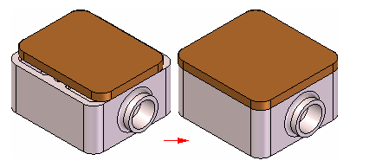
Inter-part associativity
Depending on the approach you use, the included geometry can be associative or non-associative to the original edges.
When you create new geometry associatively, then modify the original, or parent geometry; the child geometry also updates. If you change the size of the parent part, the included child geometry for the base feature also updates.

Slide 11
Associative Geometry
The following commands and functions in Solid Edge allow you to use existing geometry associatively:
Include command
Inter-Part Copy command
Assembly-Driven Part Features
Reference Plane Definition
Feature Extent Definition
Variable Table

Slide 12
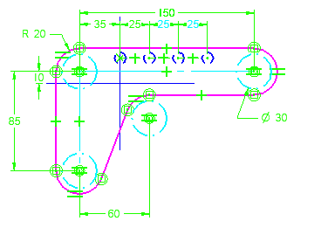
Assembly layouts
As you develop the design concepts for a new assembly, it is useful to create a layout of the preliminary design. The Sketch command in the Assembly environment allows you to draw 2D sketch geometry on part or assembly reference planes.
You can draw assembly sketches on the three default assembly reference planes or you can create new assembly reference planes to draw sketches on.
You can use assembly sketches to do the following:
Create 3D ordered geometry within parts.
Create assembly features.
Position 3D parts relative to the sketch geometry.
Position an assembly sketch relative to a 3D part.

Slide 13
Activities
Activity: Transferring and dispersing assemblies
Activity – Inter-part assembly modeling
Activity – layout sketches in assembly

