Slide 1
Solid Edge ST4 Training Assembly Features

Slide 2
Assembly-based features
You may want to construct a feature within the context of the assembly, rather than in the Part or Sheet Metal document.
You can use the feature commands in the Assembly environment to construct features such as cutouts, revolved cutouts, holes, chamfers, and threads. You can also mirror and pattern these features.
In Solid Edge, you can construct two types of assembly-based features:
Assembly Features
Assembly-Driven Part Features
You use the Feature Options dialog box to specify whether the assembly-based feature you are constructing affects only the selected parts (Assembly Feature), or affects all parts with the same document names as the selected parts (Assembly-Driven Part Feature).

Slide 3
Assembly features
When you set the Create Assembly Features option, the feature affects only the parts you select.
For profile-based features, the reference plane, profile, extent definition, and surface geometry resides in and can only be viewed from the assembly document where the feature was constructed.
This option is useful when you want to modify one or more commonly-used parts, but do not want to affect other instances of the same parts in the active assembly or other assemblies that reference those parts.
You do not need write access to the affected part files to construct an assembly feature.

Slide 4
Assembly-Driven Part Features
When you set the Create Assembly-Driven Part Features option, the feature affects all parts with the same document name as the selected parts.
The reference plane, profile, and extent definition, resides in and can only be viewed from the assembly document where the feature was constructed. The surface geometry resides in the part documents. The surface geometry can be viewed in the part documents, and any other assemblies that reference the part documents.
This option is useful when you want to globally modify one or more parts while working in the assembly.
You need write access to the affected part files to construct an assembly-driven part feature.
A part document that contains an assembly-driven part feature is associatively linked to the assembly document where the feature definition (reference plane, profile, and extent definition) resides.

Slide 5
Assembly-Driven Part Features
You can break the links that control an assembly-driven part feature by in-place activating the part document, selecting the feature in PathFinder, and clicking the Break Links command on the shortcut menu. After the link is broken, it is likely that some aspects of the feature will become undefined. For example, the reference plane may no longer be associated to its parent face. You can repair the broken links by selecting the feature, and using the Edit Definition option on the command bar to redefine the reference plane, feature extents, and so forth.

Slide 6
Creation steps
The steps for creating assembly based features is as follows.
Draw the Profile
Dimension the Profile
Define the Extent
Select the Parts
If the Create Assembly option is selected, the feature will only exist in the assembly and the original part remains untouched.
If the Create Assembly Driven feature option is selected, the feature is associatively linked to the part and the actual part is modified.

Slide 7
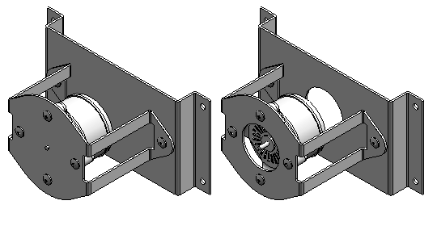
Activities
Activity: Assembly features

