Slide 1
Solid Edge ST4 Training Adjustable parts and assemblies

Slide 2
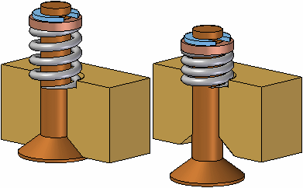
Adjustable Parts
In some designs, there are parts that must react to changing conditions in the assembly. For example, a spring that is compressed or uncompressed based on the position of other parts in the assembly.
The Adjustable Parts functionality in Solid Edge allows you to define parameters in a part model that will adjust with respect to corresponding parameters within the assembly. This allows you to control the size and shape of the part based on parameters you define in the assembly.

Slide 3
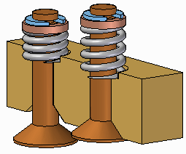
Adjustable Parts
When you specify that a part is adjustable, the design body in the part model does not change when the assembly parameters change. An associative copy of the design body in the assembly changes. The associative copy of the design body is placed in the assembly automatically and is managed by Solid Edge when you specify that a part is adjustable within the context of the assembly.
This allows you to place several occurrences of an adjustable part into an assembly, and each occurrence of the adjustable part will conform to the current parameter values for that occurrence of the part. For example, one occurrence of a spring can be shown compressed while another occurrence of the spring can be shown uncompressed.

Slide 4
Making a part adjustable
To make a part adjustable within the context of an assembly, you first must define the parameters you want to adjust in the part document. You can then define corresponding parameters in the Assembly environment.
You can use driving dimensions and variables that control a feature, reference plane, or construction element as the parameters to define an adjustable part.
When you specify that a part is adjustable, you cannot in-place activate the part using the Edit command. You can use the Open command to open the part.

Slide 5
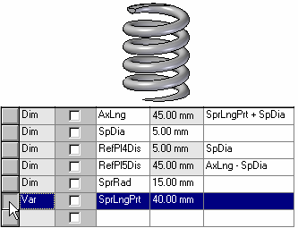
Defining the part parameters
The Adjustable Part command on the Tools tab in the Part or Sheet Metal environments displays the Adjustable Part dialog box so you can define or edit the adjustable parameters.
When the Adjustable Part dialog box is displayed, you can select features to display their dimensions, or you can click the Variable Table button on the Adjustable Part dialog box to display the variable table.
For example, to make the length of the spring shown adjustable, you can add the variable which controls spring length: SprLngPrt, to the adjustable parameters list by selecting the variable in the Variable Table.

Slide 6
Defining the part parameters
When you add a variable or dimension to the Adjustable Part dialog box, the parameter name is added to the Variable Name column (A). You can also add text to the Notes column (B) to make it easier to remember later what aspect of the part the adjustable parameter controls.

Slide 7
Placing adjustable parts in an assembly
When adding an adjustable part to an assembly, you should place and position the parts which interact with the adjustable part first. This allows you to use the surrounding parts to define the assembly parameters required to complete the process. You can specify whether an adjustable part is adjustable or rigid in the assembly when placing the part or after you position the part in the assembly.
When you drag and drop an adjustable part into an assembly, a dialog box is displayed that allows you to specify whether the part is rigid or adjustable.
When you set the Place Rigid option, the part placement process proceeds as it would for a typical part. You can then define assembly relationships to position the part in the assembly. An adjustable part placed as rigid in an assembly behaves the same as any other part in an assembly.
When you set the Place Adjustable option, the part placement process is temporarily suspended so you can define the adjustable parameters in the assembly using the Adjustable Part dialog box.

Slide 8
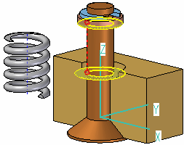
Defining the assembly parameters
Defining the assembly parameters
In addition to the options for selecting driving dimensions and variables, the Adjustable Part dialog box in the Assembly environment contains options that allow you to define a measurement variable. This allows you to use geometry on other parts in the assembly to define variables which will control the size and shape of the adjustable part in the assembly.
The measurement variable options activate one of the Measurement commands that are also available on Inspect→Measure. For example, you can use the Measure Minimum Distance option to specify that the minimum distance between the two faces shown controls the height parameter of the part.

Slide 9
Defining the assembly parameters
After you select the elements in the assembly that define the distance you want to measure, an assembly variable is created automatically and added to the Assembly Variable cell in the Adjustable Part dialog box for the adjustable part you are placing or editing.

Slide 10
Defining the assembly parameters
There are three columns in the Adjustable Part dialog box in the Assembly environment: Part Variable (A) Notes (B), and Assembly Variable (C). In this example, the part variable SprLngPrt is controlled by the measurement variable SprLngAsm in the assembly.
In addition to defining measurement variables, you can also use assembly relationship variables for an adjustable part. For example, you can use the offset value for a mate or planar align relationship as an assembly variable by selecting the variable value for the relationship in the Variable Table.

Slide 11
Defining the assembly parameters
The place like a spring option will use the variable created by measuring a distance to adjust the length of the corresponding variable in the part or sheet metal document. The position of the parts attached to the adjustable part determines the length of the variable defining the distance.
The adjust to fit and allow assembly relationships option will use the variable created by the measurement to change the length of the adjustable part, and reposition parts within the assembly that are not constrained. The length of the variable defining the adjustable part length is used to position the unconstrained parts connected to the adjustable part.

Slide 12
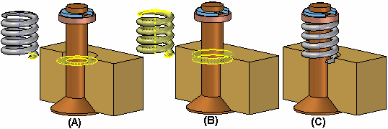
Defining the assembly parameters
After you have defined all the parameters in the assembly to control the adjustable part, click the OK button on the Adjustable Part dialog box to resume the part placement process. In this example, a mate relationship (A) and an axial align relationship (B) fully position the part in the assembly (C).
You can also specify that a part is adjustable after it has been positioned in the assembly. First, you must define the adjustable parameters for the part in the Part or Sheet Metal environment. Then, in the assembly, you can use the Adjustable Part command on the shortcut menu when a part is selected to specify that the part is adjustable and then define the adjustable parameters.

Slide 13
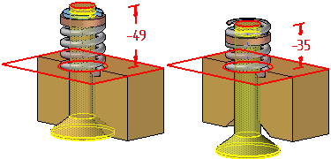
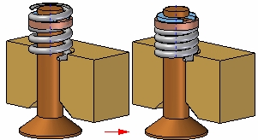
Updating adjustable parts
When you edit the assembly such that the adjustable part must change, the size and shape of the adjustable part updates automatically when the Automatic Update option is set. For example, in this assembly, if you edit the offset value for the planar align relationship between the valve and body parts, the valve opens.
This causes the size and shape of the adjustable part to update automatically.

Slide 14
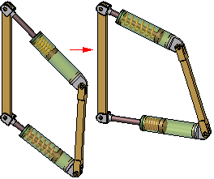
Adjustable parts in adjustable subassemblies
You can place a subassembly that contains an adjustable part into an assembly, then make the subassembly adjustable. For example, you may need to place two instances of a cylinder subassembly, with each subassembly in different positions.
Each cylinder assembly contains a spring that is an adjustable part, which allows the spring to change length as the cylinder subassemblies change positions.
When you make a subassembly adjustable that contains adjustable parts, the adjustable part variables are promoted to the current assembly.
For more information on creating and using adjustable assemblies, see the Adjustable assemblies Help topic.

Slide 15
Activity
Activity: Creating an adjustable part

Slide 16
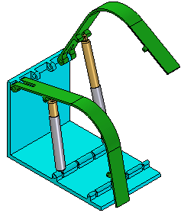
Adjustable and rigid assemblies
When working with assemblies, it is sometimes necessary to allow movement within a subassembly while working in a higher-level assembly. In other instances, it can be necessary to show identical subassemblies in different positions. For example, you can have two identical hydraulic cylinder subassemblies in an assembly, but need to show the hydraulic cylinders in different positions.

Slide 17
Comparing rigid and adjustable subassemblies
Specifying that a subassembly is adjustable allows you to place positioning relationships between parts in the subassembly while in the higher-level assembly. This is not possible with a rigid subassembly.
When you specify that a subassembly is adjustable, you are prevented from in-place activating the subassembly. For example, when you try to in-place activate the subassembly using the Edit command, a dialog box is displayed that informs you that the subassembly is adjustable and to use the Open command to open the subassembly.

Slide 18
Displaying identical subassemblies in different positions
There are several approaches to solving this problem:
You can create uniquely-named subassemblies for each of the otherwise identical subassemblies. This allows you to assign unique offset values to the affected relationships, but creates extra files and complicates data management.
You can create a single-level assembly where the subassembly components are placed as discrete parts, instead of as a subassembly. This also allows you to assign unique offset values to the affected relationships, but makes it more difficult to reuse the hydraulic cylinder components later in another assembly. Another disadvantage of this method is that the parts are listed individually, rather than as a subassembly.

Slide 19
Displaying identical subassemblies in different positions
Alternately, you can use the Adjustable Assembly functionality within Solid Edge. This approach eliminates the need to create multiple copies of the hydraulic cylinder subassembly data set or to create single-level assemblies.

Slide 20
Preparing the subassembly
To use the Adjustable Assembly functionality, the subassembly should be left under-constrained in the range of motion in which you want to adjust. This allows you to apply the relationship(s) that you want to adjust in the higher level assembly, not in the subassembly.

Slide 21
Placing the subassembly into the higher-level assembly
You place the subassembly into the higher-level assembly in the same manner as you would any subassembly. There are several methods available to specify that you want the subassembly to be considered an adjustable assembly.
To specify that the subassembly is considered adjustable while you are placing the subassembly, set the Place As Adjustable option on the Options dialog box on the Assemble command bar.
To specify that the subassembly is considered adjustable after you have completed positioning the subassembly, select the subassembly in PathFinder, then click the Adjustable Assembly command on the shortcut menu.
Note:
Only subassemblies that contain parts that are not fully positioned can be marked as adjustable.

Slide 22
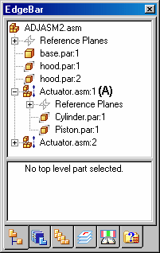
Placing the subassembly into the higher-level assembly
You can also specify that a subassembly is adjustable by setting the Place as Adjustable when this Assembly is Placed into Another Assembly option on the Assembly tab on the Options dialog box.
Regardless of the method used, a special symbol is used in PathFinder (A) to indicate the subassembly is adjustable.

Slide 23
Working with adjustable assemblies
When a subassembly is set to adjustable, all assembly relationships existing within the subassembly are solved at the level of the active assembly. In other words, the relationships in the subassembly are promoted to the higher-level assembly for solve purposes.
The relationships used to position the parts within the subassembly can be viewed in the bottom pane of PathFinder when you select a part in the subassembly. These relationships are read-only and the text label is gray to indicate that the relationship cannot be edited. Displaying the read-only relationships makes it easier to evaluate the existing relationships and apply the remaining relationships.

Slide 24
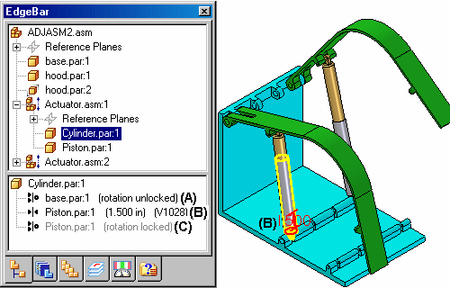
Working with adjustable assemblies
For example, when you select cylinder.par:1 in the adjustable assembly named Actuator.asm:1, three relationships are displayed. The axial align relationship to base.par (A) was placed in the current assembly. It was used to position the subassembly in the current assembly, and is editable.
The Mate relationship to piston.par:1 (B) was placed in the current assembly after the subassembly was made adjustable. Its purpose is to adjust the length of the hydraulic cylinder subassembly and the relationship is editable.
Notice that no visual distinction is made between relationships (A) and (B), although one of the relationships was used to position the subassembly in the current assembly (A), and the other was used to position the two parts in the subassembly.

Slide 25
Working with adjustable assemblies
The remaining axial align relationship to piston.par:1 (C) was placed in the subassembly, is read-only and not editable within the current assembly. Notice that the text label is gray, indicating that the relationship is read-only.
If you specify that a subassembly is flexible, add positioning relationships, and then specify that the subassembly is rigid, conflicting relationships can occur. You can delete or suppress relationships to correct this situation.

Slide 26
Adjustable assemblies and adjustable parts
You can create assemblies that contain adjustable parts within an adjustable subassembly. For example, you may need to place two instances of a cylinder subassembly, with each subassembly in different positions.
Each cylinder assembly contains a spring that is an adjustable part, which allows the spring to change length as the cylinder subassemblies change positions.

Slide 27
Activity
Activity: Creating an adjustable assembly

