Slide 1
Solid Edge ST4 Training Virtual components in assemblies

Slide 2
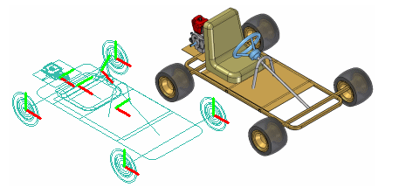
Creating and publishing Virtual Components
You can use the Virtual Component functionality in Solid Edge or in Teamcenter to define the assembly structure for a new design project.
When you have finished defining the assembly structure, you can publish the assembly. Publishing the assembly creates the new Solid Edge documents required, copies assembly sketch geometry to the new documents, and adds the 3D geometry for existing Solid Edge documents to the assembly.

Slide 3
Virtual components in Solid Edge
The basic workflow for creating and publishing a virtual assembly in the unmanaged Solid Edge environment is:
Define the virtual components you need.
Add existing documents to the virtual assembly structure.
Assign 2D geometry to individual virtual components.
Position virtual components.
Publish virtual components.

Slide 4
Defining the assembly structure
The Virtual Component Structure Editor command defines the assembly structure for a new design project in an unmanaged environment. When you click the Virtual Component Structure Editor command, the Virtual Component Structure Editor dialog box is displayed.
The Virtual Component Structure Editor defines the name and document type for new virtual components, and allows you to drag any existing Solid Edge documents into the virtual assembly structure.

Slide 5
Defining new virtual components
You use the right pane on the Virtual Component Structure Editor to define virtual components and organize the assembly structure. The Component Type options on the right pane of the Virtual Component Structure Editor define the document type for new virtual components:
Assembly components
Part components
Sheet metal components
The Name option assigns a name to the virtual component you are creating. You can select a default name from the list, or type the name you want in the Name box.

Slide 6
Adding existing documents to the virtual structure
You can also place existing Solid Edge documents into the assembly structure using the Virtual Component Structure Editor dialog box.
The left pane on the Virtual Component Structure Editor dialog box browses to and selects existing documents on your computer or another computer on your network. If you are working in Teamcenter mode, you can select existing documents from your Teamcenter database.
You can place an existing document into the virtual assembly structure in one of two ways: as a pre-defined component or as a real component.

Slide 7
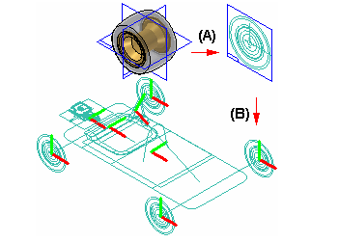
Pre-defined components
Pre-defined components are virtual components that are based on an existing document. You cannot place 3D geometry using a pre-defined component, but you can create 2D geometry in the parent document (A), then position the 2D geometry in the assembly sketch (B). You can reuse existing documents in new design projects without the overhead of 3D geometry.

Slide 8
Pre-defined components
When you clear the Add As Real Component option on the Virtual Component Structure Editor, then drag an existing component into the right pane of the structure editor, the component is placed as a pre-defined component. If you want to add the document to a virtual subassembly, position the cursor over the virtual subassembly when dropping the pre-defined component.
Pre-defined components are typically purchased or released parts that are not subject to significant changes.

Slide 9
Adding real components
When you set the Add As Real Component option on the Virtual Component Structure Editor before you drag an existing document into the virtual assembly structure, the 3D geometry associated with the component is added to the assembly. When this option is set you can only place the component in the top-level assembly.
The component is placed in the assembly hidden, with no relationships applied, and is oriented in the assembly by aligning the base reference planes of the component with the base reference planes in the assembly.
You can position the real component within the assembly sketch using assembly relationships such as mate and align, or 2D relationships and dimensions such as Connect and Distance Between.

Slide 10
Saving the tree structure
When you click the OK button on the Virtual Component Structure Editor dialog box, the virtual assembly structure you defined is added to the PathFinder tab. You can make changes to the virtual assembly structure later using the Virtual Component Structure Editor dialog box.
You can dismiss the Virtual Component Structure Editor dialog box without saving changes by clicking the Cancel button.

Slide 11
Assigning sketch geometry to Virtual Components
You can assign 2D sketch geometry from the assembly layout to a virtual component. You can create the 2D geometry before or after you define the assembly structure.
Assigning geometry to a virtual component defines its size and position in the assembly sketch. You can only assign geometry to one occurrence of a particular virtual component.
When you assign 2D geometry to a virtual component, it becomes the master, or source component. You can edit the sketch geometry associated with the source component directly. If there are additional occurrences of a particular virtual component, they become slave or instance components.

Slide 12
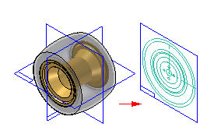
Creating sketch geometry for pre-defined Virtual Components
You create the sketch geometry for a pre-defined virtual component by opening the parent document, then using the Component Sketch command to create a component sketch.
There are two types of graphics you can create in a component sketch: component image graphics, and wireframe graphics. Component image graphics are created using the Component Image command. This command creates a 2D representation of the visible edges on a part.
Component image graphics are not individually selectable in the assembly sketch, but provide a reference envelope.

Slide 13
Positioning Virtual Components
You use the Position Virtual Component command on the PathFinder shortcut menu to position virtual components. This command is only available when you are editing an assembly sketch. You can position an empty virtual component (a virtual component that has no geometry assigned), an instance virtual component, or a pre-defined component.
You can position a virtual component by dragging it from the PathFinder tab and dropping it into the sketch window.
As discussed earlier, source virtual components are positioned as part of the process of assigning geometry.

Slide 14
Publishing Virtual Components
When you are ready to create the document set for the new design project, you can click the Publish Virtual Components command. You can then use the Publish Virtual Components dialog box to specify the target folder and template you want to use to create the document set.
In an unmanaged Solid Edge environment, when you click Publish, all virtual components are published at one time. The unmanaged Solid Edge documents are created using the names, folder path, and templates you specified.
If you have associated 2D assembly sketch graphics with source virtual components, the sketch graphics, including dimensions and relationships, are copied to the proper document as sketches. The sketch graphics are positioned in the new document using the Publish On option you specified on the Edit Definition command bar when you assigned the sketch geometry to the source component.

Slide 15
Publishing Virtual Components
There is no associative link between the sketch graphics in the original assembly and the sketch graphics copied to the new documents.
The sketch graphics associated with instance virtual components are deleted from the source assembly.

Slide 16
Activity
Activity: Virtual component editor

