Slide 1
Solid Edge ST4 Training Rendering assemblies

Slide 2
Rendering assemblies
Course overview
The Explode-Render-Animate application within the Solid Edge assembly environment is a tool for creating different types of presentations of Solid Edge assemblies. Exploding an assembly allows you to control the movement, sequence and grouping of parts and subassemblies. Rendering a view allows you to define textures, lighting, shadows, backgrounds and other properties to create presentation style images. Motors apply movement to under constrained parts in an assembly which can be animated. Using Animation, you can combine previously created exploding sequences and custom camera movement to create animation. Each frame of the animation can be rendered to create presentation quality animations.

Slide 3
Explode-Render-Animate
Course overview (continued)
Once you complete the activities in this course, you will be able to:
Assign material properties and textures to parts and subassemblies.
Set viewing properties to change lighting, backgrounds, shadows, reflections, refractions and perspectives.
Edit material properties to create different results in the final rendering.

Slide 4
Explode-Render-Animate
Entering the Explode-Render-Animate environment (ERA)
To enter the ERA environment, within an assembly, click the Tools Tab. In the Environs group, click ERA.

Slide 5
Rendering
Supported advanced rendering entities:
Advanced rendering provides rendering support for these entities:
Backgrounds
Foregrounds
Materials
Environments
Lighting Studios
Render Mode
Scenery

Slide 6
Rendering
Activating advanced rendering
Advanced rendering is activated automatically when you click the Render Scene and Render Area. When you click these commands, two new tabs are added to PathFinder automatically.
The sessions entity tab
The predefined archives tab

Slide 7
Rendering
Session entities tab
The Session Entities tab displays the name of the active assembly, along with a tree structure that shows you the entities that are applied to the assembly. You can right-click an entity to display a shortcut menu to:
Edit the properties of an entity as the basis for creating a new entity.
Detach (remove) a material that you have applied to the model.
Cut, copy, and paste an entity.
Rename an entity you created.

Slide 8
Rendering
Predefined archives tab
The Predefined Archives tab displays a list of folders that contain predefined entities, such as backgrounds, foregrounds, and materials. You can right-click an entity to display a shortcut menu to:
Create a new archive folder or advanced rendering entity.
Apply an entity to the model.
Cut, copy, and paste an entity.
Rename an entity you created.
A toolbar on the Predefined Archives page contains commands used to create, save, open, close, and import customized entities in user-defined archive folders.

Slide 9
Rendering
Adding a user defined entity to the predefined archives
Any material, color, background, light, or scene that you want to customize needs to be applied to the assembly first, and then modified within the Session Entities tab to look the way you want it to. When you have adjusted the parameters of an entity so that it looks good on the model, you then copy the entity from the Session Entities page to a user-defined entity archive on the Predefined Archives page on PathFinder.

Slide 10
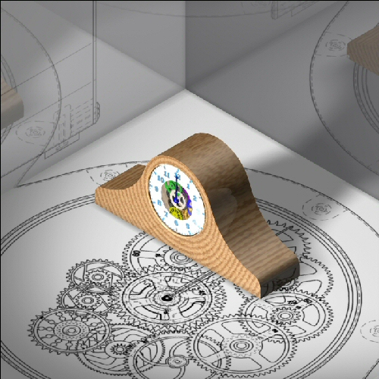
Activity
Activity – Rendering

