Slide 1
Solid Edge ST4 Training XpresRoute (tubing)

Slide 2
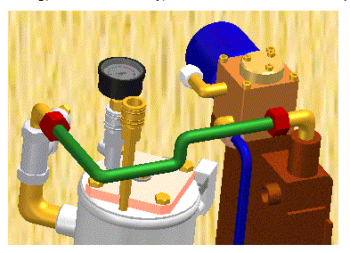
Introduction
You can use XpresRoute to create path segments and tubes in an assembly. To access the commands for tubing, while in Assembly, choose Tools→Environs→XpresRoute .
Tube parts are designed in the context of an assembly, so you to directly model them within an assembly, using existing part and assembly geometry to ensure accurate fit and function. Tube parts are fully associative and update with the parts to which they are connected. Tube wire parts are directed parts. They conform to the path segment and the options you use to construct the part. When you make changes to the assembly that cause the path to change, the part will also change.

Slide 3
Tube design workflow
Tube design workflow:
Create a path
Use the PathXpres command to automatically create a 3D path for the tube.
To learn how, see Create a tube path with PathXpres.
Use the Line Segment or Arc Segment command to manually draw the path for the tube.
Create the tube
Use the Tube command to assign pipe attributes and fittings to a path segment that defines the route the pipe should follow.

Slide 4
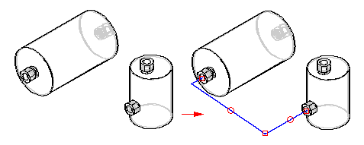
Creating the path with PathXpres
Tubes and Pipes are created along a path segment. You can use the PathXpres command in XpresRoute to create the path without manually drawing the individual lines of the path or you can use the Line Segment command or Arc Segment command to manually draw the path.
Use the PathXpres command to create a 3D path for a tube or pipe without having to manually draw the individual lines of the path. PathXpres generates a path between two points that is orthogonal to the default reference planes. These points must be circular or elliptical element, the endpoint of a segment, or the endpoint of a sketch element.

Slide 5
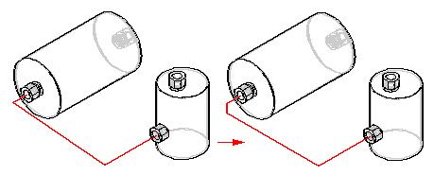
Creating the path with PathXpres
In cases where more than one way for the path exists, you can use the Next and Previous button on the PathXpres command bar to display alternative paths. The order of the paths goes from the simplest path, with the least number of segments, to the most complex path. The maximum number of segments in a path that PathXpres generates is five.

Slide 6
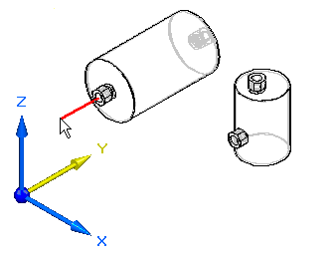
OrientXpres tool
You use the OrientXpres tool to assist you in drawing lines and arcs in 3D space when drawing a path manually. As you draw the line or arc segments, use OrientXpres to lock the orientation of the element parallel to an axis or plane as you draw it. For example, after you define the start point for a line segment, you can use OrientXpres to lock the orientation to the y axis.

Slide 7
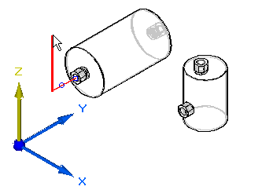
OrientXpres tool
When you click to define the second point for the line, you can then use OrientXpres to lock the orientation to the z axis.

Slide 8
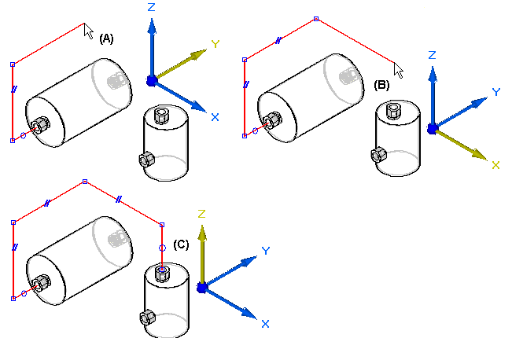
OrientXpres tool
You can continue to lock the axis or plane to assist you in defining the path (A), (B), (C).

Slide 9
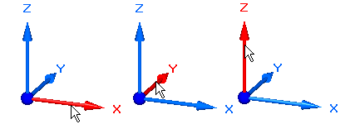
OrientXpres tool
The OrientXpres tool is an interactive design aid for drawing lines, arcs, and curves in 3D space, and for editing the position of bluedots in 3D space. OrientXpres is displayed automatically when creating or editing elements which require its capabilities. For example, OrientXpres is displayed when drawing line segments in the XpresRoute and Frame applications, and when editing bluedots in the Part and Sheet Metal environments.
When working in 3D space, you often need to restrict the placement or movement of elements to be parallel to a particular axis or plane. The OrientXpres tool provides that capability. You can do the following using OrientXpres:
To restrict movement parallel to an axis, select one of the three axes (X, Y, or Z). You can also cycle through the axes by typing Z key on the keyboard.

Slide 10
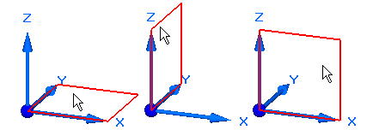
OrientXpres tool
To restrict movement parallel to a plane, select one of the three planes (XY, YZ, or XZ). You can also cycle through the planes by typing X key on the keyboard.
To move the OrientXpres tool to a more convenient location, select the origin, and drag it to a new location.

Slide 11
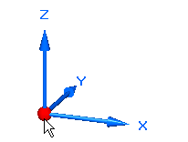
OrientXpres tool
You can type C key on the keyboard to clear any locks to planes or axes.

Slide 12
Modifying path segments
There are four types of geometric relationships for tube parts:
Connect relationships
Coaxial relationships
Parallel relationships
Tangent relationship
The PathFinder tab displays the tube path segment relationships.
You can delete any relationship by deleting its handle in the graphic window or deleting the relationship in PathFinder.
Path segments can be dimensioned to control size and the move command will allow them to be modified if a position adjustment needs to be made.

Slide 13
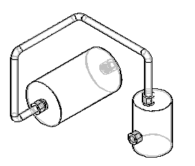
Creating the tube
Once you have drawn a tube path, use the Tube command to create a tube along the path segment. With the Tube command you can select a single segment or a chain of segments as the tube path. You can also define tube extents to both ends of the tube path.
When creating a tube part, you can use the Tube Options dialog box to define parameters such as material, outside diameter, bend radius, and wall thickness for the part. To access the Tube Options dialog box, click the Tube Options button on the Tube command bar.

Slide 14
Generating tube information
You can use tube properties to extract information to create such reports as bend tables, tube reports, and parts lists.
Outputting bend information
You can use the Bend Table command to create an ASCII text file that contains information about how to manufacture the tube. You can output the tubes as a select set or output them all at once. The information consists of columns of data such as feed length, rotation angle, bend radius, and bend angle.
Creating tube reports and parts list
You can include tube properties defined on the Tube Options dialog box in reports or parts lists. When you create a tube file, these tube properties are automatically stored in the tube file and are exposed so that they can be included in reports and parts lists.

Slide 15
Activity
Activity: Placing tubes in assembly with XpresRoute

