Slide 1
Solid Edge ST5 Instructor-Led Training Fundamentals

Slide 2
Lessons
Sketching
Constructing base features
Moving and rotating faces
Working with face relationships
Constructing treatment features
Constructing procedural features
Modeling synchronous and ordered features
Modeling assemblies
Creating detailed drawings
Practicing your skills with projects

Slide 3
Sketching

Slide 4
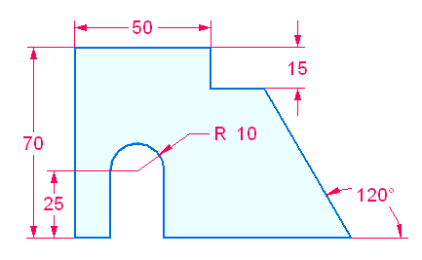
3D Sketching Overview
Sketch workflow
Activity: Draw a simple sketch

Slide 5
Locking the sketch plane
Automatic plane locking
Manual plane locking
Using the lock icon to lock or unlock a sketch plane
Using the F3 function key to lock a plane

Slide 6
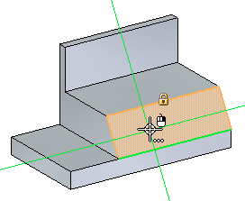
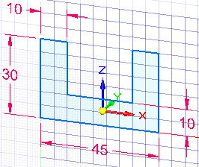
Drawing synchronous sketches
Lock to a face or plane to draw sketch
Alignment lines
Using a grid

Slide 7
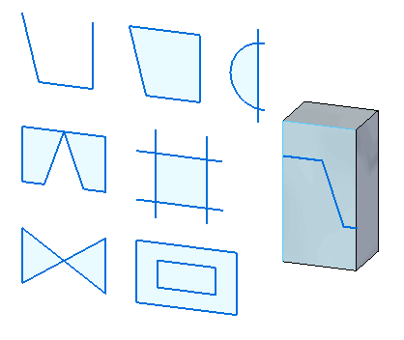
Drawing synchronous sketches
regions
Activity: Create regions

Slide 8
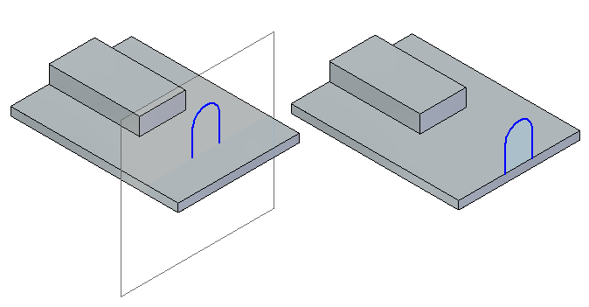
Drawing synchronous sketches
open sketches

Slide 9
Synchronous sketch behavior in the ordered environment
Synchronous sketch dimensions are not migrated to ordered features.
Synchronous sketches are not consumed when creating an ordered feature.
Synchronous sketches can drive ordered features.
Synchronous sketches appear while in the ordered environment.
Regions are disabled.
Synchronous sketches appear in the synchronous sketch style and colors.
When using the Select Tool in the ordered environment, synchronous sketch elements locate as individual elements.
Synchronous sketches can be moved using the steering wheel handle. The entire sketch moves (not single elements).
In the ordered environment, synchronous sketch geometry or relationships commands are not available.
Synchronous and ordered sketches cannot be copied while in ordered environment.
Manual plane locking
Using the lock icon to lock or unlock a sketch plane
Using the F3 function key to lock a plane

Slide 10
Drawing ordered sketches
Workflow
Choose the sketch command.
Select a reference plane or part face as the sketch plane.
Automatically enter the sketch environment.
Draw sketch elements.
Add sketch geometric relationships and functional variables.
Add sketch dimensions.
Close the sketch environment.

Slide 11
Drawing 2D elements
Overview
Intent zones
Construction geometry
Modifying sketch elements
Applying colors and patterns to closed sketch boundaries

Slide 12
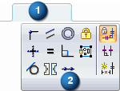
Geometric relationships
The sketch relationship commands are located on the Sketching tab (1) in the Relate group (2).
Note: When creating a synchronous feature, the sketch relationships do not migrate to the feature created from them.
Relationships

Slide 13
Drawing tools
Working with grids
IntelliSketch
Projection lines
Distance and area measurements in sketches

Slide 14
Dimensioning sketches
Dimensioning commands are located in three locations. They are located in the Dimension group on the Home, Sketching and PMI tabs.
Locked dimensions
Dimension orientation
Dimension style

Slide 15
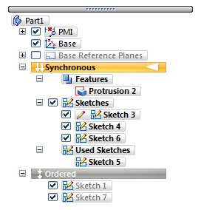
Sketches in PathFinder
Sketches context menu in PathFinder
Used Sketches context menu in PathFinder

Slide 16
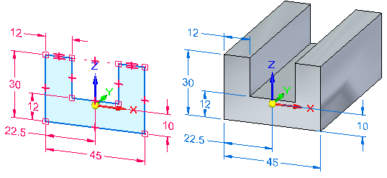
Sketch consumption and dimension migration
Working with combinable sketches

Slide 17
Manipulating sketches
Moving and copying sketches
Projecting elements to a sketch

Slide 18
Sketching activities
(3) Instructional activities
(5) Creating a sketch from a dimensioned drawing

Slide 19
Constructing base features

Slide 20
What is a base feature?
When constructing a 3D model in Solid Edge, it is helpful to evaluate the basic shape of the part, and develop a plan as to how you want to construct the model. The part’s overall shape can be captured in the very first feature, called the base feature.

Slide 21
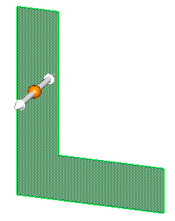
Creation methods
Once a region exists, two workflows are available for creating a base feature.
Selection workflow
Select a region.
Click the extrude handle to create a solid from the sketch region.
Creation workflow
Choose the Extrude command.
Select the sketch region to define the feature.

Slide 22
Base feature creation workflow
Extrude a region
Revolve a region

Slide 23
Constructing synchronous features using select tool
Extruded features
Extent options
Activity: Create a base extruded synchronous feature
Revolved features
Activity: Create a base revolved synchronous feature
Activity: Remove material from a base feature
Activity: Add material to a base feature

Slide 24
Using the feature construction commands
Workflow
Command bar

Slide 25
Model dimensions
Dimensioning the model
Editing model dimensions
Activity: Dimension a model
Sketch consumption and dimension migration

Slide 26
Coordinate systems
Base coordinate system
User-defined coordinate system
Activity: Model with a coordinate system

Slide 27
Additional information
Working with user-defined sets
Part modeling: Tips for getting started

Slide 28
Moving and rotating faces

Slide 29
Overview
A synchronous solid model is defined as a set of connected facial topology that encompasses a volume. A synchronous solid model is modified by manipulating the facial topology.
In this course, you will learn to modify a synchronous model by moving and rotating facial topology.

Slide 30
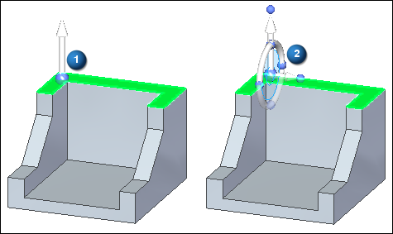
Moving synchronous faces
When a synchronous face or reference plane is selected, a default graphic handle (1) appears at the select point. If the handle origin is selected, a different graphic handle (2) appears with more move options. Click the primary axis, secondary axis, or torus to start the Move command.

Slide 31
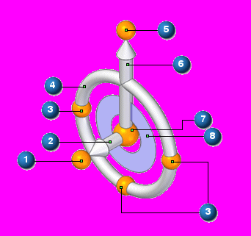
Graphic handle (3D steering wheel)
(1) secondary knob
(2) secondary axis
(3) cardinal points
(4) torus
(5) primary knob
(6) primary axis
(7) origin
(8) tool plane

Slide 32
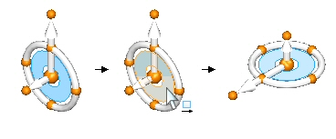
Reorient the steering wheel
Swap the primary and secondary axes
Change the direction of the primary axis at 90° increments
Change the direction of the primary axis at a user-defined angle
Change the direction of the primary axis using a geometric keypoint
Change the direction of the secondary axis
Change the secondary axis direction at a user-defined angle
Maintain a steering wheel orientation at a different location
Activity: Reorient the steering wheel

Slide 33
Moving a face
You can move a face in the following ways:
Move a face in a direction along the primary axis or secondary axis by selecting either axis.
Move a face freely along a plane where the graphic handle is connected by clicking the plane on the handle.
Set the direction of the primary axis by dragging the handle origin to an edge or vertex. The primary knob also locks onto the edge to define the direction.
Reposition the primary knob to change the direction of the primary axis.
Reposition the secondary axis direction in 90° increments by selecting one of three cardinal points.
The origin is the move from point. The origin can be moved prior to a move.

Slide 34
Rotating a face
Rotate a face by positioning the steering wheel secondary axis on an edge. The secondary axis becomes the axis of revolution.
Select the torus to begin dynamic rotation or type a rotation angle in the dynamic input box.

Slide 35
Move face workflow
Single face move
Using the Select tool, select a face. The 3D steering wheel appears on the selected face. Initially you get the primary axis only. Click the 3D steering wheel origin to display entire steering wheel.
Command bar appears with the available operations that can be performed on the selected face. Move is the default operation and thus does not need to be selected.
Click the primary axis on the handle to move the face in or out in a direction normal to the face.
Define the move to location by one of the following methods:
Dynamically drag the face to a new location and then click.
Click a keypoint location. Choose the keypoint type on the Move command bar drop list.
Type in a ± distance in the dynamic input box.
Press Esc key to end move.

Slide 36
Move face workflow
Single face rotate
Using the Select tool, select a face. The 3D steering wheel is displayed on the selected face. Initially you get the primary axis only. Click the 3D steering wheel origin to display entire steering wheel.
Click and drag the origin of the steering wheel to an edge to rotate about.
Make sure the secondary axis of the steering wheel lies on the edge to rotate about. Click and drag the secondary knob to position if necessary.
Click the torus on the handle to rotate the face. Dynamically rotate the face by moving the cursor or by typing in a ± angle in the dynamic edit input box.
Press Esc key to end rotate.

Slide 37
Move face activities
Activity: Move and rotate faces
Activity: Copying a face and using keypoints to define movement

Slide 38
Selecting faces
Select faces using the Select tool.
A collection of selected faces to perform an action on is referred to as a select set.
Face selection methods
Select and deselect faces manually (one face at a time).
Select and deselect faces with the assistance of a selection manager.
The selection manager uses the topological and attribute data of the face selected to add faces to a select set.

Slide 39
Selection mode
A selection mode symbol is located next to the cursor.
Press the spacebar to change the select mode.
The select mode selection is also available on the Home tab in the Selection group.

Slide 40
Selection mode
normal mode
Normal mode is the default selection mode.
Normal mode is a single selection.
Select a face and the steering wheel displays on that face.
Select another face and the steering wheel moves to that face.
The face previously selected is deselected.
Only one face selected per click.

Slide 41
Selection mode
add/remove mode
The add/remove selection mode is used to build a select set.
In the normal mode, select a face and then press the spacebar to switch to the add/remove mode.
Each face selected in this mode is added to the select set.
If a face is selected that has already been selected, it is deselected.
The graphic handle remains on the first face selected.
Both selected and unselected faces highlight as the cursor moves over them.

Slide 42
Selection mode
add mode
The add mode only adds faces to the select set.
Only unselected faces highlight as the cursor moves over faces.
To set the mode to add, cycle through the select modes by pressing spacebar.

Slide 43
Selection mode
remove mode
The remove mode only removes (deselects) faces from the select set.
Only selected faces highlight as the cursor moves over faces.
To set the mode to remove, cycle through the select modes by pressing spacebar.

Slide 44
Selection mode
Selection Manager mode
The selection manager icon attaches to the cursor.
Move cursor over a face and click to display the Selection Manager menu.

Slide 45
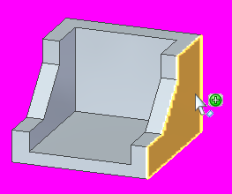
Selection manager
Use Selection Manager to add or remove items from a select set using the topological and attribute data of a selected object.

Slide 46
Selection manager
In Selection Manager mode, clicking on a face displays the Selection Manager menu.
The topological relations relate only to the face selected.
The topological relations listed in the Select Manager menu are determined by the type of face selected (planar, non-planar, cylindrical, partial cylindrical).
You can also switch to a Selection Manager mode. On the Home tab, in the Select group, in the Select drop list, choose the Select Manager Mode command .

Slide 47
Selection manager
You can also start the Select Manager mode by pressing Shift + Spacebar.
When in this mode Select Manager is active.
Click on a face in the select set to display the select manager.
To end the Select Manager mode, press the Spacebar.

Slide 48
Selection manager
Selection manager options
Select tool menu
Activity: Using the Selection Manager
Activity: Modifying a part by moving select sets

Slide 49
Command bar options for moving faces
You can control the results of the Move command with options that control the interaction of the select set and the rest of the model.
By setting these options, the resultant transformation can be altered within the command.
The options are Connected faces, Copy, Detach, and Precedence.

Slide 50
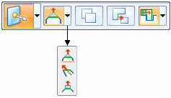
Connected face options
Extend/Trim
Default option. Selected face moves by extending and trimming the adjacent faces.
Tip
Selected face is rigid. Adjacent faces change to meet the movement of the rigid selected face.
Lift
Selected face is rigid. Adjacent connected faces are not affected. The selected face moves in a direction normal to the face to either add or remove material.

Slide 51
Copy
The copy option creates a copy of the faces in the select set.
The faces are collected into a face set feature.
The face set feature can be moved or rotated.
This option is similar to a copy and paste operation.
The original selected faces are unchanged.
Activity: Copying and attaching a feature (method 1)
Activity: Copying and attaching a feature (method 2)
Activity: Copying, rotating, and attaching a feature to a new location

Slide 52
Detach
The detach option removes the select set from the part body.
The removed select set can be moved or rotated.
This option is similar to a cut and paste operation.
Activity: Detaching and attaching a feature

Slide 53
Precedence
The precedence option is used to set which face(s) have priority during a synchronous move operation.
Select Set Priority Selected and other moving faces have priority over non-moving faces.
Model Priority Non-moving faces have priority over moving faces.

Slide 54
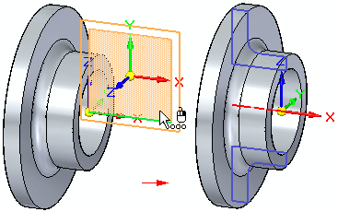
Working with Live Sections
You use the Live Section command to create a 2D cross-section on a plane through a 3D part. For example, you can select one of the principal planes on the base coordinate system as the plane for a live section.

Slide 55
Working with Live Sections
Creating live sections
Editing live sections
Editing 2D elements in a live section to modify the 3D model
Editing the entire live section
Displaying live sections
Model editing and live section update
Live sections in an assembly
Activity: Live Section

Slide 56
Working with face relationships

Slide 57
Face relationships overview
When modeling synchronous features, you have control over the solve behavior of a model or an assembly during face editing. The control is achieved through relationships between faces. Face relationships are inherited from sketch elements used to create the faces of a body feature. Face relationships are also applied using the Face Relate commands. Relationships applied with the Face Relate commands are temporary by default. If a relationship is to be permanent, the user can set the applied relationship to a Persist state. The Persist must be applied during the command.

Slide 58
Face relationships overview
Relationships are assigned to faces. During a face move, Live Rules considers found relationships, persistent relationships and locked dimensions in the model. Live Rules allows you to control any or all of these during the operation. Found relationships are applied based on the geometric state of the model when the edit is being performed and on the Live Rules settings. Live Rules settings allow you to control what you want to look for.

Slide 59
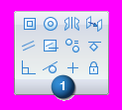
Creating face relationships
Use the relationship commands in the Face Relate Group (1) to apply face relationships to selected faces.
The relationship commands define how faces are related to each other.
You select a face to relate (seed face) and then select a face to relate to (target face).
The relationship is temporary by default. However, the relationship can be set to permanent (persist).
Default and persisted relationships detected can be ignored by the system during a solve of a geometric change.

Slide 60
Relationship commands options
This example is the Coplanar Relationship command bar.

Slide 61
Relationship commands options
Understanding seed and target faces
Seed face
The seed face refers to the initial face selected.
The seed face is the face to be related.
The seed face position changes.
The steering wheel locks onto the seed face.
More faces can be related simultaneously by adding the faces to a select set. The seed face definition remains.

Slide 62
Relationship commands options
Understanding seed and target faces
Target face
The target face defines the relationship to be applied to the seed face.
The target face does not change during the relate command.
There can only be one target face.

Slide 63
Relationship commands options (Persist)
Face relationships applied are temporary by default.
These relationships are ignored if that specific relationship is not turned on in Live Rules.
The Persist option is located on the Face Relationship command bar.
A persistent relationship is always detected by the system during a synchronous command.
Persistent relationships are stored in the Relationships collector in PathFinder.

Slide 64
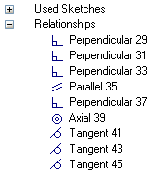
Relate options (Persist)
A persistent relationship can be deleted using the relationships context menu in PathFinder.
A persistent relationship on a face in a select set can be turned off in Live Rules.

Slide 65
Relationship command options
Accept or cancel
If the desired relationship results are achieved, click Accept. The face relationship command ends but the select set is still active.
If the desired relationship results are not achieved, click Cancel. The face relationship command ends but the select set is still active.

Slide 66
Face relationship options
Single/All face alignment
Single Align Only the seed face is related to the target face. The remaining faces in the select set maintain their original relationship with the seed face.
Multiple Align All faces in the select set relate to the target face.

Slide 67
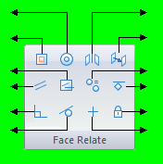
Relationships
concentric
symmetry
coplanar
offset
coplanar axis
equal radius
parallel
ground
perpendicular
rigid
tangent
horizontal/vertical

Slide 68
Workflow for relating faces
Select a face (seed) or a select set (a seed face with additional faces).
One Home tab → Face Relate group, choose a relationship command.
At this point, you can select a target face, which uses the default option settings. You can select other options at any time during the command.

Slide 69
Workflow for relating faces
If more than one face is in the select set, click the Multiple Align option.
Select the target face (face for the seed to be related to).
If the relationship is to be permanent, click Persist.
If the desired result is not achieved, click Cancel. The select set remains and the relationship command can be started again.
If the desired result is achieved, click the Accept button to apply the relationship.

Slide 70
Relationships activities
Activity: Relating a single face with a rigid select set
Activity: Relating faces using parallel, coplanar, perpendicular and concentric relationships
Activity: Relating all faces in a select set
Activity: Coplanar axis hole alignment
Activity: Coplanar axis alignment using a custom axis

Slide 71
Live Rules
The user can control which face relationships Solid Edge detects during a synchronous face(s) move. Live Rules is the tool used to set the face relationships to detect. Live Rules appears in the document window when a part face is selected.
Live Rules is a global setting. If a change is made to the default settings, opening a new or existing file will use these settings. The Restore Defaults button returns the default settings to the system delivered settings.

Slide 72
Working with Live Rules
Restore default rules
Option to restore the system delivered Live Rules. Live Rules maintains the current settings while a Solid Edge session is running. When a Solid Edge is closed, the Live Rules return to the default settings.

Slide 73
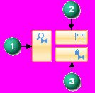
Working with Live Rules
Suspend relationships You can Suspend relationships detected for the current edit operation.
Suspend options for relationship categories are on the Live Rules panel. When making a synchronous edit, the solution honors these options. You can suspend:
(1) Live Rule relationships.
(2) Locked dimensions.
(3) Persisted relationships.
When you suspend a relationship category, the button changes as shown.

Slide 74
Working with Live Rules
Additional options
Reference Planes (1) Consider reference planes when applying Live Rules.
Sketch Planes( 2) Consider sketch planes when applying Live Rules.
Coordinate Systems (3) Consider coordinate system planes and axes when applying Live Rules.

Slide 75
Working with Live Rules
Detect local symmetry
Option to detect a local symmetry plane. You are prompted to select a local symmetry plane to be used for symmetric face detection.
Activity: Detecting symmetry relationships
Activity: Applying a symmetric about relationship

Slide 76
Detected face relationships
Overview
Face relationships are detected during a synchronous face move.
During a synchronous face move, the system is instructed to detect relationships turned on in Live Rules and also persistent relationships.

Slide 77
Solution Manager overview
Synchronous models use face relationships to control the model behavior during an edit. These face relationships include:
Found Relationships the system finds at the instance of a synchronous edit. These relationships are found if the relationship type is turned on in Live Rules.
Persisted User applied relationships that are permanent and are maintained during a synchronous edit.
PMI Locked dimensional relationships.

Slide 78
Solution Manager overview
It is possible that a synchronous edit could fail due to an over constrained condition. It is also possible for a synchronous edit be successful but produce unexpected or unwanted results.
Solution Manager provides detail and actions regarding the faces participating in the solution of a synchronous edit. Solution Manager is a tool that graphically interacts with the model to provide control of all relationships relevant to the current solve.
Solution Manager is an optional step during synchronous move or edit operations.

Slide 79
Solution Manager
When in Solution Manager mode:
Relevant faces change color to represent their role in the solution.
Click on a face to switch between relationships.
Right-click a face for access to all relationships to the face.
Click a locked dimension to relax the constraint. The dimension returns to a locked state after making an edit.

Slide 80
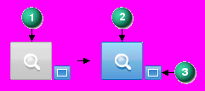
Solution Manager options
The Solution Manager options are located on the Live Rules panel. During a synchronous edit, the Solution Manager button (1) changes from inactive to active (2). The Auto-Solution Manager button (3) is off by default.
When Auto-Solution Manager is turned on, synchronous edits automatically start the Solution Manager.

Slide 81
Solution Manager options
If there are no failures and you are satisfied with the solution, you complete the edit and then click the check box (4) to accept the results.
If the solution produces unwanted results or a failed condition, you click the Solution Manager button to make changes to the solving face relationships. You can also press the V key to start Solution Manager.
When Auto-Solution Manager (3) is turned off, you must manually start the Solution Manager.

Slide 82
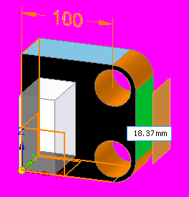
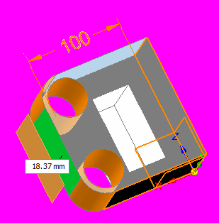
Solution Manager
Model display

Slide 83
Solution Manager
Managing face relationships in Solution Manager
In Solution Manager mode, only faces that are relevant to the solution display in color. The nonparticipating faces display transparent. Right-clicking a colored face displays a relationship palette listing all relationships to the face.

Slide 84
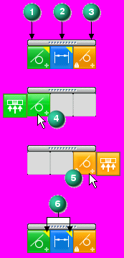
Solution Manager
Relationship palette
Columns
Found relationships (1). These are the detected relationships that are turned on in Live Rules.
Dimensional constraints (2)
Persisted relationships (3)
Hovering over a relationship on the palette (4, 5) exposes a fly out option. Use the fly out option to turn off all similar relationships to other faces.
The yellow triangle (6) on a relationship denotes that the relationship contributes to a failed solution.

Slide 85
Solution Manager workflow
Select a face to edit.
Click the primary axis on the steering wheel to start a synchronous edit operation. (Two solution conditions are possible (success or failure). You can use the Solution Manager in both conditions.)
Start Solution Manager by pressing the V key or by clicking the Solution Manager button on the Live Rules panel. (If Auto-Solution Manager is turned on, Solution Manager starts when you click to define a move distance.)
While in Solution Manager mode, you graphically interact with the face relationships involved in the edit. You resolve over constrained relationships in failed conditions. You change relationships in a successful condition to produce the intended solution.
When the synchronous edit is complete and no failed condition exists, you click the check box. This exits the Solution manager mode.

Slide 86
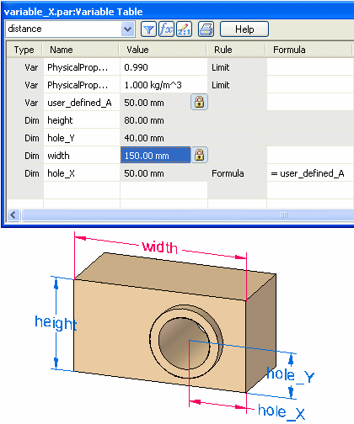
Using variables
Activity: Using the variable table

Slide 87
Constructing treatment features

Slide 88
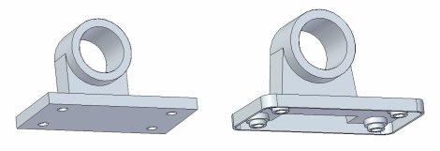
Treatment features
Treatment features are those which affect a model’s existing edges or faces. You construct treatment features by applying face and edge treatments, such as drafts, rounds, and thin wall to the part.
Treatment feature types within Solid Edge
A round feature applies a constant radius to one or more part edges.
A blend feature applies a variable radius to one or more part edges or blends between two faces.
A draft feature tilts an existing part face to a specified angle relative to a reference plane.
The thin wall feature is useful in plastic part modeling to create a shell of a part.

Slide 89
When to add treatment features to models
For best results, add treatment features to your model as late as possible in the design process.
In particular, it is preferable to round edges after constructing thin-walls. If a draft is crucial for positioning other features, construct the draft just before you define the other features. Although you can construct a treatment feature at any time, non critical features can complicate the display of the part in orthogonal views (especially the presence of drafted faces).

Slide 90
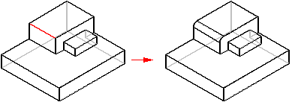
Rounding and blending
Use rounding to replace a model's sharp edges with a smooth, rounded surface to improve its appearance or function. Rounding is edge-based, which means you can only round edges.
constant rounding radius
variable radius
blend

Slide 91
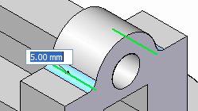
Rounding workflow
Choose the Round command located on the Home tab→Solids group.
On the Round command bar, use the Select menu (1) to specify the element that you want to round (chain, edge/corner, face, loop, all fillets or all rounds).
Select the elements you want to round. When an edge is selected, you'll see a dynamic preview of the round.

Slide 92
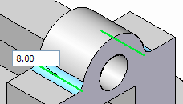
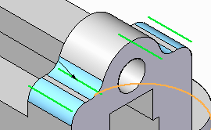
Rounding workflow
Type the radius for the round.
Continue selecting edges defined with the same radius value.
Right-click when finished with this common radius. This converts all preview geometry to finished geometry. The command remains active.

Slide 93
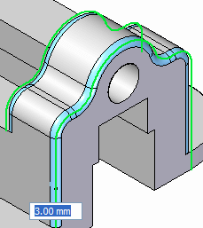
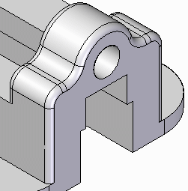
Rounding workflow
To place additional rounds with different radii, continue selecting edges and then change the radius value.
Right-click to finish the round.
Press the Esc key or pick the Select command to terminate round placement.

Slide 94
Rounding
Rounding order
Reordering rounds
Activity: Round edges

Slide 95
Rounding
Editing rounds
Variable radius rounds
Blend workflow
Activity: Blend between faces
Defining the blend shape

Slide 96
Chamfers
Chamfer command
Constructs a chamfer between two faces along their common edge.
Activity: Creating chamfer features

Slide 97
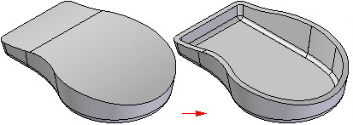
Thickening and thinning parts
You can use the Thicken command to add thickness to a part.
Or use the Thin Wall command to thin a part.

Slide 98
Thickening and thinning parts
Thicken feature workflow
Thin wall feature workflow
Things to consider when using thin walls
Activity: Create a plastic part using Thin Wall
Activity: Model an oil pan

Slide 99
Constructing procedural features

Slide 100
Procedural features
Procedural features are manufactured features which perform a particular function. Unlike rounds and drafted faces, procedural features generally come later in the design process and thus do not affect the form of the model. There are several types of procedural features available within Solid Edge, some of which are used extensively in the plastics industry. In this lesson, you will learn how to define the following features.
Hole
Rib
Vent
Lip
Also in this lesson, you will define feature patterns for repetitive use, as well as learn the organizational aspects of feature libraries. You will learn how to manage features using standard Windows operations Cut, Copy and Paste. You will also learn about the Attach and Detach functionality.

Slide 101
Hole command
Plane locking
Precise placement
Hole types
Threaded holes
Hole extents
V bottom angles
Hole edits
Holes.txt and Pipethreads.txt files
Saving commonly used hole parameters
Activity: Place holes
Activity: Edit holes

Slide 102
Pattern features
Rectangular Pattern command
Activity: Rectangular Patterns
Circular Pattern command
Activity: Circular Patterns
Pattern Along Curve command
Activity: Pattern Along Curve
Fill pattern
Activity: Fill pattern

Slide 103
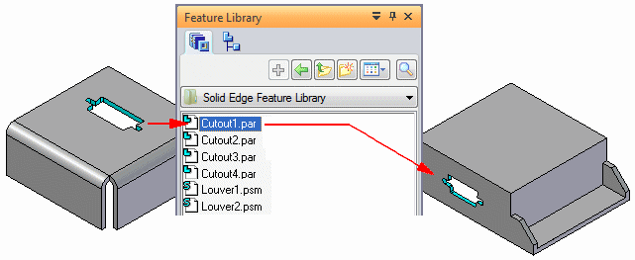
Feature libraries
You can use many of the features used for modeling in Solid Edge in a similar fashion in other designs. The Feature Library page and Teamcenter Feature Library page provides a place for you to store commonly used part and sheet metal features in an easy to access location so you create new designs with less effort and more consistency.
For example, you can
construct a cutout feature in one part, store the feature in a feature library location, then reuse the feature in a new part later.

Slide 104
Feature libraries
Storing features in a library
Placing feature library members
Redefining parent edges
Feature library guidelines
Create an unmanaged feature library member
Place a feature library member into another document
Activity: Feature Libraries

Slide 105
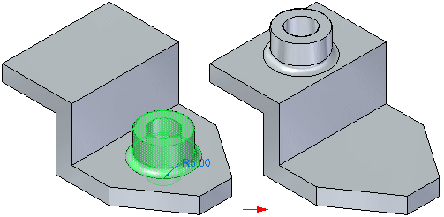
Detaching and attaching faces and features
You can modify synchronous models by detaching and attaching one or more faces or features. Detaching faces or features makes it possible to remove faces from the solid model without deleting them. This can be useful when you need to create a new variation of an existing model that does not contain some of the features on the existing model, but you want to maintain the features in the document for possible future needs.
Detaching faces or features also makes it possible for you to move or rotate the face set to a new position on the model and then reattach them in the new location.

Slide 106
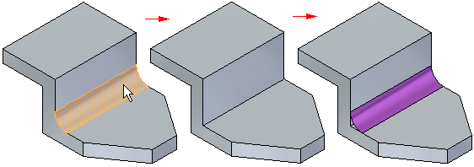
Detaching faces
You can detach faces using the Detach command on the shortcut menu when one or more faces or features are selected, or you can use the Detach option available on the Move QuickBar. You can select the faces in the graphics window or in PathFinder.
When you use the Detach shortcut menu command, the detached faces are hidden automatically in the graphics window, and the color is changed to the construction color. You can use PathFinder to redisplay the faces.

Slide 107
Attaching faces
You can attach faces using the Attach command on the shortcut menu when detached faces are selected in PathFinder or the graphics window. To successfully attach, a valid solid body must be formed. If the faces you are trying to attach do not form a valid solid body, a message is displayed.

Slide 108
Detaching and attaching faces and features
Detach faces
Attach features
Activity: Detach and attach face sets
Activity: Attach

Slide 109
Cutting, copying, and pasting model elements
Copying and cutting elements
Pasting elements
Activity: Copy and move face sets
Activity: Copy and paste face sets

Slide 110
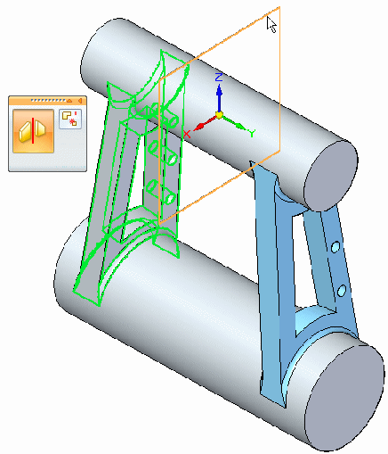
Mirror
Constructs a mirror copy of selected elements about a plane you define.
You can mirror any of the following
Faces of the model body
Face Sets
Surfaces
Procedural Features, such as Hole Occurrences and Patterns
Entire model body
The mirror plane can be a reference plane or a planar face.
Activity: Mirror faces and features

Slide 111
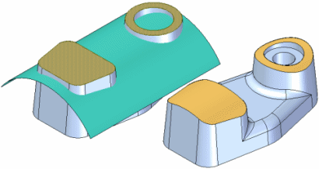
Replace face command
Replaces selected faces on a part. The replacement face can be a construction surface, a reference plane, or another face on the part. When replacing more than one face, the faces being replaced cannot touch each other.
When you replace a face using a construction surface, the construction surface is hidden automatically when you finish the feature.
If edges on the face you are replacing have rounds applied, the rounds are reapplied after you complete the replace face operation.

Slide 112
Plastics design features
Rib command
Web network command
Vent command
Lip command
Activity: Functional features in consumer products

Slide 113
Modeling synchronous and ordered features

Slide 114
Feature modeling environments
Opening a Solid Edge modeling document
Moving between modeling environments
Feature display
Editing features
Moving ordered features to synchronous
Activity: Creating ordered features
Activity: Creating both ordered and synchronous features in a model

Slide 115
Modeling ordered features
Sketching activities:
Sketching activities
Using IntelliSketch
Applying sketch relationships (collinear, parallel, equal)
Applying sketch relationships (symmetric)
Using construction elements in a profile
Creating ordered base feature activities:
Constructing ordered features from sketches
Creating a loft and swept protrusion
Creating profile-based ordered features activity

Slide 116
Modeling ordered features
Miscellaneous activities:
Constructing a mouse base
Embossing text on a part
Modeling a machined part
Constructing a bracket

Slide 117
Modeling assemblies

Slide 118
Placing parts in assemblies
Placing the first part in an assembly
Placing additional parts in an assembly
Positioning parts
Placing parts that are not fully positioned
Placing the same part more than once
Positioning a set of parts
Finding parts
Part placement properties
Placing simplified parts
Placing subassemblies

Slide 119
PathFinder in assemblies
Using the top pane
Determining the status of a component
Determining how the assembly was constructed
Making changes to assembly components
Changing the display status of assembly components
Reordering parts within an assembly
Grouping parts and subassemblies within an assembly
Renaming PathFinder entries
Finding parts
Replacing the file name with the document name formula value
Using the bottom pane
Viewing assembly relationships
Modifying assembly relationships

Slide 120
PathFinder in assemblies (continued)
Deleting assembly relationships
Replacing relationships
Conflicting relationships
Suppressing assembly relationships
Displaying document status in PathFinder
Dashed line in the bottom pane
Managing relationships in nested assemblies

Slide 121
Assembly relationships
Part positioning workflows
Maintaining assembly relationships
Capturing design intent
Assembly relationships and part movement
FlashFit
FlashFit options
Moving and rotating parts with FlashFit
Traditional part positioning workflow
Reduced steps
Capture fit
Defining offset values
Locking and unlocking rotation on axial align relationships
Assembly relationship dimensions

Slide 122
Assembly relationships (continued)
Assembly Relationship Assistant command
Applying a connect relationship
Recognizable elements for the connect relationship
Differences between assembly relationships and sketch relationships
Positioning parts using coordinate systems

Slide 123
Capture fit
Capture fit command
Capture the assembly relationships for a part
Activity: Positioning parts with mate, axial align, planar align and insert
Activity: Placing parts in an assembly using FlashFit

Slide 124
More relationships
Relationship List
Relationship Types
Connect Relationship
Activity: Positioning assembly parts using the connect relationship
Activity: Positioning assembly parts using the angle relationship

Slide 125
Assemble command
Activity: The Assemble command

Slide 126
Designing in the context of an assembly
Activity: Designing in the context of a synchronous assembly

Slide 127
Creating detailed drawings

Slide 128
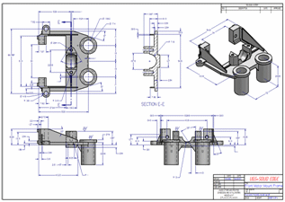
Drafting
Course Overview
The Drafting course focuses on creating and editing drawings of 3D models. Upon completion of this course, you will be able to:
Create drawings
Add views to a drawing
Create dimensions
Create annotations

Slide 129
Drawing View Types
When working from a 3D model, you can create the following types of drawing views:
Principal views
Auxiliary views
Perspective views
Detail views (dependent and independent)
Section views
Broken views
Draft quality or high quality views
Exploded assembly drawings

Slide 130
Drawing production
Workflow to create a part drawing
Workflow to create an assembly drawing
Opening and saving draft documents
Drawing sheets
Drawing view manipulation
Drawing view updates
Drawing properties
Defining Drawing Standards
2D drawing views and 2D model views
Schematic Diagramming using Blocks and Connectors
Symbols overview

Slide 131
TBDrawing views activities
Activity: Drawing view placement
Activity: Assembly drawing creation
Activity: Quicksheet
Activity: Broken view creation
Activity: Broken-out section creation

Slide 132
Dimensions, Annotations and PMI
Dimensioning overview
Using dimensions to control elements
Locking and unlocking dimensions
Dimension color
Changing dimension color in Draft
Not-to-scale dimensions
Placing dimensions
Snapping to keypoints and intersection points
Placing driving dimensions to an intersection
Placing dimensions with the dimension axis
Dimensioning with a grid
Dimensioning automatically

Slide 133
Dimensioning overview
Using the Relationship Assistant
Formatting dimensions
Adding breaks to dimension projection lines
Copying dimension data
Using the mouse scroll wheel to change dimensions
Using expressions in dimensions
Setting or modifying units of measure
Showing variability
Tracking changed dimensions and annotations

Slide 134
Annotations
Types of annotations
Annotations with leaders
Snapping to keypoints and intersection points
Adding leaders
Inserting and deleting vertices on leaders
Annotations and associativity
Formatting annotations
Saving annotations
Tracking changed dimensions and annotations

Slide 135
Annotations
Parts lists
Balloons
Center lines, center marks, and bolt hole circles
Engineering Fonts
Geometric Tolerancing

Slide 136
Product Manufacturing Information (PMI)
PMI overview
Product Manufacturing Information, or PMI, consists of dimensions and annotations that are added to the 3D model and can be used in the review, manufacturing, and inspection processes.
In synchronous and ordered modeling, PMI dimensions also provide an important design modification tool. By editing dimension values you can make changes to the model. You can lock and unlock dimensions to control how connected model faces respond to dimension value edits. And you can control the direction in which dimension edits are applied. This greatly simplifies the process of design, testing, and update.
The Solid Edge PMI application combines the functionality of adding dimensions and annotations, generating fully rendered 3D model views with 3D section views, drawing formatting, and publishing the information.

Slide 137
PMI
You can add these types of PMI:
Dimensions—Smart Dimension, Distance Between, Angle Between, Coordinate Dimension, Angular Coordinate Dimension, Symmetric Dimension.
Annotations—Leader, Balloon, Callout, Surface Texture Symbol, Weld Symbol, Edge Condition, Feature Control Frame, Datum Frame, Datum Target.
You can create these types of views:
3D section views, which can be added to or removed from
3D model views

Slide 138
PMI
PMI commands
PathFinder, PMI, and model views
Reviewing a PMI model
Sharing a PMI model
Creating drawings of a PMI model

Slide 139
PMI
Model view creation workflow
PMI dimensions and annotations
Creating 3D model views with PMI
Publishing PMI and model views to View and Markup

Slide 140
Annotations activities
Activity: Retrieving and placing dimensions
Activity: Placing annotations
Activity: Placing a parts list

