Slide 1
Working with Solid Edge Embedded Client

Slide 2
Overview
Working with Solid Edge Embedded Client instructs end users how to use the Solid Edge Embedded Client (SEEC) to create, revise, and manage data in the context of their daily tasks.

Slide 3
Overview
What is cPDM?
Collaborative Product Data Management (cPDM) is a tool that helps manage all the processes, applications, and information required to design, manufacture, and support a product throughout its life cycle.
A collaborative product data management tool such as Teamcenter helps you:
Reduce duplicate data, which reduces storage requirements.
Simplify finding and distributing data to those who need it.
Manage assemblies and relationships between parts.
Maintain the history of a product's development evolution.
Have revision control and assurance of latest data.
Have access control to ensure integrity of data.

Slide 4
Overview
What is Solid Edge Embedded Client?
Solid Edge Embedded Client (SEEC) connects the Solid Edge computer-aided design (CAD) system with Teamcenter, the document management system. The integration is transparent, and you do not need to learn a unique interface to use it. Solid Edge ST5 commands and supporting tools that create or close documents interact with the Teamcenter data structure to manage those documents so you do not have to.

Slide 5
Course Objectives
This course was developed to demonstrate how to utilize the transparent integration between Solid Edge and Teamcenter.
After successfully completing this course, you will be able to:
Understand the relationship between Solid Edge ST5, the Solid Edge Embedded Client, and Teamcenter.
Understand and utilize Solid Edge Embedded Client workflows and common property dialog boxes.
Move unmanaged documents into a Teamcenter managed environment.
Create and modify Solid Edge documents managed in the Teamcenter environment.

Slide 6
Getting Started with SEEC
After completing this lesson, you will be able to:
Activate and use Solid Edge with Teamcenter.
Determine your default modeling environment.
Create and save Solid Edge documents using the Solid Edge Embedded Client.
Use Solid Edge Help tools.

Slide 7
Getting Started with SEEC
Starting Solid Edge Embedded Client
Enable Teamcenter in Solid Edge
Click the Application button, and choose Manage→Teamcenter.
Teamcenter is indicated in the application title displayed in the title bar of the window.
NOTE - If Teamcenter is not indicated in the application title, you are working in an unmanaged environment.

Slide 8
Getting Started with SEEC
When Teamcenter is enabled, the Solid Edge user interface changes in the following ways:
Teamcenter is indicated in the startup screen.
Teamcenter is displayed in the application title displayed in the title bar of the window.
When browsing for Solid Edge files you are presented with the data from the Teamcenter database.
When new documents are created you are prompted to upload them to the Teamcenter database, as they are not yet resident in the database.
When you save a file, it is only saved locally to your cache. When you close the document, it is uploaded into the Teamcenter database.

Slide 9
Getting Started with SEEC
Determine your default modeling environment
You can specify the modeling environment you want to start in when creating a Part or Sheet Metal document. Assembly documents can be comprised of both types of content, so there is no need to specify a starting environment for Assembly.
The available environments are:
Synchronous — collection of faces that define the feature shape. There is no history retained of how a synchronous feature was created. Face(s) of a synchronous feature can be edited.
Ordered — history based. You can edit an ordered feature by returning to any step used in the feature creation process. No face(s) of an ordered feature can be edited.
Note: The default environment is typically set by the system administrator, who may also choose to allow you to change your default environment.

Slide 10
Getting Started with SEEC
You can create a new document in the following ways:
Use the New command on the Application menu and then select the template you want from the New dialog box.
Open one of the Solid Edge environments from the Create menu. When you use the Create menu, an appropriate template is used as the starting template. For example, when you open the ANSI Part environment, the default template is used as the starting template for a new part document.
Templates are delivered for each environment:
Part
Assembly
Draft
Sheet Metal

Slide 11
Getting Started with SEEC
The Solid Edge window with Teamcenter enabled:
Teamcenter is indicated in the title bar of the window.
The new document is given a temporary document identifier and extension.
PathFinder shows the formula for the unsaved document. The default document name formula is controlled on the Helpers page of the Solid Edge Options dialog box.

Slide 12
Getting Started with SEEC
Objects in PathFinder:
Item - a commonly used workspace object that captures the metadata describing all the associated revisions.
Item Revision - Captures the revision-specific metadata. It is metadata that is useful in data retrieval and reuse.
Dataset - Captures the document and is connected to the Item Revision.

Slide 13
Getting Started with SEEC
You can open an existing document in the following ways:
Use the Open command on the Application menu and then select the document you want from the Open File dialog box.
On the startup screen, choose Open Existing Document and then select the document from the Open File dialog box.
Click the document in the Recent Documents portion of the startup screen.

Slide 14
Getting Started with SEEC
To save a document within Solid Edge Embedded Client:
Use the Save command on the Application menu.
Save the active document by selecting the Save icon from the Quick Access toolbar at the top left of the Application window.
Use the Save As command on the Application menu.

Slide 15
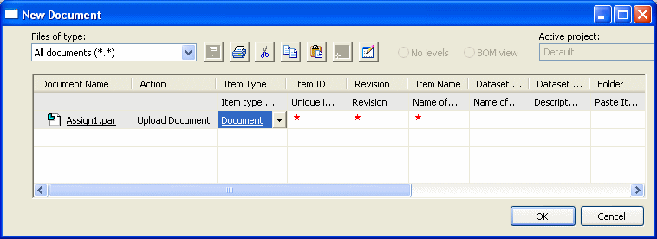
Getting Started with SEEC
Use the New Document dialog box to assign attributes to the document, such as the Item ID, Revision, and Item Name.

Slide 16
Getting Started with SEEC
To close a document within Solid Edge Embedded Client:
On the Application menu, click Close.
On the Application menu, click Close→Close All.
The Close command closes the active document. If you have never saved the document, you will be prompted to save it.

Slide 17
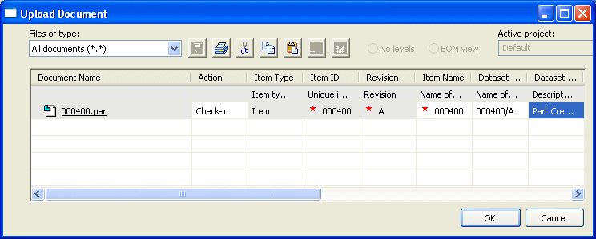
Getting Started with SEEC
The Upload Document dialog box is displayed so that you can give the document a name and specify a folder and format to save it to.
You may change the values for some of the columns, such as Item Name, on this dialog box. You can also set the value to either Check In or Upload Document.

Slide 18
Getting Started with SEEC
To exit Solid Edge:
On the Application menu, click Exit Solid Edge.
Click the X in the upper right corner of the application window.
Exiting Solid Edge quits the application and prompts you to save any changes to the open documents. The Upload dialog box is displayed so that you can give the document a name and specify a folder and format to save it to.

Slide 19
Getting Started with SEEC
User Assistance:
Tooltips help you identify a user interface element.
Command tips provide contextual assistance as you work with Solid Edge.
Learning Tools such as tutorials and self-paced training courses are available through the Help pane.
The About Solid Edge link on the Help window displays the software version and license information.
Online Help provides contextual help information as well as search capability.
Solid Edge Technical Support provides technical support for Solid Edge customers.

Slide 20
Lesson Review
List the environments available when working in Solid Edge Embedded Client.
List two ways to open a new document. List three ways to save a document.
What are the three objects that combine to fully describe the associated document when you are working with Teamcenter?
Where can attributes, such as Item Name, be assigned to a document?
How can you find information about the Search command?
What tool would you use to locate the Open command?

Slide 21
Answers
The environments available when working in Solid Edge Embedded Client are:
Part
Assembly
Sheet Metal
Draft
You can open a new document using several methods including:
Selecting Application Button->New and selecting the appropriate template.
Clicking the environment (Part, Assembly, Sheet Metal) from the Create portion of the Solid Edge startup screen
You can save a document by:
Selecting Application button->Save.
Clicking the Save icon on the Quick Access toolbar.
Selecting Application Menu->Save As (or Ctrl + S).
3. The object’s Item, Item Revision, and Dataset combine to fully describe the Teamcenter-managed document.
Attributes can be assigned to a document on the:
New document dialog box for new documents.
Upload document dialog box for existing documents.
Information regarding the Search command or any command in Solid Edge can be found in on-lin Help by clicking the Help Index icon located at top-right of the window.
6. You can use Command Finder, located on the status bar, to locate the commands within Solid Edge.

Slide 22
Activity: Create, save, and close
After completing this activity, you will be able to:
Determine your default modeling environment.
Open any of the Solid Edge environments.
Create a new Teamcenter-managed Solid Edge document.
Save a Teamcenter-managed Solid Edge document.
Close a document.
Note:
For this class, all students will be working in a common local folder on each machine. Instructions for loading the class files are found in the Activity Data Set section of the Course Overview. The activities assume ANSI templates are loaded.

Slide 23
Lesson Summary
The best way to learn the functionality of the Solid Edge Embedded Client is to spend time using it.
Things to remember:
When browsing for Solid Edge files in Teamcenter mode, you will be presented with the data from the Teamcenter database.
The Login to Teamcenter dialog box only displays when you start a new Solid Edge session. Once a document is open and you are connected to Teamcenter, it no longer displays.
Saving a document saves it to disk and creates it in Teamcenter, but it is not loaded to the database until it is closed.

Slide 24
Searching and viewing data
After completing this lesson, you will be able to:
Understand Items, Item Types, Item Revisions and Datasets.
Execute searches to find item objects.
Find and open managed Solid Edge documents.
Create custom saved searches.
Customize the display of document attributes on the Open File dialog box.

Slide 25
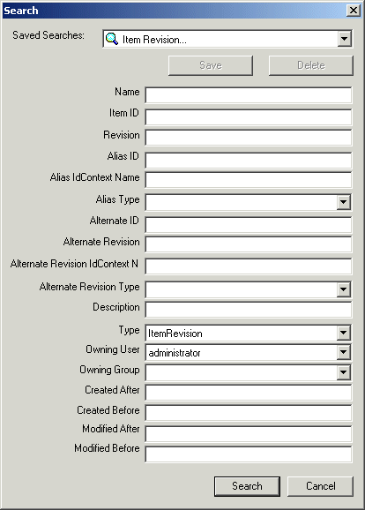
Searching and viewing data
The Search dialog box assists you in locating documents that meet a defined search criteria.
You can search for documents based on such attributes as Name, Item ID, and Revision.
Each named search displays only the attributes associated with that type of search.

Slide 26
Searching and viewing data
Searching for Items
Items are the fundamental objects you use to manage data in a Teamcenter environment. Items are used to store data that is configuration or revision-controlled, such as business data from CAD files and document files created in Microsoft Office.
Each item has a label containing two pieces of information:
Item ID - A unique identifier similar to a part number or document number.
Item Name - A short description of the item, such as a bolt, bracket, or title of a document.
Using the system-defined searches, you can search for documents based on their Item ID or Item Name.

Slide 27
Searching and viewing data
Searching for Item Types
To search for an item, you should search for a specific type of item. The term item describes all types of items that exist in the database.
The following types of items are delivered with Solid Edge Embedded Client and Teamcenter:
Document - Used for data that is revision or configuration-controlled.
Engineering Order - Contains data related to an engineering change and can also be used as part of a workflow to route change information.
Item - Used for data stored in the database that represents manufactured parts, subassemblies, end-items, and tools.
Standard - Used for standard or purchased parts.
You can search for item types using the system-defined search Item-simple.

Slide 28
Searching and viewing data
Searching for Item Revisions
Item revisions manage changes to items. When you create an item, the first item revision is automatically created for you. As you make changes to the item, additional item revisions are created to represent the revision changes.
Item revisions are what most users commonly access. They are used to manage changes and track history of the items.
Item revisions contain objects referred to as forms and datasets. Forms contain attribute data for the item revision. Datasets represent the physical data files for the item revision. Revisions may also contain other objects, such as folders and other item revisions.
There is a system-defined search to find objects based on Item Revision.

Slide 29
Searching and viewing data
Searching for Datasets
Datasets manage data files and are typically stored in item revisions.
Double-clicking a dataset launches the software application and loads the file in the application.

Slide 30
Searching and viewing data
Searching for non-Solid Edge documents
Non-Solid Edge documents are saved under the same Item Revision as the parent document or to a new Item and Item Revision.
Supported non-Solid Edge documents include:
Microsoft Office Excel (.xls and .xlsx)
Microsoft Office Word (.doc and .docx)
Joint Photographic Experts Group (.jpg),
bitmap (.bmp), and
Tagged Image File Format (.tiff)
Use the system-defined search for Item Revision or Item to find non–Solid Edge documents within the Teamcenter-managed environment.

Slide 31
Lesson Review
Objects which are used to store data that is configuration or revision-controlled are called _________________________.
True or False: Each item is described by a name, description, and creation date.
True or False: You can search for documents based on attributes such as name, Item ID and Revision.
Name three of the Item types delivered with Solid Edge Embedded Client.
True or False: Item Types are used to manage changes and track history of items.
What workspace object is used to manage data files created by other software applications?
Non–Solid Edge documents such as Microsoft Excel and Word documents as well as image documents are saved in the same _________ _________________ as the parent or to a new Item and Item Revision.
True or False: The creation of custom searches requires special privileges.

Slide 32
Answers
Objects which are used to store data that is configuration or revision-controlled are called Items.
False – Each item has a label containing the Item ID, a unique identifier, and an Item Name, a short description. The creation date is not part of the label.
3. True – You can search for items based on several properties associated with the Item. The name, Item ID, and Revision are three of the properties that can be used for search for items.
Three of the Item types delivered with Solid Edge Embedded Client are:
Item – used for data stored in the database that represents parts, subassemblies, and other items such as 2D or 3D images of models.
Document – used for data that is revision or configuration-controlled such as a test procedure or spreadsheet.
Standard – used for standard parts.
False – Item Revisions manage change to Items.
Datasets are used to manage data files created by other software applications such as Microsoft Word or Excel documents.
A non-Solid Edge document is saved under the same Item Revision as the parent document or to a new Item and Item Revision.
False – The creation of custom searches do not require special user privileges.

Slide 33
Activity: Searching and viewing
Following this activity, you will be able to:
Open a managed Solid Edge document.
Search for particular Solid Edge documents in a managed environment.
Create a customized search and save the search for future use.

Slide 34
Lesson Summary
In this lesson you reviewed the dataset model for Solid Edge Embedded Client and learned how to search for document attributes based on this data model.
Things to remember:
Items are generally used to store revision-controlled information.
Each item has at least one item revision.
Item revisions store specific information about a particular revision of an item.
A dataset is an object that stores and manages a collection of data files.
Document attributes such as Name, Item ID, Revision, and Item Name can be found in the database using the Search command.

Slide 35
Preparing unmanaged documents
After completing this lesson, you will be able to prepare unmanaged documents for loading into Teamcenter using:
Attribute mapping to map Solid Edge properties to Teamcenter attributes.
Custom property definition to define properties for importing non-Solid Edge documents.
A dry run of the Add to Teamcenter process.
Add to Teamcenter to add the documents into the Teamcenter-managed environment.

Slide 36
Preparing unmanaged documents
Document preparation
To prepare your unmanaged documents for Teamcenter, you should:
Remove documents you do not want to manage.
Find duplicate document names.
Scan for invalid document names.
Map Solid Edge properties to Teamcenter attributes.
Create custom properties to define the Item Revision for non-Solid Edge documents (image files, .pdf documents, and Microsoft Office documents) and to define the properties for non-graphic parts (grease, paint, etc.).
Find and repair broken links.

Slide 37
Preparing unmanaged documents
Map Solid Edge properties to Teamcenter attributes
Solid Edge property | Teamcenter attribute | Required or Optional | File Property
Teamcenter Item Type | Item Type | Required | Custom (Localized)
Document Number | Item ID | Required | Project
Revision Number | Revision | Required | Project
Project Name | Item Name | Required | Project
Dataset Name | Dataset Name | Required | Custom
TC Engineering Description | Dataset Description | Optional | Custom

Slide 38
Preparing unmanaged documents
Creating custom properties
You can create custom Solid Edge properties to map to Teamcenter attributes. For example, you can create custom properties to define the Item Revision for non-Solid Edge documents including image files, .pdf documents, and Microsoft Office documents (MS Word, MS Excel, MS PowerPoint). You can also create custom properties to define the properties for non-graphic parts.
There are three basic steps to creating custom properties:
Provide a name for the custom property.
Select the type of property you are creating.
Type a value for the property.

Slide 39
Preparing unmanaged documents
Add to Teamcenter
Direct documents - the documents that you select to add to the managed library.
Indirect documents – documents linked to direct documents or referenced by other documents.
Example: When you add an assembly to a managed library, all the parts and subassemblies within the selected assembly are indirect documents.

Slide 40
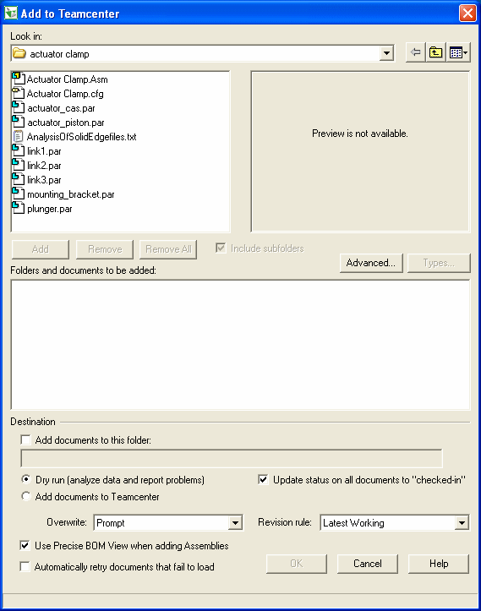
Preparing unmanaged docs
Start menu, choose Programs→ Solid Edge ST5→Data Preparation→Add to Teamcenter.

Slide 41
Preparing unmanaged documents
Add to Teamcenter
Log files
Default location defined on the File Locations page of the Solid Edge Options dialog box.
Use log file to determine the success or failure of your unmanaged documents loading into the Teamcenter database.
Output files
Default location …\Unigraphics Solutions\Solid Edge\Version 105\Log Files\Add to Teamcenter
For Windows 7 systems, the default location is \Users\<userid>\AppData\Roaming\Unigraphics Solutions\Solid Edge\Version 105\Log Files\Add to Teamcenter

Slide 42
Lesson Review
List three things you should do before adding documents to a managed environment.
What is the significance of defining property information before adding documents to a managed environment?
Where do you access the Add to Teamcenter program and data preparation tools?
If no document number is defined, where does the value for the Item ID come from when the document is loaded into Teamcenter?
True or False: The log files and output files generated by Add to Teamcenter are automatically archived after each successful import of unmanaged documents into the Teamcenter-managed environment.

Slide 43
Answers
Three things you should do before adding unmanaged documents to a managed environment are:
Remove documents you do not want included in your managed environment.
Find duplicate or invalid document names.
Map Solid Edge properties to Teamcenter attributes.
Defining the document properties you will exchange between Solid edge and Teamcenter prior to adding unmanaged documents to the managed environment will ensure your database will be more accurately populated from the start.
The Add to Teamcenter program and data preparation tools are located in the Start menu by choosing Programs->Solid Edge ST5->Data Preparation.
If the Solid Edge Document Number property is not defined prior to adding your unmanaged document to the Teamcenter-managed environment, the Item ID is automatically generated for you in Teamcenter.
False – Log files and output files generated by Add to Teamcenter are not automatically archived. You should work with your system administrator to develop a system to manage the spce on the computer where the Add to Teamcenter program is used.

Slide 44
Activity: Preparing documents
After completing this activity, you will be able to:
Set properties in groups of files.
Create custom properties.
Perform a dry run of data import.
Use Add to Teamcenter to load unmanaged documents to Teamcenter.
Note: A folder containing unmanaged files has been made available for use with this activity. Prepare and then load the unmanaged documents into Teamcenter.

Slide 45
Lesson Summary
Things to remember:
Proper preparation prior to adding documents to a managed environment minimizes future efforts.
When a folder is added to a library, the entire contents of the folder are added to the managed environment. Remove any outdated or unwanted files from the folder prior to adding them to Teamcenter.
The key attributes used to track part numbers and revisions are Item ID, Revision ID, and Item Name.
When you add documents to Teamcenter, if the Document Number property is left blank, the Item ID is automatically generated and assigned for you.
Additional information regarding the automated tools for data preparation is available in the Solid Edge Embedded Client Administrator's Guide and in Solid Edge Help.

Slide 46
Working with Assemblies
After completing this lesson, you will be able to:
Create an assembly in the managed environment.
Navigate the document structure using PathFinder.
Create in-place additions to the document.
Create a drawing from the assembly.
Save and upload the documents into Teamcenter.

Slide 47
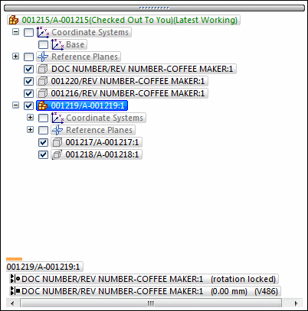
Working with Assemblies
Understanding PathFinder
In the Assembly environment, PathFinder is divided into two panes:
The top pane lists the components of the active assembly in a folder tree structure.
The bottom pane shows the assembly relationships applied to the part or subassembly selected in the top pane.

Slide 48
Working with Assemblies
Using the PathFinder top pane
You can do the following using the top pane of PathFinder:
View components in collapsed or expanded form. For example, when you expand a subassembly, you can view all of its parts.
Highlight, select, and clear components for subsequent tasks.
Determine the current status of the components within the assembly.
Determine who the document is checked out to.
Determine how the assembly was constructed.
Reorder parts within an assembly.
Rename reference planes, sketches, and coordinate systems.
Hide parts and subassemblies to make it easier to position a new part you are placing in an assembly.

Slide 49
Working with Assemblies
Using the PathFinder bottom pane
When you select a relationship in the bottom pane you can do the following:
View which elements were used to apply the relationship.
Edit the fixed offset value of the relationship.
Change the offset type of the relationship.
Delete the relationship.
Suppress the relationship

Slide 50
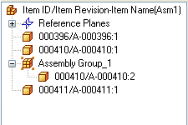
Working with Assemblies
PathFinder in the managed environment
In the managed environment, an unsaved document is shown in PathFinder using the document name formula defined on the Manage page of the Solid Edge Options dialog box: Item ID/Item Revision-Item Name.
When the document has been saved, the default formula is replaced by the saved assembly item information.

Slide 51
Working with Assemblies
Displaying document status in PathFinder
After a document has been saved in the managed environment, the document status is displayed as text after the document formula. The document status provides information about whether it is available for checkout, and whether there is a new version or new revision available.
In addition to the Teamcenter UserID, Solid Edge Embedded Client displays the name of the person who has the managed document checked out.
You can use the Status→Display Status command on the PathFinder shortcut menu to turn off and on the document status.

Slide 52
Working with Assemblies
Placing parts in assemblies
You can place any of the following types of solid parts in Solid Edge assemblies using the Teamcenter Parts Library tab:
A part constructed in the Solid Edge Part environment.
A part constructed in the Solid Edge Sheet Metal environment.
Another assembly constructed in the Solid Edge Assembly environment.
Any document that is open in Solid Edge other than a Draft document.
To place parts that were constructed in other CAD formats, you must first convert them to Solid Edge part files.

Slide 53
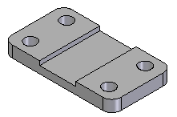
Working with Assemblies
Placing the first part in an assembly
To start the part placement process, on the Teamcenter Parts Library page, select the part you want, then drag it into the assembly window.
The first part you place into an assembly serves as the foundation upon which the rest of the assembly will be built. Because the first part is placed grounded, you should pick a part with a known location, such as a frame or base.
The first part you place should remain grounded and not be deleted.

Slide 54
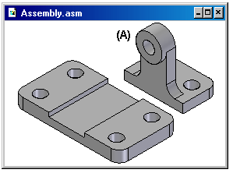
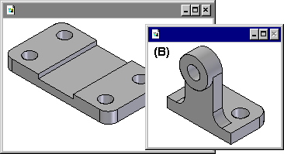
Working with Assemblies
Placing additional parts in an assembly
You can use the Do Not Create a New Window During Place Part Assembly page on the Options dialog box to specify whether subsequent parts are temporarily placed in the assembly window (A), or displayed in a separate Place Part window (B).

Slide 55
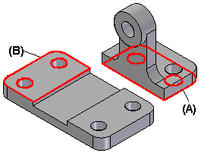
Working with Assemblies
Positioning parts
You use assembly relationships to position the new part relative to a part already in the assembly.
The Relationship Types option on the Assemble command bar contains a wide range of assembly relationships for positioning parts relative to one another.
The FlashFit option reduces the steps required to position a part using the mate, planar align, or axial align relationships. This option is recommended in most situations.

Slide 56
Working with Assemblies
Constructing new managed parts within an assembly
On the Teamcenter Parts Library tab, click Create In-Place to create a new part or subassembly within the context of a managed assembly.
On the Create New Part In-Place dialog box:
Define the document template for the new part, sheet metal, or assembly.
Select a placement option for creating a part in-place:
Coincident with Assembly
By Graphic Input
Offset From Assembly Origin
Specify the Item ID, Revision, and Item Name for the new document manually, on the New Document common property dialog box, or automatically using the Assign All command.

Slide 57
Working with Assemblies
Drawing view creation
Use the Drawing View Creation Wizard to create a primary view of a 3D part or assembly. A primary view is simply the first view placed on the drawing.
You can create part views of any Solid Edge part, sheet metal, or assembly document (.par, .psm, and .asm file types).
You can place any number of drawing views on a sheet. However, in the Teamcenter-managed environment, the draft document is created in the same Item Revision and is automatically assigned the same Item ID as the first view on the drawing.

Slide 58
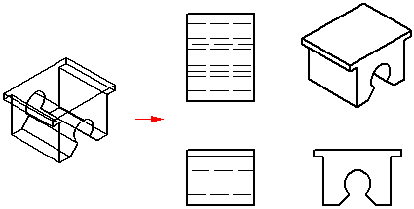
Working with Assemblies
Placing a primary part view
When you click Finish on the Drawing View Creation Wizard, the cursor is displayed as a rectangle the size of the new part view. You can position the view anywhere on the sheet, and then click to place it. If you selected companion views from the wizard's Drawing View Layout dialog box, when you click the drawing sheet, all selected views will be placed at once.

Slide 59
Working with Assemblies
Creating drawing views automatically
You can create drawing views quickly and automatically by dragging a Solid Edge document onto a drawing sheet.
When you drag an assembly model onto an empty drawing sheet, an isometric view is created.
When you drag any other model file onto an empty drawing sheet, front, top, and right views are created.
You also can drag a model onto a Quicksheet template. With a Quicksheet template, you can customize the view types and properties, save the document as a template, and reuse it with any model you want.

Slide 60
Lesson Review
True or False: You can use PathFinder to in-place activate a part of a subassembly.
In the top pane of Pathfinder you can do all of the following except:
a. View components in collapsed or expanded form.
b. Determine the current status of the components within the assembly.
c. Rename documents, reference planes, and coordinate systems.
d. Determine how the assembly was constructed.
In the Teamcenter-managed environment, an unsaved document is shown in PathFinder using the default document name formula that consists of the ______________________.
True or False: You can use PathFinder to determine a managed document's status.
Describe the difference between the function of the Parts Library tab and the Teamcenter Parts Library Tab.

Slide 61
Answers
True – You can use PathFinder to in-place activate a part of subassembly so you can make edits to individual assembly components while viewing the entire assembly.
In the top pane of PathFinder you can perform all of the functions listed except for (C). In the managed environment, you cannot use PathFinder to rename documents..
In the Teamcenter-managed environment, an unsaved document is shown in PathFinder using the default document name formula that consists of the Item ID/Item Revision-Item Name.
True – After a document has been saved in the managed environment, the document status is displayed in pathFinder after the document formula.
The Teamcenter Parts Library tab is used to create-in-pace in the Teamcenter managed environment. The Parts Library tab is used to create-in-place in the unmanaged Solid Edge environment.

Slide 62
Activity: Create an assembly
In this activity, you will learn how to create an assembly in a managed environment using parts from the Teamcenter Parts Library.
After completing this activity, you will be able to:
Place parts into an assembly file using the Teamcenter Parts Library.
Use the Create In-Place command in a managed environment.
Save and upload the assembly into Teamcenter.
Recognize the relationship between the Draft document and the parent item.

Slide 63
Activity: Create a drawing
In this activity, you will learn how to create a drawing in a managed environment using an existing assembly from the managed library.
After completing this activity, you will be able to:
Use the assembly to create a drawing.
Save and upload a drawing into the database.

Slide 64
Lesson Summary
PathFinder is a valuable tool that you can use to manipulate components of an assembly file.
Things to remember:
In the managed environment, the document is saved using the default document name formula: Item ID/Item Revision-Item Name.
PathFinder is divided into two panes. The top pane lists the components of the active assembly in a folder tree structure. The bottom pane shows the assembly relationships applied to the part of subassembly selected in the top pane.
To use the Create In Place command, you must first save the assembly.
By default, the draft document is created in the same Item Revision and is automatically assigned the same Item ID as the first view on the drawing.

Slide 65
Opening and adding content
After completing this lesson, you will be able to:
Use additional options in the Open File dialog box to open existing managed documents.
Understand and use basic Revision Rules.
Add to and modify existing managed document content.

Slide 66
Opening and adding content
The Open command
When you use the Open command to open a Teamcenter-managed document:
The document is checked out and downloaded to the local cache.
If the document you are opening contains links to other documents, those documents are downloaded to cache as well.
The document is opened so you can work on it. While the document is checked out, other users cannot make edits to it.
Subsequent use of the Open File dialog box displays the Look In box set to the last location used. When you open another managed document, you can select the document from the location shown or use the Look In box to navigate to the location of your choice.

Slide 67
Opening and adding content
The Open command focuses on an Item-centric view of items in the database, including those with no dataset.
Basic—Default display. The Item, Item Revision, and Dataset are displayed on a single line.
Intermediate—Displays the Item and Item Revision combined in one row. The Dataset displays on a separate row.
Full—Displays the Item, Item Revision, and Dataset on individual rows.

Slide 68
Opening and adding content
Revision Rules
Parameters you set to determine which item revisions are displayed for the item you choose.
Version from Cache opens the item you have selected using the version already in your local cache.
Latest Working opens the latest item revision regardless of the release status.
The revision rule being used is displayed in the formula shown in PathFinder after the Item ID, Item Revision, and Item Name. For example:

Slide 69
Opening and adding content
Mirroring items
In this lesson, you will use the Mirror command to illustrate how assemblies with parts placed using the Mirror command behave in the managed environment. You can mirror one or more parts or assemblies about a reference plane you select.

Slide 70
Lesson Review
True or False: You can open multiple assemblies at the same time when working in Solid Edge Embedded Client.
True or False: The Files of Type field on the Open File dialog box filters the types of files displayed in the Look In list.
Setting the File of Type field to (*.psm) filters the display to show only ____________________ documents.
Name three options you can set when opening existing documents from the Open File dialog box.
When you open an item you work with consistently throughout the day and you want to improve performance, set the __________ ________ ___________ Revision Rule from the Open File dialog box.

Slide 71
Answers
False – You can only open one assembly at a time when working in Solid Edge embedded Client.
True – By using the Files of Type filter, you can limit the types of files displayed to that which you choose and minimize the effort required to locate the file you are looking for.
Setting the Files of Type field to (*.psm) filters the display to show only sheet metal documents.
A few of the options available to you in the Open File dialog box are:
When you open an assembly from the Open dialog box, you can improve performance by choosing to hide all components.
When you open a draft document you can choose to Inactivate Drawing Views so the 3D content is not downloaded to cache.
You can use Revision Rules to determine which item revisions are displayed for the item you choose.
When you open an item you work with consistently throughout the day and you want to improve performance, set the Version from Cache Revision Rule in the Open File dialog box.

Slide 72
Activity: Add content
In this activity, you will learn how to open existing Teamcenter-managed Solid Edge documents and use options to minimize the effort required to locate them. You will learn how to work with revision rules to access the most appropriate version of the document and how to examine multiple files as they are written to disk and to Teamcenter.
After completing this activity, you will be able to:
Open an existing managed document using options on the Open File dialog box.
Focus the display of items in the Look In list.
Use Revision Rules to your advantage.

Slide 73
Lesson Summary
Things to remember:
The Open command is used to open existing documents.
You can only open one assembly at a time.
Setting various options on the Open File dialog box can assist you in locating files, accessing the most appropriate version, and can also help you improve performance.

Slide 74
Working with managed docs
After completing this lesson, you will be able to:
Use Hide All Components to efficiently work with large assemblies.
Open documents using the Read Only option.
Recognize the Read-Only Status Indicator.
Understand the functionality of the Read Only Assistant.
Create a new Revision of an item.

Slide 75
Working with managed docs
Opening documents efficiently
You can control how much of the assembly is downloaded to cache by hiding the components you do not need.
When you use the Hide All Components option on the Open File dialog box:
All the components in the assembly are hidden when it is opened.
Only the direct first-level children of the assembly being opened are downloaded to cache.
Then you can judiciously expand and show only those subassemblies you need to work with using PathFinder.

Slide 76
Working with managed docs
Working with read-only documents
When you open a document as read-only, the document is not checked out of the database, but only copied to the local cache and opened for viewing purposes.
Indicators that the document is opened with read-only status:
The document title displays [Read-Only].
The Save command is disabled.
The Read-Only Status Indicator displays in the upper right corner of the graphics window and is enabled.
You can click the Read-Only Status Indicator to display the Read-Only Assistant.

Slide 77
Working with managed docs
Read-only Assistant
Informational and interactive menu comprised of five sections related to your open document:
Document status
Messages
Command
Request write access
Refresh

Slide 78
Working with managed docs
Read-Only as the default setting
You can save the selection to open documents read-only by clicking Save As Default on the Open File dialog box. The selection becomes the default the next time the Open File dialog box is displayed.
Caution:
Clicking Save As Default sets the option on the dialog box to the default for all Solid Edge document types.

Slide 79
Working with managed docs
Additional concepts:
You can only edit the most recent version of the document.
When you request to open an indirect document, the indirect document is opened using the value of the Open As Read-Only check box of the parent, or direct document, and the selected radio button First level read-only or All levels read-only.

Slide 80
Lesson Review
When you are working with a large assembly and want to work with the files as efficiently as possible, you should use the __________________ option on the Open File dialog box.
True or False: When opening an assembly with all components hidden, only the direct first-level children of the assembly being opened are downloaded to cache.
Name two indicators that are present when a document is opened with read-only status.
Which of the statement(s) below are true regarding opening documents Read Only.
a. Any changes you make to an item opened read-only are lost.
b. Changes made to an item opened read-only can be saved by requesting write access and then using the Check Out command to check the item out of the database and then save it.
c. You can use the Save As command to specify a new Item ID to save the changes to an item opened as read-only.
d. You have to close the open item and reopen it without using the Read-Only option and then save the changes.

Slide 81
Lesson Review (continued)
5. True or False: The Save As command is automatically invoked if you select the Save command for documents that are new to Teamcenter.
6. To revise the active document, choose __________________ from the Application menu.

Slide 82
Answers
When you are working with a large assembly and want to work with the files
as efficiently as possible, you should enable the Hide All Components option
on the Open File dialog box.
2. True — When opening an assembly with all components hidden, only the direct
first-level children of the assembly being opened are downloaded to cache.
3. Two indicators that are present when a document is opened with read-only
status are:
The document title displays [Read Only].
The Read-Only Status Indicator displays in the upper right corner of the graphics windows and is enabled.
4. Of the statements listed, (B) and (C) are true.
B — Changes made to an item opened read-only can be saved by requesting write access and then using the Check Out command to check the item out of the database and then save it.
C — You can use the Save As command to specify a new Item ID to save them changes to an item opened as read-only.
5. True — The Save As command is automatically invoked if you select the Save command for documents that are new to Teamcenter.
6. To revise the active document, choose Manage->Revisions from the Application menu.

Slide 83
Activity: Use Hide All Components
After completing this activity, you will understand how to use Hide All Components to effectively work with large assemblies.

Slide 84
Activity: Read Only documents
After completing this activity, you will be able to:
Open a document read-only.
Recognize the Read-Only Status Indicator.
Access and use the Read-Only Assistant when working with a read-only document.
Use the Revise command to save changes made to an item opened read-only.

Slide 85
Lesson Summary
In this lesson, you learned how to use various commands to assist you while you work with managed documents:
Use Open→Hide-All Components to effectively and efficiently open large assemblies.
Open documents read-only and then use the Read-Only Assistant to evaluate your options for saving the changes made to the document.
Create a Revision of a document.

Slide 86
Managing your cache
After completing this lesson, you will be able to:
Understand the functions of the Cache Assistant.
Check documents in and out of a managed library.
Download documents from the managed library.
Filter the display of the contents of your cache.
Delete documents from the local cache.
View cache summary information.

Slide 87
Managing your cache
What is the cache?
Teamcenter maintains the documents that are a part of the library. As you work on documents, Solid Edge Embedded Client downloads a copy of the document to a local folder in the Windows file system and only downloads it again if the document becomes out of date.
The location for the local copy of the document is called the cache. Working with a local copy of the document improves performance over working directly with the one stored in the library.

Slide 88
Managing your cache
You can manage the contents of your local cache using the Cache Assistant command on the Manage menu.
You can use the Cache Assistant dialog box to synchronize all the documents in the managed library, check in documents you have checked out, download documents from the managed library to your local cache, filter the display of the contents of your cache, or clear documents from your local cache.

Slide 89
Managing your cache
Redefining the cache location
Changing the predefined cache location removes existing contents of the cache and should performed with care. The default cache location is %APPDATA%\Unigraphics Solutions\Solid Edge\SEEC.
If you need to change the default location for cache, you should:
Schedule the change at the beginning of a project.
Use Cache Assistant to check in all items you want to keep in Teamcenter.
Manually clear each cache folder using the Delete All button on the Cache Assistant dialog box.
Open a new document and use the SEEC Cache entry on the File Locations page of the Solid Edge Options dialog box to redefine the location for the local cache.

Slide 90
Managing your cache
Best Practices for Cache management
Provide a private cache for each user
The location of the cache should be on the physical disk of the local machine. This is a personal cache and should not be shared by multiple users.
Use the Solid Edge revision rule that best suits your needs
For example, when you open a large assembly using the Revision Rule Latest Working, the assembly is placed in the cache for your working session. On subsequent working sessions, opening the assembly using the Revision Rule Version from Cache causes all subassemblies to be configured to use what is already downloaded to the cache. The version information is validated and the documents are checked out, but no file transfers need to take place, resulting in optimized performance.

Slide 91
Lesson Review
True or False: When referring to the location of the cache in regard to Solid Edge Embedded Client, you are referring to a temporary location in the memory of the operating system.
You can use the __________ _____________ command on the Cache Assistant shortcut menu to reverse changes you make to a checked out document.
What command is useful if you want to work off-line with managed documents?
True or False: Clicking the Delete All button on the Cache Assistant dialog box removes all files from the local cache.
Which is the most efficient and recommended configuration for the local cache?
a. A personal cache on the physical disk of the local machine.
b. A personal cache accessed through a mapped network drive.
c. A shared cache location.
d. None of the above.

Slide 92
Answers
False – When referring to the location of the cache in regard to solid Edge Embedded Client, you are referring to a local folder in the Windows file system.
You can use the Undo Checkout command on the Cache Assistant shortcut menu to reverse changes you make to a checked out document.
The Download command is useful if you want to work off-line with managed documents. This command downloads the documents you choose to your local cache so they are available to you when you are off-line.
True – Clicking the Delete All button on the Cache Assistant dialog box removes all files from the local cache.
The most efficient and recommended configuration for the local cache is (A) a personal cache on the physical disk of the local machine.

Slide 93
Activity: Manage the local cache
In this activity, you will learn how to use Cache Assistant to:
Check documents in and out of the managed library.
Download documents to the local cache.
Filter the display of the contents of your cache.
Delete documents from the cache.
View cache summary information.
Use the Undo Check Out command to recover unchanged items from Teamcenter.

Slide 94
Lesson Summary
The cache is a folder in the Windows file system that contains local copies of the documents from the managed library.
Things to remember:
In a managed environment, a copy of the Solid Edge document you want to edit is downloaded from the database to your local cache. The local copy of the document is only downloaded again if the document becomes out-of-date.
Documents in the cache should not be manipulated through the operating system, but only through the Cache Assistant dialog box.
Changing the default cache location removes any existing contents of the cache.
Each user should have access to an individual cache. The location of the cache should be on the physical disk of the local machine for optimum performance.

Slide 95
Using the Structure Editor
After completing this lesson, you will be able to:
Start the Structure Editor.
Find and open an assembly in the Structure Editor.
Clone an assembly to a new item in the Teamcenter database.
Manipulate the BOM structure of an assembly.
Revise a component of an assembly.
Manage the cache associated with Structure Editor.

Slide 96
Using the Structure Editor
What is the Structure Editor?
Structure Editor provides advanced capabilities for managing assembly structures in a collaborative environment giving you Bill of Materials (BOM) markup and change capability for Teamcenter managed data.
Structure Editor lets you do such tasks as:
Copy Teamcenter managed assembly structures to new documents stored in new Teamcenter items.
Revise partial or whole assembly structures.
Update or maintain references in the document hierarchy.
Show Teamcenter properties.
Add, create new, remove, cut, copy, paste structure elements.
Preview an assembly.
Print the assembly structure.

Slide 97
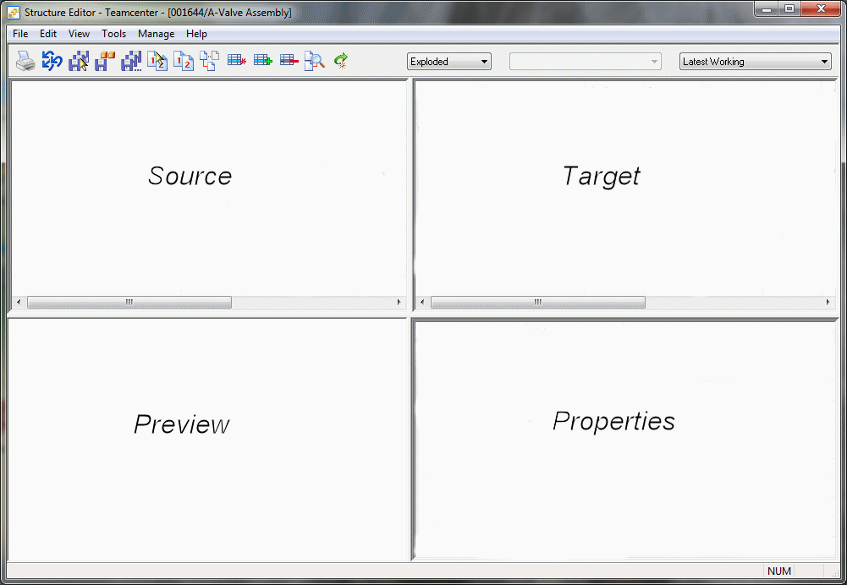
Using the Structure Editor
The Structure Editor window

Slide 98
Using the Structure Editor
The Structure Editor toolbar

Slide 99
Using the Structure Editor
Structure Editor includes Bill of Materials (BOM) markup and change features giving you the functionality to make changes to the BOM structure while maintaining a single revision of an item within the structure.
Within the structure you have the ability to:
Add rows
Create new rows
Remove rows
Cut, copy, and paste rows
Multiple actions can be performed on a row. For example, you can add a new row to a structure, and then add rows to the newly added row.

Slide 100
Lesson Review
You can use the Structure Editor to perform all of the following functions except:
a. Copy assembly structures to new Teamcenter items.
b. Revise partial assembly structures.
c. View an assembly in Exploded or Parts List format.
d. Print Teamcenter properties.
Name the four window panes that comprise the Structure Editor window.
True or False: Scroll-Lock causes the column order to be identical in both upper windows of the Structure Editor.
What is the difference between the Revise Selected and Revise All commands?
True or False: You should not work in Solid Edge and Structure Editor simultaneously.

Slide 101
Answers
You can use the Structure Editor to perform all of the following functions except:
d. Print Teamcenter properties
The four windows panes that comprise the Structure Editor window are:
Source – contains the Bill of Materials used for markup.
Target – contains the final view of th eBill of Materials.
Preview – displays a saved preview image of the assembly.
Property – displays Teamcenter property information.
False – Scroll-Lock controls the simultaneous vertical scrolling of the upper-left (source) and upper-right (target) window panes.
The Revise Selected command revises selected files within a structure to a new revision. The Revise All command revises all the files within a structure to a new revision.
True – You should not work in Solid Edge and Structure Editor simultaneously.

Slide 102
Activity: Use the Structure Editor
In this activity, you will learn how to:
Open an assembly in Structure Editor.
Clone a complete assembly.
Revise an assembly component in Structure Editor.
Save and close the files in Structure Editor.

Slide 103
Lesson Summary
The Structure Editor is a tool for managing assembly structures in a collaborative environment.
Things to remember:
You can revise partial or whole assembly structures in Structure Editor.
There are four windows panes in the viewing area of Structure Editor. Each pane can be manipulated independently of one another.
The Save As All command makes a copy (or clones) all items and the new structure is saved as a new item in Teamcenter.
You should not work in Solid Edge and Structure Editor simultaneously. Exit one of the applications before making changes to your document.

Slide 104
SEEC Diagnostics
In this lesson, you will learn how to:
Start the Solid Edge Embedded Client Diagnostics Application.
Supply basic configuration information.
Perform a diagnostics scan.
Read the SEEC Diagnostic log file.
Export your Teamcenter attribute mapping.
Create a package of information to supply to product support.

Slide 105
SEEC Diagnostics
The Solid Edge Embedded Client diagnostic application enables you to easily create a collection of information regarding your Solid Edge Embedded Client configuration.
The application is delivered with Solid Edge Embedded Client and collects client information such as:
Software location
Database connection
Cache information
Registry details
Log files

Slide 106
SEEC Diagnostics
The Solid Edge Embedded Client diagnostic application dialog box contains two areas of information:
Teamcenter – displays Teamcenter connection information
Detail – contains specific configuration details discovered during scan
SEECDiagnostic_YYYYMMDDHHMMSS.txt - Log file generated by the scan.
YYYY is the year
MM is the month
DD is the day
HH is the hour
MM is the minute
SS is the second the scan was started

Slide 107
SEEC Diagnostics
The SEECDiagnostic log file and other output generated by the scan is stored in a folder in the diagnostic package location you define in the SEEC Diagnostics dialog box.
The data in the diagnostic package folder should be zipped along with an export of your Teamcenter attribute mapping and sent to product support for analysis in the event assistance is needed.

Slide 108
Lesson Review
True or False: Use the Diagnostic Application when you need a collection of information regarding your Solid Edge Embedded Client configuration.
The Diagnostic Application is delivered with _________ __________ ____________ ______________.
The SEECDiagnostic log file contains all of the following information except:
a. Teamcenter attribute mapping.
b. Solid Edge version.
c. Disk information.
d. Teamcenter preferences.
True or False: Attribute mapping defines the document properties you will exchange between Solid Edge and Teamcenter.

Slide 109
Answers
True – Use the Diagnostic Application when you need a collection of information regarding your Solid Edge Embedded Client configuration.
The Diagnostic Application is delivered with Solid Edge Embedded Client and is available from Programs->Solid Edge ST5->SEEC->Diagnostic Application.
The SEECDiagnostic log file contains all of the following information except:
a. Teamcenter attribute mapping.
True – Attribute mapping defines the document properties you will exchange between Solid Edge and Teamcenter.

Slide 110
Activity: Run SEEC diagnostics
In this activity, you will learn how to:
Start the Diagnostic Application.
Perform a diagnostic scan.
Read the SEEC Diagnostics log file generated by the scan.
Export your Teamcenter attribute mapping.
Create a collection of files necessary for assistance with troubleshooting.

Slide 111
Lesson Summary
The Diagnostic Application is a tool for creating a collection of information regarding your Solid Edge Embedded Client configuration.
Things to remember:
Exit Solid Edge, Structure Editor, and Add to Teamcenter prior to running diagnostics.
The SEEC Diagnostics dialog box consists of the two sections: Teamcenter and Detail.
Multiple log files are collected in the location you specify when you perform a diagnostics scan. The SEECDiagnostic<timestamp>.txt file contains pertinent information regarding your client system.
You should not edit the contents of the SEECDiagnostic log file.
Create a Zip file of the data in the diagnostic package folder along with the export file containing your Teamcenter attribute mapping to send to product support.

