Slide 1
Solid Edge ST5 Training Constructing base features

Slide 2
What is a base feature?
When constructing a 3D model in Solid Edge, it is helpful to evaluate the basic shape of the part, and develop a plan as to how you want to construct the model. The part’s overall shape can be captured in the very first feature, called the base feature.

Slide 3
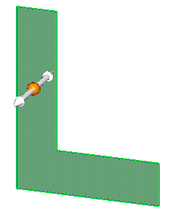
Creation methods
Once a region exists, two workflows are available for creating a base feature.
Selection workflow
Select a region.
Click the extrude handle to create a solid from the sketch region.
Creation workflow
Choose the Extrude command.
Select the sketch region to define the feature.

Slide 4
Base feature creation workflow
Extrude a region
Revolve a region

Slide 5
Constructing synchronous features using select tool
Extruded features
Extent options
Activity: Create a base extruded synchronous feature
Revolved features
Activity: Create a base revolved synchronous feature
Activity: Remove material from a base feature
Activity: Add material to a base feature

Slide 6
Using the feature construction commands
Workflow
Command bar

Slide 7
Model dimensions
Dimensioning the model
Editing model dimensions
Activity: Dimension a model
Sketch consumption and dimension migration

Slide 8
Coordinate systems
Base coordinate system
User-defined coordinate system
Activity: Model with a coordinate system

Slide 9
Additional information
Working with user-defined sets
Part modeling: Tips for getting started

