Slide 1
Solid Edge ST5 Training Working with face relationships

Slide 2
Face relationships overview
When modeling synchronous features, you have control over the solve behavior of a model or an assembly during face editing. The control is achieved through relationships between faces. Face relationships are inherited from sketch elements used to create the faces of a body feature. Face relationships are also applied using the Face Relate commands. Relationships applied with the Face Relate commands are temporary by default. If a relationship is to be permanent, the user can set the applied relationship to a Persist state. The Persist must be applied during the command.

Slide 3
Face relationships overview
Relationships are assigned to faces. During a face move, Live Rules considers found relationships, persistent relationships and locked dimensions in the model. Live Rules allows you to control any or all of these during the operation. Found relationships are applied based on the geometric state of the model when the edit is being performed and on the Live Rules settings. Live Rules settings allow you to control what you want to look for.

Slide 4
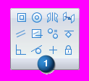
Creating face relationships
Use the relationship commands in the Face Relate Group (1) to apply face relationships to selected faces.
The relationship commands define how faces are related to each other.
You select a face to relate (seed face) and then select a face to relate to (target face).
The relationship is temporary by default. However, the relationship can be set to permanent (persist).
Default and persisted relationships detected can be ignored by the system during a solve of a geometric change.

Slide 5
Relationship commands options
This example is the Coplanar Relationship command bar.

Slide 6
Relationship commands options
Understanding seed and target faces
Seed face
The seed face refers to the initial face selected.
The seed face is the face to be related.
The seed face position changes.
The steering wheel locks onto the seed face.
More faces can be related simultaneously by adding the faces to a select set. The seed face definition remains.

Slide 7
Relationship commands options
Understanding seed and target faces
Target face
The target face defines the relationship to be applied to the seed face.
The target face does not change during the relate command.
There can only be one target face.

Slide 8
Relationship commands options (Persist)
Face relationships applied are temporary by default.
These relationships are ignored if that specific relationship is not turned on in Live Rules.
The Persist option is located on the Face Relationship command bar.
A persistent relationship is always detected by the system during a synchronous command.
Persistent relationships are stored in the Relationships collector in PathFinder.

Slide 9
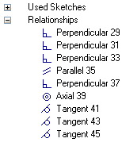
Relate options (Persist)
A persistent relationship can be deleted using the relationships context menu in PathFinder.
A persistent relationship on a face in a select set can be turned off in Live Rules.

Slide 10
Relationship command options
Accept or cancel
If the desired relationship results are achieved, click Accept. The face relationship command ends but the select set is still active.
If the desired relationship results are not achieved, click Cancel. The face relationship command ends but the select set is still active.

Slide 11
Face relationship options
Single/All face alignment
Single Align Only the seed face is related to the target face. The remaining faces in the select set maintain their original relationship with the seed face.
Multiple Align All faces in the select set relate to the target face.

Slide 12
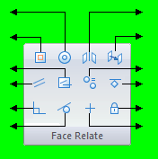
Relationships
concentric
symmetry
coplanar
offset
coplanar axis
equal radius
parallel
ground
perpendicular
rigid
tangent
horizontal/vertical

Slide 13
Workflow for relating faces
Select a face (seed) or a select set (a seed face with additional faces).
One Home tab → Face Relate group, choose a relationship command.
At this point, you can select a target face, which uses the default option settings. You can select other options at any time during the command.

Slide 14
Workflow for relating faces
If more than one face is in the select set, click the Multiple Align option.
Select the target face (face for the seed to be related to).
If the relationship is to be permanent, click Persist.
If the desired result is not achieved, click Cancel. The select set remains and the relationship command can be started again.
If the desired result is achieved, click the Accept button to apply the relationship.

Slide 15
Relationships activities
Activity: Relating a single face with a rigid select set
Activity: Relating faces using parallel, coplanar, perpendicular and concentric relationships
Activity: Relating all faces in a select set
Activity: Coplanar axis hole alignment
Activity: Coplanar axis alignment using a custom axis

Slide 16
Live Rules
The user can control which face relationships Solid Edge detects during a synchronous face(s) move. Live Rules is the tool used to set the face relationships to detect. Live Rules appears in the document window when a part face is selected.
Live Rules is a global setting. If a change is made to the default settings, opening a new or existing file will use these settings. The Restore Defaults button returns the default settings to the system delivered settings.

Slide 17
Working with Live Rules
Restore default rules
Option to restore the system delivered Live Rules. Live Rules maintains the current settings while a Solid Edge session is running. When a Solid Edge is closed, the Live Rules return to the default settings.

Slide 18
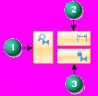
Working with Live Rules
Suspend relationships You can Suspend relationships detected for the current edit operation.
Suspend options for relationship categories are on the Live Rules panel. When making a synchronous edit, the solution honors these options. You can suspend:
(1) Live Rule relationships.
(2) Locked dimensions.
(3) Persisted relationships.
When you suspend a relationship category, the button changes as shown.

Slide 19
Working with Live Rules
Additional options
Reference Planes (1) Consider reference planes when applying Live Rules.
Sketch Planes( 2) Consider sketch planes when applying Live Rules.
Coordinate Systems (3) Consider coordinate system planes and axes when applying Live Rules.

Slide 20
Working with Live Rules
Detect local symmetry
Option to detect a local symmetry plane. You are prompted to select a local symmetry plane to be used for symmetric face detection.
Activity: Detecting symmetry relationships
Activity: Applying a symmetric about relationship

Slide 21
Detected face relationships
Overview
Face relationships are detected during a synchronous face move.
During a synchronous face move, the system is instructed to detect relationships turned on in Live Rules and also persistent relationships.

Slide 22
Solution Manager overview
Synchronous models use face relationships to control the model behavior during an edit. These face relationships include:
Found Relationships the system finds at the instance of a synchronous edit. These relationships are found if the relationship type is turned on in Live Rules.
Persisted User applied relationships that are permanent and are maintained during a synchronous edit.
PMI Locked dimensional relationships.

Slide 23
Solution Manager overview
It is possible that a synchronous edit could fail due to an over constrained condition. It is also possible for a synchronous edit be successful but produce unexpected or unwanted results.
Solution Manager provides detail and actions regarding the faces participating in the solution of a synchronous edit. Solution Manager is a tool that graphically interacts with the model to provide control of all relationships relevant to the current solve.
Solution Manager is an optional step during synchronous move or edit operations.

Slide 24
Solution Manager
When in Solution Manager mode:
Relevant faces change color to represent their role in the solution.
Click on a face to switch between relationships.
Right-click a face for access to all relationships to the face.
Click a locked dimension to relax the constraint. The dimension returns to a locked state after making an edit.

Slide 25
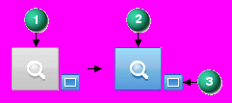
Solution Manager options
The Solution Manager options are located on the Live Rules panel. During a synchronous edit, the Solution Manager button (1) changes from inactive to active (2). The Auto-Solution Manager button (3) is off by default.
When Auto-Solution Manager is turned on, synchronous edits automatically start the Solution Manager.

Slide 26
Solution Manager options
If there are no failures and you are satisfied with the solution, you complete the edit and then click the check box (4) to accept the results.
If the solution produces unwanted results or a failed condition, you click the Solution Manager button to make changes to the solving face relationships. You can also press the V key to start Solution Manager.
When Auto-Solution Manager (3) is turned off, you must manually start the Solution Manager.

Slide 27
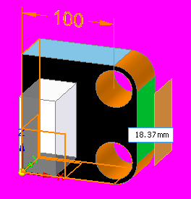
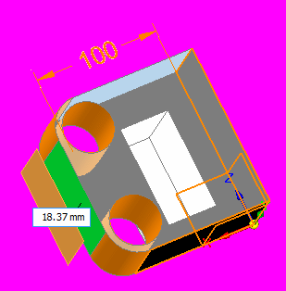
Solution Manager
Model display

Slide 28
Solution Manager
Managing face relationships in Solution Manager
In Solution Manager mode, only faces that are relevant to the solution display in color. The nonparticipating faces display transparent. Right-clicking a colored face displays a relationship palette listing all relationships to the face.

Slide 29
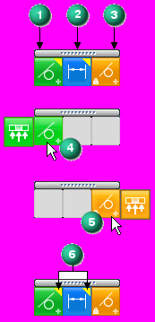
Solution Manager
Relationship palette
Columns
Found relationships (1). These are the detected relationships that are turned on in Live Rules.
Dimensional constraints (2)
Persisted relationships (3)
Hovering over a relationship on the palette (4, 5) exposes a fly out option. Use the fly out option to turn off all similar relationships to other faces.
The yellow triangle (6) on a relationship denotes that the relationship contributes to a failed solution.

Slide 30
Solution Manager workflow
Select a face to edit.
Click the primary axis on the steering wheel to start a synchronous edit operation. (Two solution conditions are possible (success or failure). You can use the Solution Manager in both conditions.)
Start Solution Manager by pressing the V key or by clicking the Solution Manager button on the Live Rules panel. (If Auto-Solution Manager is turned on, Solution Manager starts when you click to define a move distance.)
While in Solution Manager mode, you graphically interact with the face relationships involved in the edit. You resolve over constrained relationships in failed conditions. You change relationships in a successful condition to produce the intended solution.
When the synchronous edit is complete and no failed condition exists, you click the check box. This exits the Solution manager mode.

Slide 31
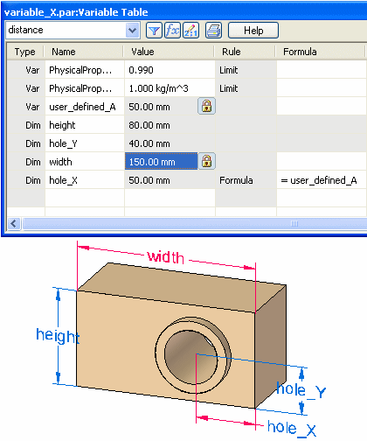
Using variables
Activity: Using the variable table

