Slide 1
Solid Edge ST5 Training Constructing treatment features

Slide 2
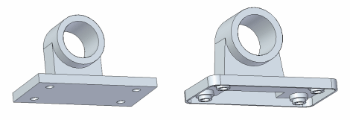
Treatment features
Treatment features are those which affect a model’s existing edges or faces. You construct treatment features by applying face and edge treatments, such as drafts, rounds, and thin wall to the part.
Treatment feature types within Solid Edge
A round feature applies a constant radius to one or more part edges.
A blend feature applies a variable radius to one or more part edges or blends between two faces.
A draft feature tilts an existing part face to a specified angle relative to a reference plane.
The thin wall feature is useful in plastic part modeling to create a shell of a part.

Slide 3
When to add treatment features to models
For best results, add treatment features to your model as late as possible in the design process.
In particular, it is preferable to round edges after constructing thin-walls. If a draft is crucial for positioning other features, construct the draft just before you define the other features. Although you can construct a treatment feature at any time, non critical features can complicate the display of the part in orthogonal views (especially the presence of drafted faces).

Slide 4
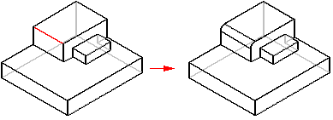
Rounding and blending
Use rounding to replace a model's sharp edges with a smooth, rounded surface to improve its appearance or function. Rounding is edge-based, which means you can only round edges.
constant rounding radius
variable radius
blend

Slide 5
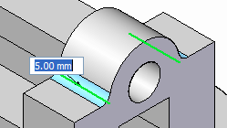
Rounding workflow
Choose the Round command located on the Home tab→Solids group.
On the Round command bar, use the Select menu (1) to specify the element that you want to round (chain, edge/corner, face, loop, all fillets or all rounds).
Select the elements you want to round. When an edge is selected, you'll see a dynamic preview of the round.

Slide 6
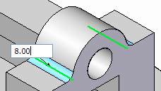
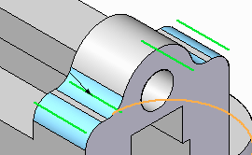
Rounding workflow
Type the radius for the round.
Continue selecting edges defined with the same radius value.
Right-click when finished with this common radius. This converts all preview geometry to finished geometry. The command remains active.

Slide 7
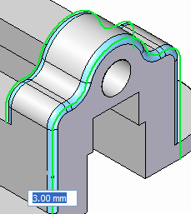
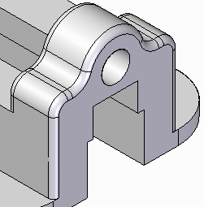
Rounding workflow
To place additional rounds with different radii, continue selecting edges and then change the radius value.
Right-click to finish the round.
Press the Esc key or pick the Select command to terminate round placement.

Slide 8
Rounding
Rounding order
Reordering rounds
Activity: Round edges

Slide 9
Rounding
Editing rounds
Variable radius rounds
Blend workflow
Activity: Blend between faces
Defining the blend shape

Slide 10
Chamfers
Chamfer command
Constructs a chamfer between two faces along their common edge.
Activity: Creating chamfer features

Slide 11
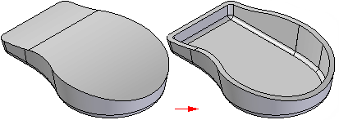
Thickening and thinning parts
You can use the Thicken command to add thickness to a part.
Or use the Thin Wall command to thin a part.

Slide 12
Thickening and thinning parts
Thicken feature workflow
Thin wall feature workflow
Things to consider when using thin walls
Activity: Create a plastic part using Thin Wall
Activity: Model an oil pan

