Slide 1
Solid Edge ST5 Training Multi-body modeling

Slide 2
Multi-body modeling
Multi-body modeling is a design method which uses more than one solid design body in a single file. In multi-body modeling, you can design more than one in the same space and according to the same set of rules.
This modeling method provides the ability to model many components of an assembly as a single part or sheet metal file. When placing a multi-body part into an assembly, the resulting multiple bodies are represented as a single entry in Assembly PathFinder and on a bill of materials. An entire assembly could be represented as a single multi-body part.

Slide 3
Design bodies
Can be a part or sheet metal model type
Can contain both ordered and synchronous features
A part design body can contain a single solid or disjoint solids
Sheet metal design bodies do not support disjoint solids
New design bodies share the existing material properties of the initial design body

Slide 4
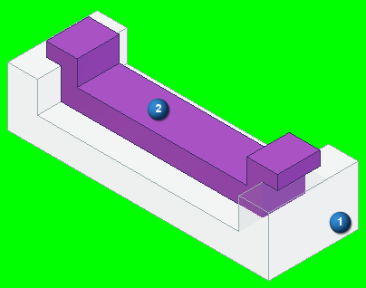
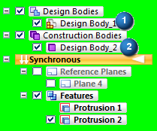
Construction bodies
You can switch a design body to a construction body.
A construction body display is turned off by default in an assembly or draft file.
Construction bodies display with the construction color (purple).
Construction bodies do not publish.

Slide 5
Editing a multi-body file
Only one design body can be active, all other bodies are inactive.
You can only add or remove features on the active design body.
When performing a synchronous move on a face of the active design body, the inactive synchronous design bodies also participate in move operations in which Live Rules controls.
If you do not want a design body to change, ground the design body.
Dimensions can be placed between all design body faces.

Slide 6
Active design body
You can make the selected design body active using the Activate Part Body command.
The environment shifts and displays the tool ribbon for the active body type.
The active design body displays in the normal part colors. Inactive design bodies display with an opaque color.
Note: The inactive solid body face style opacity is set by the adjustable setting accessed in Solid Edge options→View tab. If the option dim surrounding assemblies when in place activated is off, then the inactive body is shown in full opacity. If the option is on, then the inactive body is shown dimmed by percentage controlled by the slider.

Slide 7
Sheet metal design bodies
Sheet metal files support both part and sheet metal design bodies.
All synchronous bodies are held together by geometric relationships and are considered to be one body in any synchronous editing of the file.
Inactive design body faces participate when a synchronous edit is made to the active design body.

Slide 8
Sheet metal design bodies
You can add sheet metal attributes to a file by: Switching to the sheet metal environment Adding a new sheet metal body
Once the sheet metal attributes are added to the file, they are maintained, even if no sheet metal bodies exist in the file.
When you add a sheet metal body to a file, the sheet metal attribute variables are added to the variable table.
If the file previously contained sheet metal bodies, those sheet metal variables are kept within the variable table.

Slide 9
Sheet metal design bodies
All sheet metal design bodies residing in the same file have the same set of attributes:
Material Thickness
Bend Radius
Neutral Factor
Bend Relief Parameter
If you add a sheet metal design body to a part file, the Gage tab appears on the Material dialog box.
All sheet metal design bodies share the same gage and bend properties within the same file.
When you select the Apply to Model button on the Material dialog box, all sheet metal bodies in the file recompute to accept the new sheet metal parameters.

Slide 10
Multi-body commands
Add Body
Activate Part Body
Activate Assembly Body
Toggle Design/Construction Body
Show Body Features

Slide 11
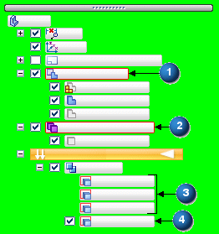
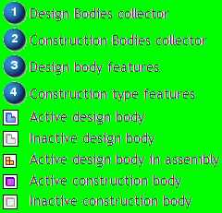
Multi-bodies in PathFinder
When more than one design body exists in a part or sheet metal file, PathFinder displays additional collectors. You use these collectors to manage design bodies. The main collector is named Design Bodies. All solid design bodies reside in this collector. When you change the design body type to construction, a Construction Bodies collector displays. You can turn the display on or off for any design or construction body.

Slide 12
Multi-body publish
In multi-body modeling, you may want to have each design body reside in an individual file. There are a number of reasons for this.
Account for the design body as a unique part number in an assembly bill of materials
Flatten a sheet metal model
Reuse the individual model in another context
Build an assembly from the multi-body part models
Apply assembly features on all bodies
Use the Multi-body Publish command to write each design body of a multi-body file into a separate file. The command also provides the option to create an assembly using the multi-body published parts.

Slide 13
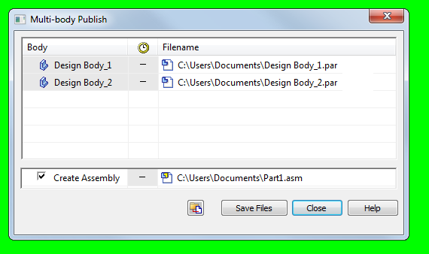
Multi-body Publish dialog

Slide 14
Publish a multi-body part
Open a part or sheet metal file which contains more than one design body.
Do one of the following:
In the part environment, choose the Home tab→Solids group→Add Body list→Multi-body Publish command.
In the sheet metal environment, choose the Home tab→Sheet Metal group→Add Body list→Multi-body Publish command.
The Multi-Body Publish dialog box displays.
If you want to create an assembly file using the published file components, select the Create Assembly check box.
Click Save Files.

Slide 15
Publish a multi-body part
If you are working in a managed environment, update the property data in the Edit Profile (Insight) or New Document dialog box (Insight XT or Teamcenter), and then click OK. The file name for each component is determined upon check in to the database. The file names are replaced by the Item ID in the Multi-Body Publish dialog box.
Click Close.

Slide 16
Activities
Multi-body modeling
Multi-body publishing

