Slide 1
Solid Edge ST5 Training Assembly patterning

Slide 2
Assembly Patterning
The Pattern Part command is used to copy parts or subassemblies in a rectangular or circular pattern.
The pattern can be driven by either an assembly sketch pattern, or a pattern that exists within one of the parts.
If the pattern exists in a part, the pattern will have a reference feature, an example being a hole for a fastener to be placed. The first part should be placed into the reference feature, and the pattern can then be created using the parts pattern.

Slide 3
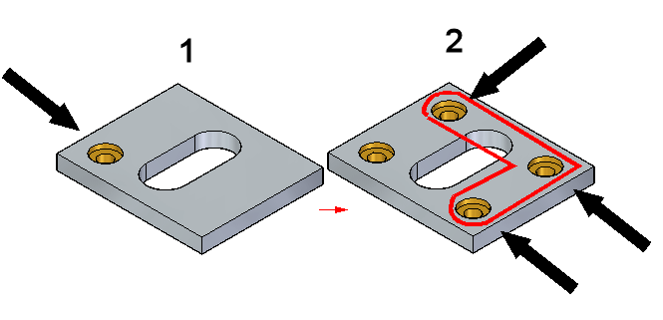
Reference feature in a part pattern
To create an assembly pattern of parts using an existing pattern in an assembly, the first part should be placed in the pattern reference feature.
1: Reference feature contained in the part
2: Patterned features

Slide 4
Reference feature in a part pattern
The part or subassembly to be patterned does not have to be positioned on the reference feature, or on the part containing the pattern. Pattern Part creates the pattern using the distances defined by the pattern in the part. If the part to be patterned is offset from the reference feature, the pattern will be offset by that same distance.
In most cases, such as patterning fasteners in an assembly, the first parts will be positioned in the reference feature.

Slide 5
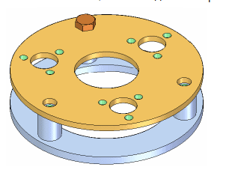
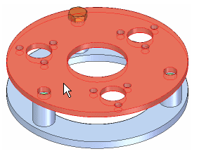
Steps for patterning parts using an existing part pattern
1. Position the first part in the reference feature as shown.
2. Identify the part containing the pattern feature.

Slide 6
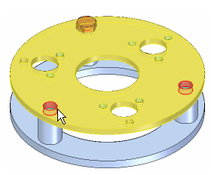
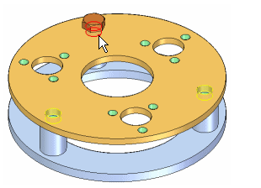
Steps for patterning parts using an existing part pattern
3. Select the pattern feature on the part or assembly sketch.
4. Identify the reference feature

Slide 7
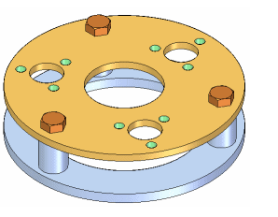
Steps for patterning parts using an existing part pattern
5. Finish. The pattern of parts is created.

Slide 8
Pattern parts from an assembly sketch
A pattern of parts can also be created from an assembly sketch.
Once in the sketching environment in assembly, the patterning commands will exist on the home tab in the features group.

Slide 9
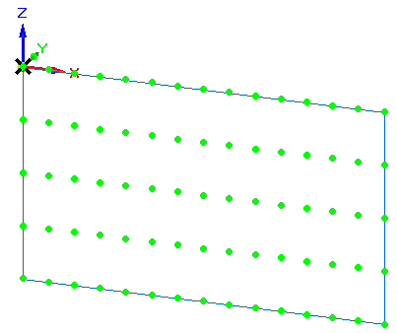
Pattern parts from an assembly sketch
The steps for patterning parts using an assembly sketch are the same as using an embedded pattern in a part. Identify the sketch as the location of the pattern when prompted.

Slide 10
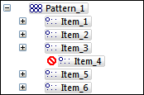
Suppressing patterned parts in an assembly
Assembly pathfinder shows the parts contained in the pattern. Expand the pattern and suppress individual occurrence(s) of the part or subassembly that were patterned.
To suppress, right click the item in pathfinder and then click suppress.

Slide 11
Suppressing patterned parts in an assembly
Assembly pathfinder shows the parts contained in the pattern. Expand the pattern and suppress individual occurrence(s) of the part or subassembly that were patterned.
To suppress, right click the item in pathfinder and then click suppress.

Slide 12
Suppressing patterned parts in an assembly
Assembly pathfinder shows the parts contained in the pattern. Expand the pattern and suppress individual occurrence(s) of the part or subassembly that were patterned.
To suppress, right click the item in pathfinder and then click suppress.

Slide 13
Suppressing patterned parts in an assembly
Assembly pathfinder shows the parts contained in the pattern. Expand the pattern and suppress individual occurrence(s) of the part or subassembly that were patterned.
To suppress, right click the item in pathfinder and then click suppress.

Slide 14
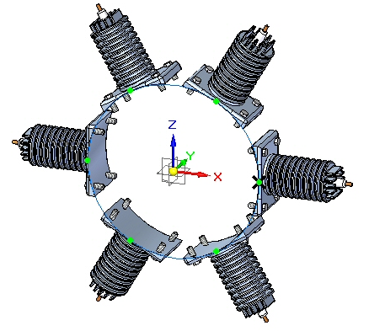
Activity
Activity: Generating a pattern in an assembly

