Slide 1
Solid Edge ST5 Training Assembly Reports

Slide 2
Types of assembly reports
Solid Edge creates reports that provide information about the components that make up an assembly. You can create:
Assembly reports—For assembly and structural frame models, assembly reports list the parts and subassemblies in the model.
You can generate these types of reports:
Bill of Materials—This report supports item number levels that match the assembly structure.
Exploded Bill of Materials
Summary of Atomic Reports
Parts List—This report is a flat list that shows the quantity of each element.
Pipe reports—For pipe and tubing models, lists the pipes and fittings in an assembly.
Harness reports: You can create the following types of wire reports:
Top Level
Expanded

Slide 3
Showing assembly item numbers in reports
You can show assembly item numbers in assembly and structural frame reports, and in pipe reports. Assembly item numbers are saved with the assembly and are available for downstream use, for example, in balloons placed on a model and in ballooned parts lists placed on an assembly drawing. This ensures consistent part numbering is propagated across all applications of the model.
To create item numbers in the assembly, select the Maintain item numbers check box in the Item Numbers page (Solid Edge Options dialog box).
To use these item numbers in assembly reports, select the Use assembly generated item numbers check box, which is available in the Report dialog box.
Alternatively, you can leave this option unchecked and have the assembly Report command generate item numbers on the fly.

Slide 4
Assembly item numbers
Item numbers for parts and subassemblies can be created and maintained automatically in an assembly model. Item numbers are based on the assembly structure, that is, the order in which parts, subassemblies, and assemblies are displayed in Assembly PathFinder.
Item numbering allows you to:
Create item numbers in assemblies
Edit item numbers
Use assembly item numbers in reports
Use assembly item numbers in PMI balloons
Use assembly item numbers on a drawing

Slide 5
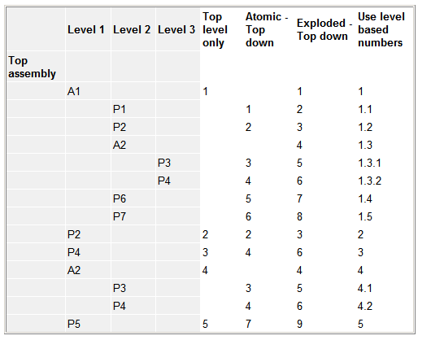
Item numbering schema
Use the Item Numbers page (Solid Edge Options dialog box) to select an item numbering schema for the parts and subassemblies in the assembly model. Refer to the following table for a comparison of item numbering options.

Slide 6
Formatting a report
You can format the report using the Format option on the Reports dialog box. Using the Format Report dialog box, you can set the following:
Font
Column headings (based on available properties)
Sorting method
Each property you include in the report will be a new report column. Standard properties you can choose from include Quantity, Document Number, Revision, and Author. You can also include custom file properties that you have recorded in the part and subassembly documents.
After you have formatted the report, you can preview the report output by selecting the OK button on the Format Report dialog box.

Slide 7
Outputting the report
After previewing the report, you have the following options:
Save the current report.
Print the current report.
Copy the current report to the Clipboard.
Create another report.

Slide 8
Activities
Activity – Revision manager (release and revise)
Activity – Revision manager (revise and release an assembly draft)
Activity – Editing a part in context of the assembly

