Slide 1
Solid Edge ST5 Training Alternate Assemblies

Slide 2
Alternate Components
Some products require you to define multiple variations of a single assembly. These variations can be categorized into two types:
Assembly variations where ALL parts are identical, but some part positions change during the physical operation of the assembly. These types of assemblies contain mechanisms, linkages, actuators, and so forth. In Solid Edge, these types of assemblies are considered Alternate Position Assemblies.
Assembly variations where MOST parts are identical, but some parts and subassemblies are different between the individual assemblies. These types of assemblies may have different components, fastener types, trim, accessories, and so forth. In Solid Edge, these types of assemblies constitute a Family of Assemblies.

Slide 3
Creating a New Alternate Assembly
Use the Alternate Assemblies tab to create alternate positions for an assembly or a family of assemblies. The first time you click the New Member button on the Alternate Assemblies tab, the Alternate Assemblies Table dialog box is displayed. You must specify whether the assembly will be converted to:
a family of assemblies or
an assembly containing alternate positions.
Once the assembly has been converted, it cannot be changed from (A) to (B) or from (B) to (A).

Slide 4
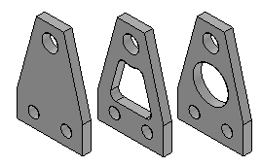
Define Alternate Component Command
Defines a list of documents which are related to the selected part or subassembly. Alternate components are typically similar in nature, and can be based on documents that were created independently. Defining a list of alternate components makes it easier to find and select valid components when replacing parts in an assembly.
A simple example of an application for an alternate component group is where there are several versions of a part that have different finishing details. The parts can be independently created or members of a family of parts.

Slide 5
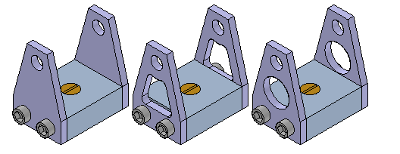
Define Alternate Component Command
In an assembly where one of the parts is used, you can use the Define Alternate Components command to specify that all three parts are members of the same alternate component group.
You can then use the Replace command to replace the part with one of the alternate component members. When you select a part to replace that is a member of a alternate component group, the Alternate Member dialog box is displayed so you can select another alternate component member as the replacement part.

Slide 6
Defining an Alternate Component Group
You can select any part or subassembly in the active assembly to define an alternate component group. When working with a nested assembly, you cannot select individual components that are in a subassembly.
Although an alternate component group would typically contain similar parts, you can define an alternate component group that contains different document types than the original component. For example, you can define an alternate component group that consists of a Part document, a Sheet Metal document, and an Assembly document.
If the component you select to define the alternate components group is a member of a family of parts or a family of assemblies, all related members from the same master document are added to the Alternate Candidates list automatically.
The assembly document in which you define the alternate components group stores the group member data.

Slide 7
Alternate Components and Alternate Assemblies
You can use an alternate component to replace a component in an alternate assembly that is a family of assemblies, but not an alternate position assembly. For example, you can use the Replace command to replace a part in a family of assembly member with an alternate component, rather than use the Exclude Occurrence functionality on the Alternate Assembly tab. Although this approach can be quicker than using the Exclude Occurrence functionality, when you use Revision Manager to copy or move the assembly data set to a new location, any members of the alternate components group that are not used in a family of assembly member will not be included in the data set.
For more information on working with alternate assemblies, see the Alternate Assemblies Help topic.

Slide 8
Sensors
When constructing parts and assemblies, you often need to keep track of critical design parameters. For example, when designing a shield or shroud that encloses a rotating part, you must maintain enough clearance for maintenance and operational purposes. You can use the Sensors tab on PathFinder to define and keep track of design parameters for your parts and assemblies.
You can define the following types of sensors:
Minimum distance sensors
General variable sensors
Sheet metal sensors
Surface area sensors
Custom sensors

Slide 9
Defining a sensor
Although there are several types of sensors, you follow the same basic steps when creating any sensor:
From the Sensors tab on PathFinder, select the sensor type you want.
Define what you want to track in the design.
Define the operating limits for the sensor.
Every sensor you define in the document is displayed and managed on the Sensors tab on PathFinder.

Slide 10
Sensor Types
Minimum distance sensors
General variable sensors
Sheet metal sensors
Surface area
Custom sensors

Slide 11
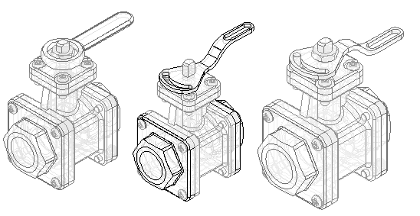
Activity
Activity: Creating an alternate assembly

