Slide 1
Solid Edge ST5 Training Exploding assemblies

Slide 2
Exploding assemblies
Course overview
The Explode-Render-Animate application within the Solid Edge assembly environment is a tool for creating different types of presentations of Solid Edge assemblies. Exploding an assembly allows you to control the movement, sequence and grouping of parts and subassemblies. Rendering a view allows you to define textures, lighting, shadows, backgrounds and other properties to create presentation style images. Motors apply movement to under constrained parts in an assembly which can be animated. Using Animation, you can combine previously created exploding sequences and custom camera movement to create animation. Each frame of the animation can be rendered to create presentation quality animations.

Slide 3
Explode-Render-Animate
Course overview (continued)
Once you complete the activities in this course, you will be able to control the sequence and direction of explode events.

Slide 4
Explode-Render-Animate
Entering the Explode-Render-Animate environment (ERA)
To enter the ERA environment, within an assembly, click the Tools Tab. In the Environs group, click ERA.

Slide 5
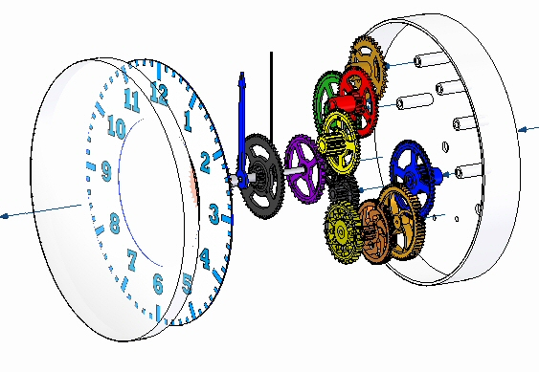
Exploding Assemblies
Solid Edge enables you to easily create exploded views of your assemblies. You can use the exploded views you define in the Assembly environment to create exploded assembly drawings in the Draft environment. You can also create presentation-quality renderings and animations of exploded assemblies.

Slide 6
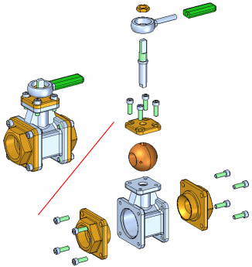
Exploding Assemblies
Explodes the active assembly by applying a spread distance between parts.
The Automatic Explode command explodes assemblies based on the relationships applied between parts. In assemblies where the components are positioned using mate or axial align relationships, the Automatic Explode command quickly gives you excellent results.

Slide 7
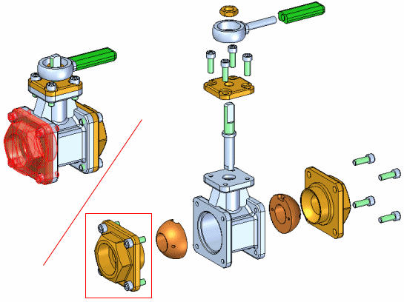
Binding Subassemblies
Groups the parts in a subassembly so they will explode as a single unit when using the Automatic Explode or Explode commands. To bind a subassembly, you must first select it using PathFinder.
A symbol is added adjacent to the subassembly entry in PathFinder to indicate that the subassembly is bound. You can use the Unbind Subassembly command to unbind a subassembly.

Slide 8
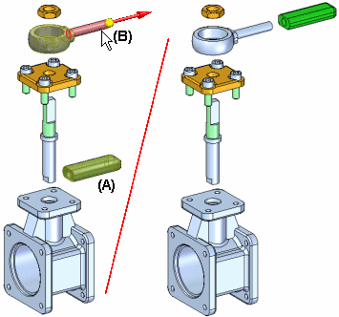
Explode Command
Explodes one or more parts in a specified direction. The parts (A) selected for explosion are offset along an explode vector you define by selecting a face or reference plane on a base or reference part (B).
You can manually explode a single part, multiple parts, and bound subassemblies. You define the offset distance using the Distance box on the command bar.

Slide 9
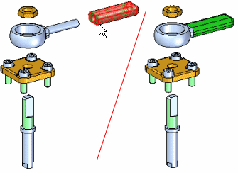
Collapse command
Returns an exploded part to its original assembly position relative to its parent part.
You can collapse several parts in one operation by holding the Shift key and selecting the parts you want to collapse. If you select a part that is a component in a bound subassembly, the entire subassembly is collapsed.
When you collapse a part, the flow line for the part is deleted.

Slide 10
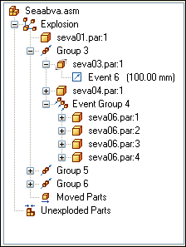
Explode PathFinder tab
Provides alternate ways of viewing and editing an exploded assembly. The Explode PathFinder tab displays the structure for the current exploded view configuration in a hierarchical list. The Explode PathFinder tab helps you work with the components that make up an exploded view.

Slide 11
Explode PathFinder tab
This allows you to view the structure and perform edit operations on the current exploded view configuration. Some of the operations you can perform include:
You can select an explode event, then edit the offset or rotational value using the command bar.
You can use the commands on the shortcut menu to show and hide parts, collapse parts, show and hide flow lines, and so forth.
You can add and remove parts from explode Groups and Event Groups. This is useful when working with animations.

Slide 12
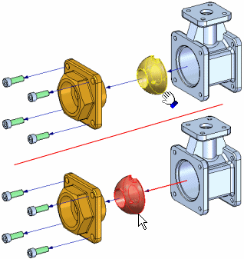
Move Part command
Moves or rotates parts in an exploded view in an assembly. You can use this command to do the following:
Move one or more parts along the original explode vector or a new vector you define.
Rotate one or more parts along the original explode vector or a new vector you define.
Move one or more parts within a plane you define.
You can move or rotate a single part, a set of parts, or a part and all its dependent parts. The same basic steps apply whether you are moving, rotating, or moving within a plane.

Slide 13
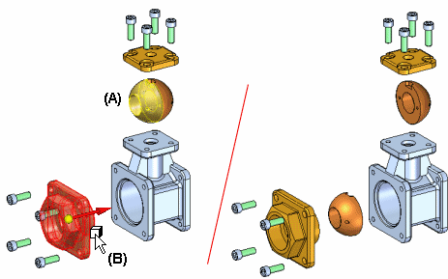
Reposition command
Repositions a part with respect to another reference part in an exploded view. This can be useful when you want to change the position of a part after using the Automatic Explode command.
To reposition a part, select the part you want to reposition (A), then position the cursor over the reference part (B). The reference part highlights, and an arrow is displayed on the reference part to indicate which side of the reference part the selected part will be repositioned to.

Slide 14
Display Configurations
To save an exploded view to be used in another application, a display configuration needs to be saved while the part is exploded. The display configuration is used to place an exploded view on a drawing sheet.

Slide 15
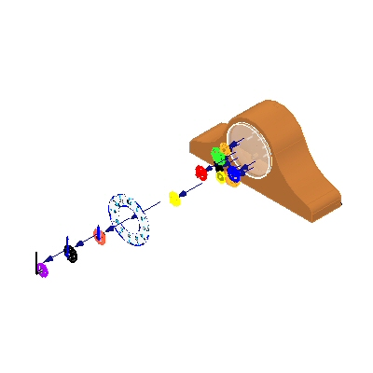
Activity
Activity – Explode

