Slide 1
Solid Edge ST5 Training Animating assemblies

Slide 2
Animating assemblies
Course overview
The Explode-Render-Animate application within the Solid Edge assembly environment is a tool for creating different types of presentations of Solid Edge assemblies. Exploding an assembly allows you to control the movement, sequence and grouping of parts and subassemblies. Rendering a view allows you to define textures, lighting, shadows, backgrounds and other properties to create presentation style images. Motors apply movement to under constrained parts in an assembly which can be animated. Using Animation, you can combine previously created exploding sequences and custom camera movement to create animation. Each frame of the animation can be rendered to create presentation quality animations.

Slide 3
Explode-Render-Animate
Course overview (continued)
Once you complete the activities in this course, you will be able to:
Add a motor to a unconstrained part of an assembly to create movement for an animation.
Manipulate animation events and explode events to create an animation of an assembly.

Slide 4
Explode-Render-Animate
Entering the Explode-Render-Animate environment (ERA)
To enter the ERA environment, within an assembly, click the Tools Tab. In the Environs group, click ERA.

Slide 5
Defining Motors
There are two types of motors that can be defined in Solid Edge: rotational and linear.
You use motor features to help you observe how a set of under-constrained parts will move relative to the part you define as a motor. This allows you to design and simulate complex mechanisms where the movement of a set of interrelated parts needs to be simulated.

Slide 6
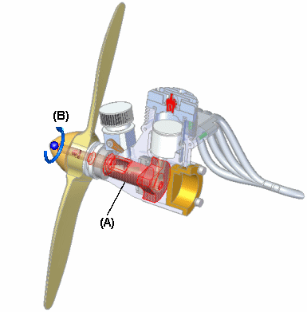
Defining Motors
Motor command
You use motor features to help you observe how a set of under-constrained parts will move relative to the part you define as a motor. This allows you to design and simulate complex mechanisms where the movement of a set of interrelated parts needs to be simulated.
For example, you can specify that a crankshaft part (A) in a mechanism rotates around an axis you specify (B).

Slide 7
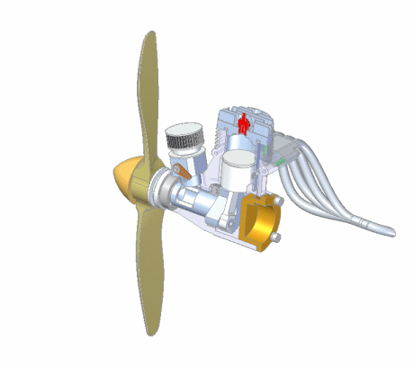
Simulate motor
Simulate motor command
Display a kinematic simulation of motion in an assembly. You use motor features to define how a set of interrelated parts will move. This is useful when working with assemblies that contain crankshafts, gears, pulleys, and hydraulic or pneumatic actuators.

Slide 8
Activity
Activity – Motor

Slide 9
Animate
Solid Edge enables you to easily create animated presentations of your assemblies. Assembly animations can be useful for motion studies of mechanisms, visualizing how parts are assembled into a completed assembly, and vender or customer presentations

Slide 10
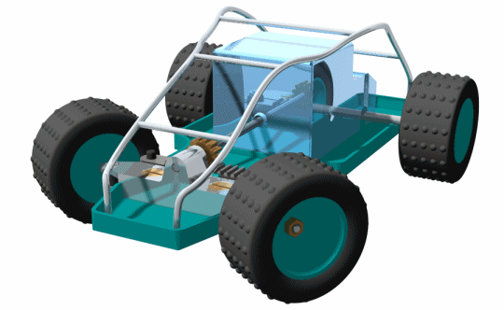
Animate
Animation Editor command
You can define the following types of animation events:
Camera
Motor
Explosion
Appearance
Motion Path

Slide 11
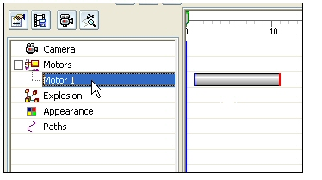
Animate
You can use the controls on the Animation Editor tool to play, stop, pause, and rewind the animation in the graphic window.
You can also save an assembly animation in AVI format with the Save As Movie button on the Animation Editor tool.

Slide 12
Animate
Event duration bar
A user-interface element on the timeline (right) pane of the Animation Editor tool.
Event duration bars allow you to visualize and control the timing of events in an assembly animation.
Event duration bars represent the start time, elapsed time, and end time for an animation event. There are two basic types of event duration bars:
Duration bars for explode, appearance, and motor events.
Duration bars for camera and motion path events. Duration bars for these event types also support key frames (A).
You can move and modify duration bars using the cursor and shortcut menu commands.

Slide 13
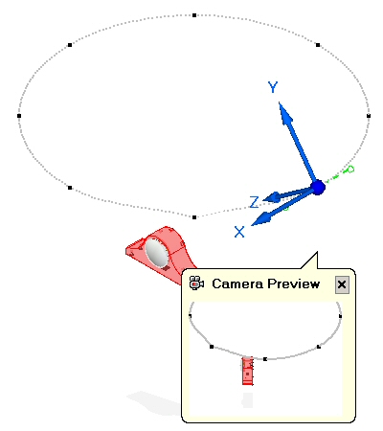
Animate
Camera Path Wizard command
Runs the Camera Path Wizard, which guides you through the process of creating a camera path for an assembly animation. The Camera Path Wizard allows you define the camera path name, camera direction, and so forth. You can use camera paths as part of an assembly animation.

Slide 14
Activity
Activity – Animate

